Slide 1
Caring for the Caregiver
Building Resilience in Long Term Care

Slide 2
Session Objectives
Identify
Identify common signs and contributing factors of burnout and secondary traumatic stress specific to aging services.
Describe
Describe how burnout and trauma can impact both personal well-being and the quality of resident care.
Apply
Understand how to apply practical self-care strategies to manage stress during and after shifts.
Commit
Commit to one actionable self-care practice to implement in the next week to build resilience and reduce burnout risk.

Slide 3
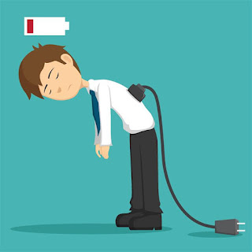
What is Burnout?
A syndrome caused by chronic workplace stress that has not been successfully managed (per WHO)
Defined by three dimensions:
  Emotional exhaustion – the energy drain.
  Depersonalization – becoming detached, cynical, or less empathetic toward those they serve
  Reduced personal accomplishment – feeling ineffective or that one’s work doesn’t matter
Burn-out an "occupational phenomenon": International Classification of Diseases

Slide 4
Emotional exhaustion is the “fuel” that drives burnout
When healthcare workers are emotionally depleted, their ability to cope, empathize, and feel effective in their role erodes—leading to burnout, which impacts not only their well-being but also resident care and organizational health.
Signs include:
Chronic fatigue
Difficulty concentrating
Irritability
Loss of empathy (“compassion fatigue”)

Slide 5
Loss of Empathy:
Compassion Fatigue and Moral Distress
 | Compassion Fatigue | Moral Distress
Definition | The physical, emotional, and psychological impact of caring for people who are suffering or traumatized. | The inner conflict healthcare workers feel when they know the right thing to do but cannot act on it due to institutional or systemic constraints.
Cause | Continuous exposure to patients’ pain, loss, and trauma | Barriers such as understaffing, policies, lack of resources, or hierarchies preventing best care.
Experience | Feels like empathy burnout—a deep depletion of the ability to nurture or feel compassion. | Feels like moral injury—a clash between professional/ethical values and actual practice.
Signs | Emotional numbness, withdrawal, irritability, difficulty empathizing, feeling “used up.” | Anger, frustration, guilt, powerlessness, questioning one’s integrity.
Compassion fatigue: emotional exhaustion from caregiving
Moral distress: system vs. values conflict
Signs: irritability, withdrawal, fatigue, absenteeism

Slide 6

Trauma & Secondary Traumatic Stress
Primary trauma refers to the direct experience of distressing events
Secondary trauma, sometimes called vicarious trauma, happens when we absorb the emotional residue from caring for others
In long-term care, there are unique triggers that can intensify trauma exposure
  These include witnessing resident suffering, navigating tense family conflicts, and facing repeated cycles of end-of-life care
The impact of trauma in staff is significant. It can reduce patience and compassion, increase mistakes on the job, and contribute to higher turnover

Slide 7

People Bring Themselves
People bring a past and a present to anything they do
  Their culture
  Their beliefs
  Their social support systems
    Positive support
    Negative support
  Their history of trauma and illness
  Their families and close others
  Their economic situation
This Photo by Unknown Author is licensed under CC BY

Slide 8
Complex Relationships
Professional Quality
of Life
Work Environment
Compassion Satisfaction (ProQOL CS)
Exhaustion
Client Environment
Compassion Fatigue
Depressed by Work Environment
(ProQOL Burnout)
Frustration Anger
Secondary Exposure (ProQOL STS)
Personal Environment
Traumatized by work
Primary Exposure

Slide 9
What Does “IT” Look Like?
Physical Signs | Emotional Signs | Cognitive Signs | Behavioral Signs
Fatigue or low energy Headaches, stomach upset, or muscle tension Sleep problems or appetite changes Frequent illness or slower recovery | Irritability, anxiety, or feeling overwhelmed Mood swings or tearfulness Emotional numbness or loss of empathy Reduced sense of accomplishment | Trouble concentrating or making decisions Memory lapses or “mental fog” Negative or racing thoughts | Withdrawal or conflict with coworkers Decline in work performance or attendance Neglecting self-care Using food, alcohol, or other substances to cope

Slide 10

Contributing Factors in LTC/Assisted Living
Chronic understaffing → heavy workloads, limited breaks, reduced patient interaction
Administrative burdens → repetitive documentation, reporting, billing requirements
Workplace violence → staff frequently face verbal threats, physical aggression, harassment
Moral distress → knowing the best care to provide but unable to act due to lack of staff, supplies, policy barriers
Isolation → staff often feel undervalued, disconnected, unsupported

Slide 11
Why This Matters in LTC & Assisted Living
Burnout directly affects resident safety and quality of care (higher turnover, lower time with residents, more medical errors)
Workforce shortages worsen access to care for older adults, particularly in rural and underserved areas
Investing in staff well-being reduces costly turnover and improves resident satisfaction

Slide 12
Burnout loses its power when we name it, share it, and face it together.
https://youtu.be/UfcAVejslrU?si=AoXp0UC_ZajrstBT
Notes:
If they did not take the ProQOL
You were all provided with the ProQOL in the pre-conference packet. I encouraged you all to take time to privately perform the assessment and bring those results with you here. I did put some on each table and will provide a few minutes for you to take if you were unable to take it prior to session.

Slide 13

Measuring CS & CF: The Professional Quality of Life Scale (ProQOL)
The ProQOL is FREE screening tool and comes in a variety of languages
A 30-item self report measure of the positive and negative aspects of caring
The ProQOL measures Compassion Satisfaction and Compassion Fatigue
Compassion Fatigue has two subscales
  Burnout
  Secondary Trauma
http://www.proqol.org/

Slide 14
Compassion Satisfaction
Professional Quality of Life
Compassion Satisfaction
Compassion Fatigue
Burnout
Secondary Trauma
The positive aspects of helping
  Pleasure and satisfaction derived from working in helping, care giving systems
May be related to
  Providing care
  To the system
  Work with colleagues
  Beliefs about self
  Altruism

Slide 15
Compassion Satisfaction
Compassion satisfaction is the pleasure you derive from the feeling of being effective in your work as a health worker.
For example, you may feel like it is a pleasure to help others through your work. You may feel positively about your colleagues or your ability to contribute to the work setting or the greater good of society.
Higher scores suggest greater satisfaction from your ability to be an effective health worker.

Slide 16
Perceived Support
Perceived support is your sense of having access to effective assistance when you need it.
Support can take many forms including carrying out tasks for us when our own capacity is overwhelmed, offering useful advice, working with us to solve difficult problems, distracting us from the stressors in our work, or offering emotional support and empathy for our struggles.
Higher scores suggest feeling well supported by others, an important component of overall quality of life.

Slide 17
Burnout
Burnout refers to feelings of hopelessness and exhaustion that make it difficult to be effective at work.
These feelings typically start slowly and get worse over time.
People struggling with burnout often have very high workloads, have few opportunities for rest, or are working in unsupportive environments.
They often feel unappreciated or that their efforts make no difference.
Higher scores suggest a higher level of burnout.

Slide 18
Secondary Traumatic Stress
Secondary Traumatic Stress (STS) is about your work-related, secondary exposure to traumatically stressful events such as witnessing terrible suffering, violence or death.
STS often starts suddenly following particularly difficult experiences.
People struggling with STS often struggle with upsetting and uncontrollable memories, constantly thinking about bad experiences, avoiding activities that remind them of bad experiences, being afraid for no reason, and having difficulty sleeping.
High scores suggest a higher level of secondary traumatic stress.

Slide 19
Moral Distress
Health workers are sometimes faced with difficult situations and choices. At times we are forced by circumstance, or instructed, to act in ways that conflict with our personal values, beliefs and morality.
It is these parts of our work that may result in lasting inner turmoil that can negatively affect our quality of life.
Moral distress of this kind is associated with feelings of guilt, shame and resentment.
Higher scores suggest higher levels of moral distress.

Slide 20
Hope begins when we realize that someone else understands our struggle.
Notes:
You are not in this alone

Slide 21
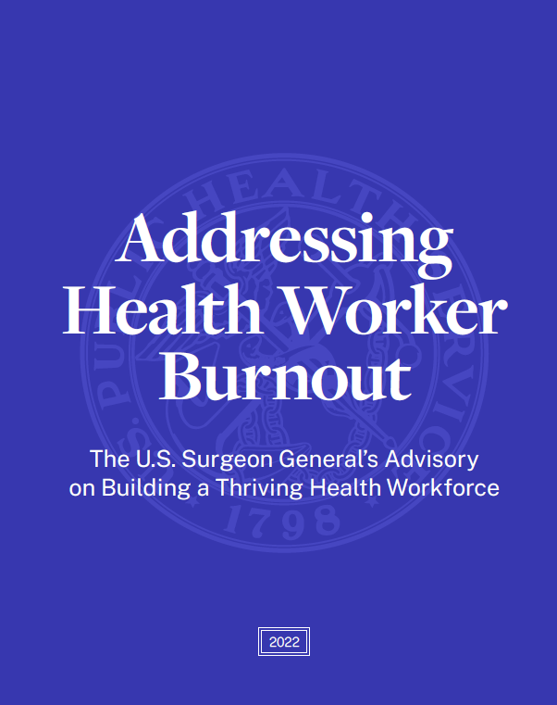
A Public Health Crisis: An Urgent Call to Action
Calls for urgent, system-level action to protect the health, safety, and well-being of health workers
Recognizes that burnout threatens patient care quality, access, equity, and the resilience of the entire U.S. health system health-worker-wellbeing-advisory
Focus on system-level change (not just individual resilience)
“We owe health workers more than our gratitude — we owe them action.”
– U.S. Surgeon General Vivek Murthy
Addressing Health Worker Burnout: The U.S. Surgeon General’s Advisory on Building a Thriving Health Workforce - NCBI Bookshelf
Notes:
Health Worker Burnout | HHS.gov

Slide 22
Build a Commitment to the Health and Safety of Health Workers into the fabric of health organizations.
Commit to health worker well-being at the highest levels of leadership
Regularly assess, measure, respond to and intervene to prevent occupational distress and burnout using validated tools
Build in time for and encourage all health workers on staff to take paid leave, sick leave, family leave, and rest breaks
Establish a zero-tolerance policy for violence, and institute a workplace violence prevention program to address violence and abuse in the workplace, (this includes physical, verbal, and/or cyber-based)
Commit to the safety and health of the workforce by prioritizing adequate personal protective equipment
Normalize conversation about the use of mental health and substance use care for health workers

Slide 23
Retention Drivers in Aging Services
What Workers Need Most
Fair, transparent compensation
Flexible schedules
Feeling heard and respected
Opportunities for growth
Mental health and peer support
How Leaders Can Respond
Competitive pay + clear raises
Schedule autonomy and family-friendly policies
Monthly listening sessions
Career ladders, mentorship, and shadowing
Normalizing EAP and grief support use

Slide 24
Recommended Actions for LTC & Assisted Living
Culture change:
  Listen to staff voices in decisions (huddles, rounding, feedback sessions).
  Foster teamwork, transparency, and recognition
Supportive policies/procedures:
  Living wages, hazard/retention pay, paid sick and family leave.
  Flexible scheduling, rest breaks, and childcare/eldercare supports.
  Integrating screening tools into organizational practice
Mental health access:
  Confidential Employee Assistance Programs (EAPs).
  Normalize help-seeking by removing stigma and licensing barriers
Violence prevention:
  Zero-tolerance policies, training, and safe reporting systems
Notes:
“The WellSky National Workforce Study (2025) echoes the Surgeon General’s call — burnout is not an individual failure, but a system challenge requiring organizational commitment to safety, fairness, and wellbeing.”

Slide 25

Key Recommendations- Self Care
Recognize Signs of Distress & Burnout
Stay Connected & Reach Out for Help
Prioritize Joy & Connection
Practice Healthy Daily Habits
Use Your Voice & Advocate

Slide 26

Why Self-Care Is Not Selfish—It’s Essential
Self-Care:
Protects your health
Improves care quality
Prevents burnout and turnover
Models healthy behavior
Sustains purpose and joy
In long-term care, your well-being directly impacts the well-being of the residents you serve.
Notes:
Somatic shaking

Slide 27

Evidence-Based Self-Care Strategies
Sleep & rest hygiene
Nutrition & hydration
Movement/stretching
Mindfulness & grounding techniques
Boundary setting
Peer connection & support
Notes:
Practice a 2-minute breathing exercise. Ask: What is one realistic self-care step you can take on your next shift?

Slide 28
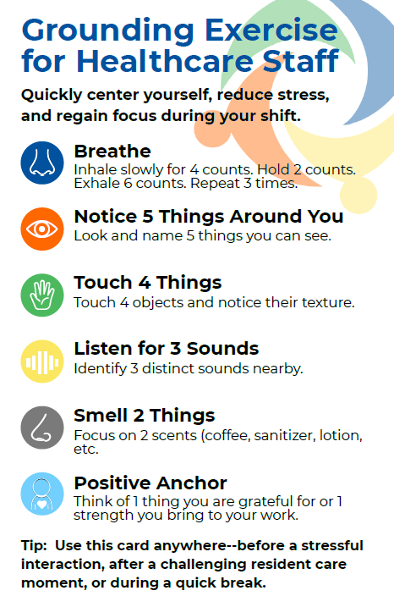
Self‑Care Action Steps
Recognize Stress Early: Identify personal warning signs
On‑Shift Mini Breaks: Breathing, grounding, hydration
Peer Support: Buddy check‑ins
Boundaries & Recovery: Protect off‑duty time.
Grief Processing: Rituals for closure
Professional Help: EAP resources
Notes:
“When we experience a crisis at work — a resident death, a violent episode, or a heavy workload — our bodies go into survival mode just like an animal escaping danger. The shaking or trembling you might feel afterward is your body’s built-in reset button. If we don’t let that energy discharge through movement, breath, or connection, we carry it into the next shift.”

Slide 29

Taking Back Your Power
Before Shift
2 minutes of mindful breathing in your car before walking in
Positive affirmation: “I bring calm and care into this building.”
During Shift
Pause for 3 slow breaths before entering a high-stress resident room
Use humor with coworkers (when appropriate) to release tension
Mini stretch after each charting session
After Shift
Wash hands slowly as a symbolic “leave it at work” ritual
Drink a full glass of water before leaving
Play “transition music” in the car to shift your mental state before home
Notes:
Ha!!!
Any of you have a song that you consistently play on your way to/from work? Any Big Sean fans out there?!?

Slide 30
Taking Back Your Power
Weekly Mental Health Maintenance
Day Off Routine: At least 30 min outdoors + one joy activity (art, cooking, walking, etc.)
Limit Work Talk: Choose a “no LTC discussion” dinner with family/friends once a week
Sleep Anchor: Consistent sleep/wake times on off days
Reflect & Adjust: Journal 1x/week about what helped or drained you
Connect: Check in with a non-work friend or family member

Slide 31

Quick Access Self-Care Toolkit
Keep these items in your work bag:
  Small stress ball or fidget item
  Herbal tea packet or electrolyte drink mix
  Hand lotion with calming scent
  Printed grounding exercise card
  EAP & crisis line numbers

Slide 32
Commit to Action- SMART Goal worksheet
SMART Component | Example | My Goal
Specific | What exactly will I commit to for self-care? Example- I will take 3 slow breaths before every care interaction where I feel tense.
Measurable | How will I track my progress? Example- Track with a tally mark in my pocket notebook or a note on phone.
Achievable | Is this realistic during my shift or at home? Example- Breathing exercises takes under 30 seconds.
Relevant | Why does this matter for me and my role? Example- Helps me reduce resident escalation and my own stress.
Time-bound | When will I do this and for how long? Example- I will do this every shift for the next 2 weeks, then reassess.

Slide 33

Personal Self-Care Commitment
One small change I can start today?
One boundary I will practice setting is …
Notes:
Provide handout/worksheet. Encourage staff to fill in one action now and keep visible at work.

Slide 34

In healthcare, resilience is not built alone—
it grows in community.
Brenda Groves
Quality Improvement Manager
KFMC Health Improvement Partners
Phone: 785-271-4150
Email: bgroves@kfmc.org
Better health outcomes for everyone.

Slide 35
References
NIOSH: Mental Health of Healthcare Workers (2021)
ANA: Healthy Nurse, Healthy Nation (2022)
Burnout an “occupational phenomenon”: International Classification of Diseases. Geneva: World Health Organization; 2019. Available from: https://www.who.int/news/item/28-05-2019-burn-out-an-occupational-phenomenon-international-classification-of-diseases
ProQOL Health Measure | ProQOL
Surgeons General Addressing Health Worker Burnout: The U.S. Surgeon General’s Advisory on Building a Thriving Health Workforce - NCBI Bookshelf
Health Workers Face a Mental Health Crisis | VitalSigns | CDC
Professional Wellbeing | Healthcare Workers | CDC
Burn-out an occupational phenomenon

