Slide 1



"You need things to do." Sense of Purpose in Residential Aged Care 2025 Person-Centered Care Conference
Justine Irving, Associate Professor

Slide 2
Learning Objectives
Explain the role and impact of sense of purpose in long term care settings.
Describe potential means of promoting sense of purpose amongst long-term care residents.
Evaluate preliminary findings from an intergenerational program involving elementary school children and nursing home residents and the program's potential to contribute to sense of purpose.
Presentation Title

Slide 3
Presentation Overview
Introduction to sense of purpose
Summary of purpose as described by older adults living in long term care
Early findings from the Logan Life Center project, Logan Kansas
Presentation Title

Slide 4
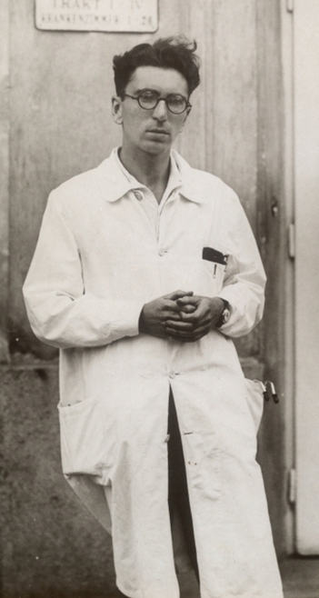
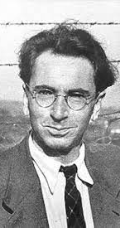
What is purpose?
Victor Frankl considered purpose in life to be a fundamental component of psychological wellbeing
Purpose can be characterized as a “central, self-organising life aim that organises and stimulates goals, manages behaviours and provides a sense of meaning” (McKnight & Kashdan, 2009)
Purpose generally comprises commitment, goal directedness, personal meaningfulness and engagement with the broader world

Slide 5

Why purpose matters
Sense of purpose is related to a range of health and wellbeing outcomes for older adults including:
Better health and functional status maintenance
Greater cognitive function
Increased physical activity and positive health behaviours
Enhanced stress recovery
Longevity
Lower incidence of Alzheimer's disease and mild cognitive impairment
Reduced risk for cardiovascular chronic health condition
Greater life satisfaction
Reduced depression severity or incidence.

Slide 6
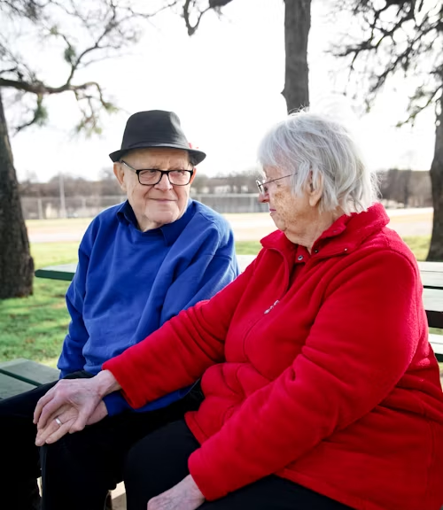
Purpose and ageing
Older adults who continue to derive purpose from life may fare better as they age.
Research suggests that purpose declines with age.
Older adults living in residential aged care/long term care settings generally report less purpose than adults living in the community.
Loss of occupational and social roles as well as disconnection from tasks, routines and a familiar home environment can make the pursuit of purpose more challenging.
A decline of purpose following transition into long-term care has also been attributed to insufficient opportunity rather than lack of interest or desire for purpose.

Slide 7
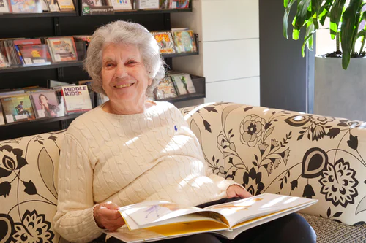
Purpose in Long Term Care
Promising evidence from interventions enabling residents to feel ‘useful’ or productive
Ensuring good quality of life and well-being amongst older adults are important goals within long-term care settings
Understanding what constitutes quality of life for older people in this environment can help inform practice and policy
But how can purpose be supported in long term care?

Slide 8
Who participated in this study?
Twenty men and women living in residential aged care
Participants ranged in age from 62-96 years (average age of 80.5 years)
Self reported length of residence in aged care setting ranged from 1-204 months

Slide 9
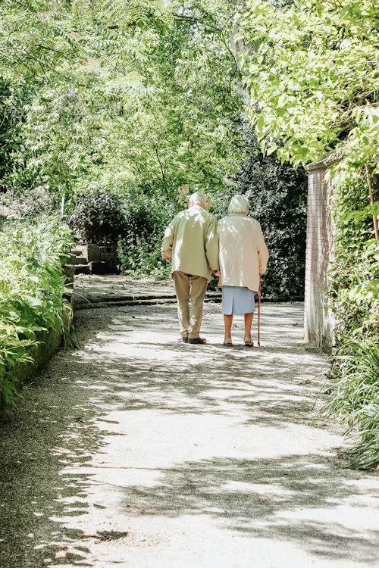
How is purpose experienced in the aged care setting?
Drive for life
Routine, activities, autonomy and security
Social interaction and relationships
Faith or spirituality

Slide 10
Drive for life
I keep myself busy I choose what I do…I do need stimulation so try to do that for myself... I guess the other answer is to the degree that I can make my life meaningful, I try. Male, 80
You are pretty much independent here. You do want you want to do. If there are things that you are you interested in you go to…I like being out with people and all that but I’m quite happy to be on my own. Female, 91
Most things I will try. That was my aim when I came here—try everything and if you don’t like it don’t do it again. But try it first. That’s what I’ve done. I’m happy. Female, 86
I like being able to get up in the morning and do what I want to do. There’s no one pushing you to do anything … you just please yourself.… It is my time now … I’ve had my life. I don’t want to go back there. Now it is just my life to fill it how I want it now. I don’t have to please anyone. I just please myself now. Female, 83

Slide 11
Routine, activities, autonomy and security
I have to have my shower and then that’s it, I know my day has started. Once I’ve had my hot shower I’m ready for anything. Because that’s what I used to do at home. Get up, have a shower go and have breakfast. That was my routine and my routine is the same here which is good. Female, 86
Being able to go for a nice walk in the morning … I walk up and down there each day … It can be hot or cold or whatever … it is all airconditioned. It is something I don’t have to worry about the weather … I can walk twice a day, in the morning and after lunch. I used to walk an hour every day until I had a big fall. Male, 78
I’m very happy. I have people who shower me which I was frightened to do in case I fell over. I’ve got people to make my meals which I wasn’t able to do. I am well looked after. And I’ve got company now. Female, 85

Slide 12
Social interaction and relationships
Just mixing with people and mingling with people. Finding out about people. Some people are very reluctant to talk but eventually they will. They will tell you things about themselves which is good. I like a social life. I’m a social person. Female, 86
They are really good here. I don’t miss anything … There is always someone I can talk to … There are some people who don’t want to talk at all and there are some who want to sit in their room all the time. I try to find those people to talk to [laughs]—talk to people who are not really happy to make them happy … I want to make people feel good. Female, 80

Slide 13
Faith or spirituality
I have a strong faith and that keeps me going … I have a certain peace because of that … that helps a lot. I have always had a very strong faith. I used to take part in missionary group work … I go to church service every Tuesday. We have a good social circle here that goes to church. Female, 90

Slide 14
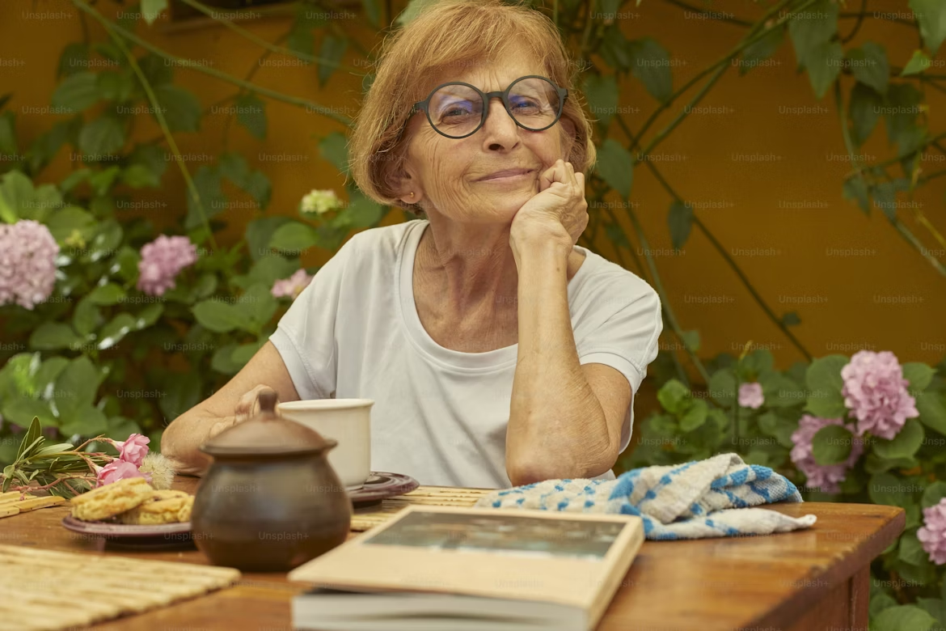
What does this look like in practice?
Purpose amongst adults living in residential communities may be facilitated through varied mechanisms.
Providing meaningful occupation may help inform relevant activities in this setting.
Providing sufficient opportunities for residents to be useful, help, or contribute
Resident designed and led programs or initiatives.
Maximizing flexibility of routine will support independence, choice and autonomy.
Facilitating access to like minded individuals or groups.

Slide 15
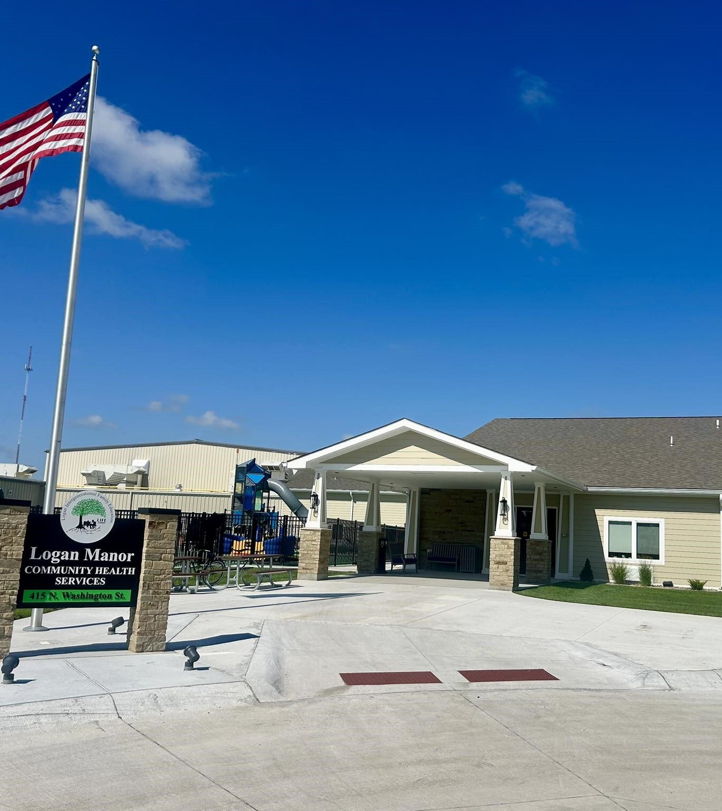
Logan Life Center
Based in Logan, Kansas, the Logan Intergenerational Family Education (LIFE) Center project(LIFE) Center integrates several community facilities into the single structure, including a nursing home, a Pre-K through 4th grade elementary school, gymnasium and other community rooms and facilities.
The goal of the LIFE Center is to create a state-of-the art intergenerational facility that responds to multiple community needs, including public education, skilled disabled and senior care services, and community center, in a way that improves educational outcomes, enhances quality of life for residents, while maximizing cost efficiency through centralization of resources and facilities.

Slide 16
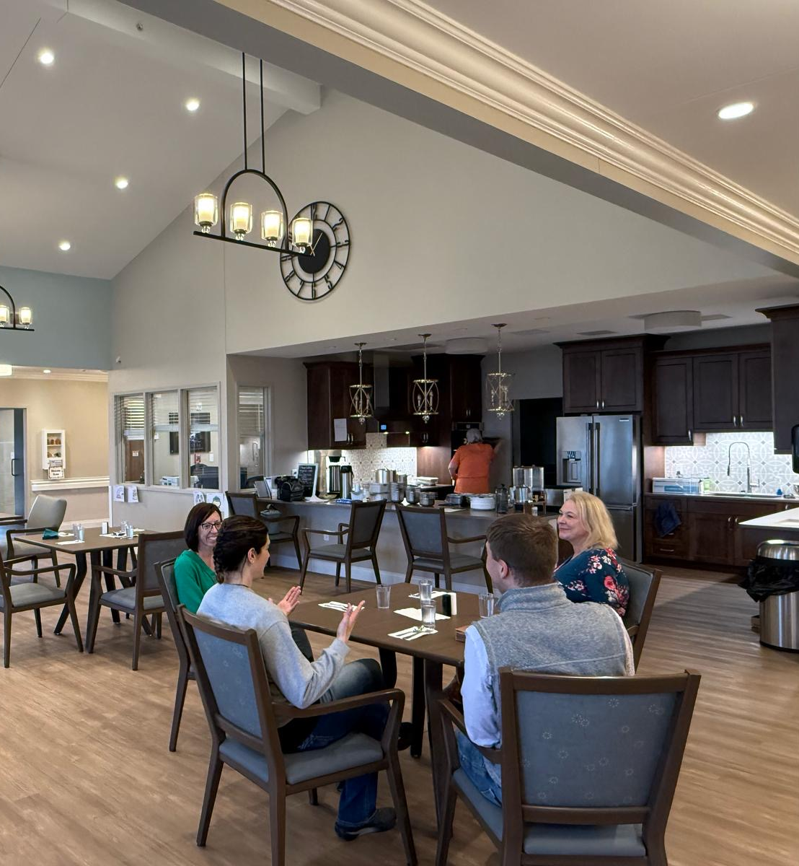
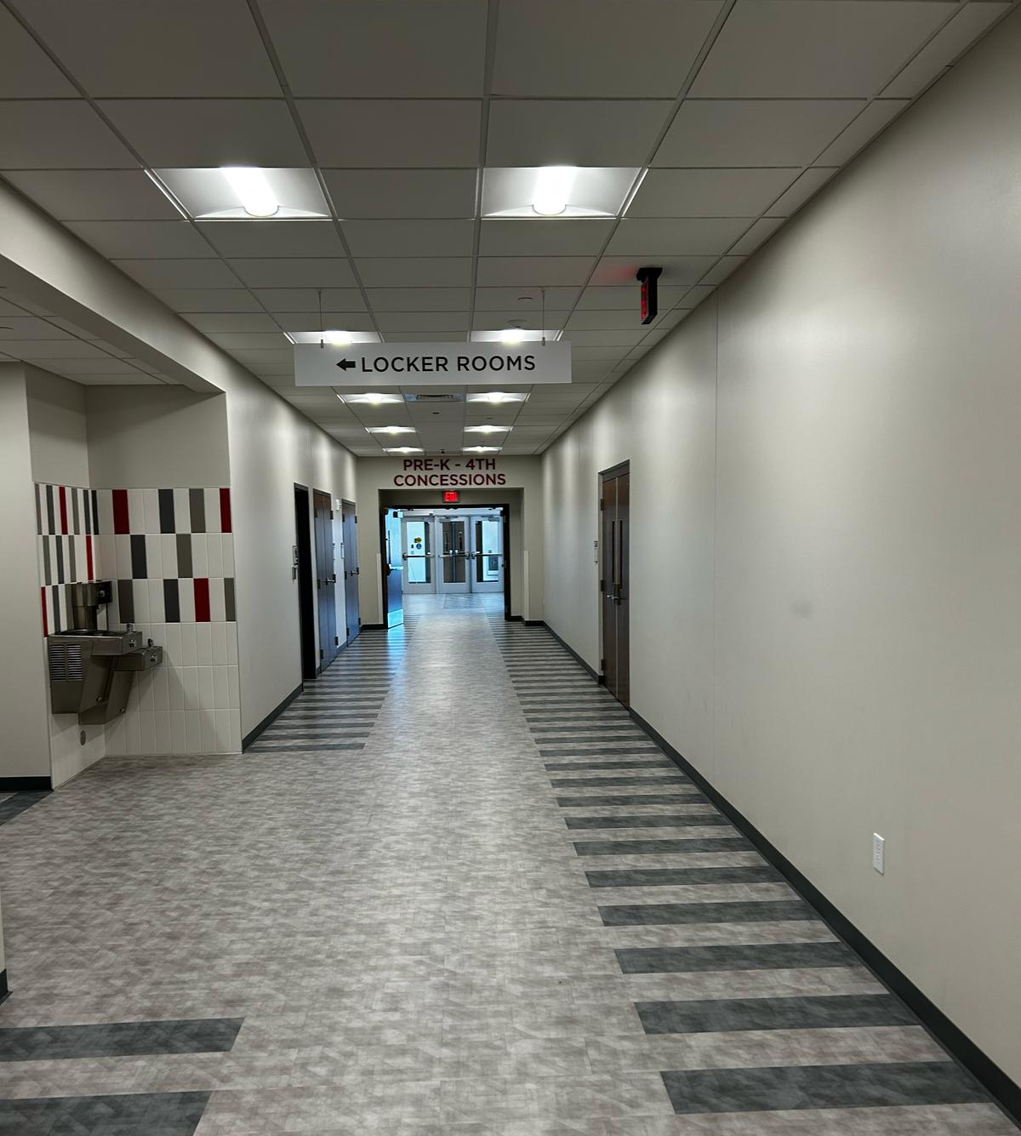
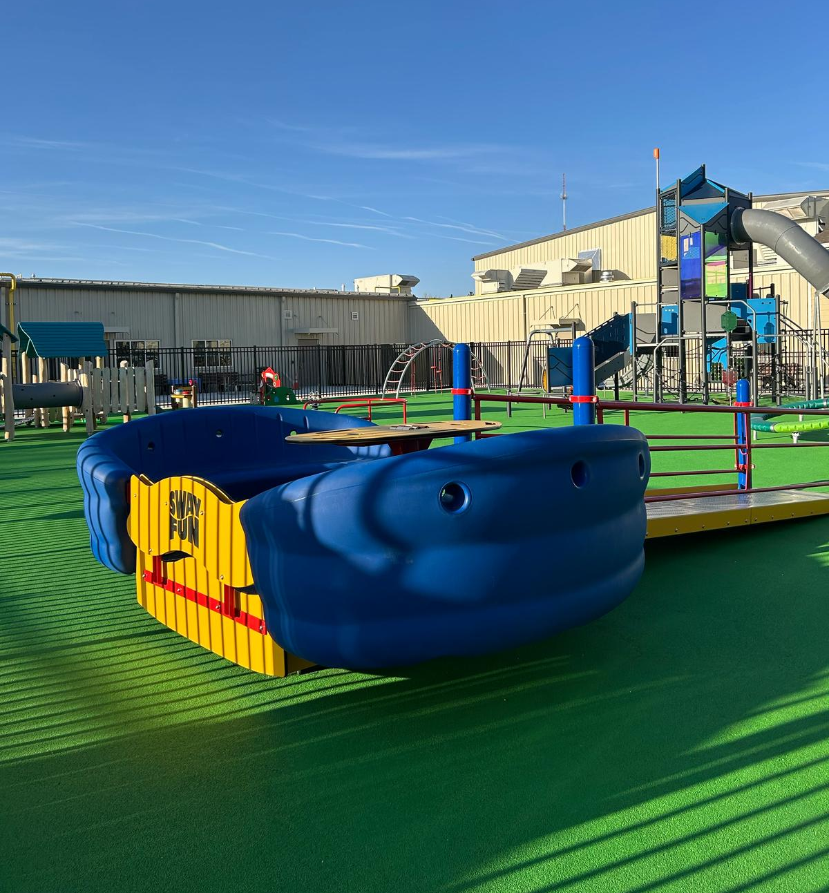
Logan Life Center
The newly constructed 36 bed nursing home (Logan Manor) is designed in line with the modern small house or Green House Project principles
The nursing home is interconnected with the elementary school, enabling residents to regularly interact with the elementary school students.

Slide 17
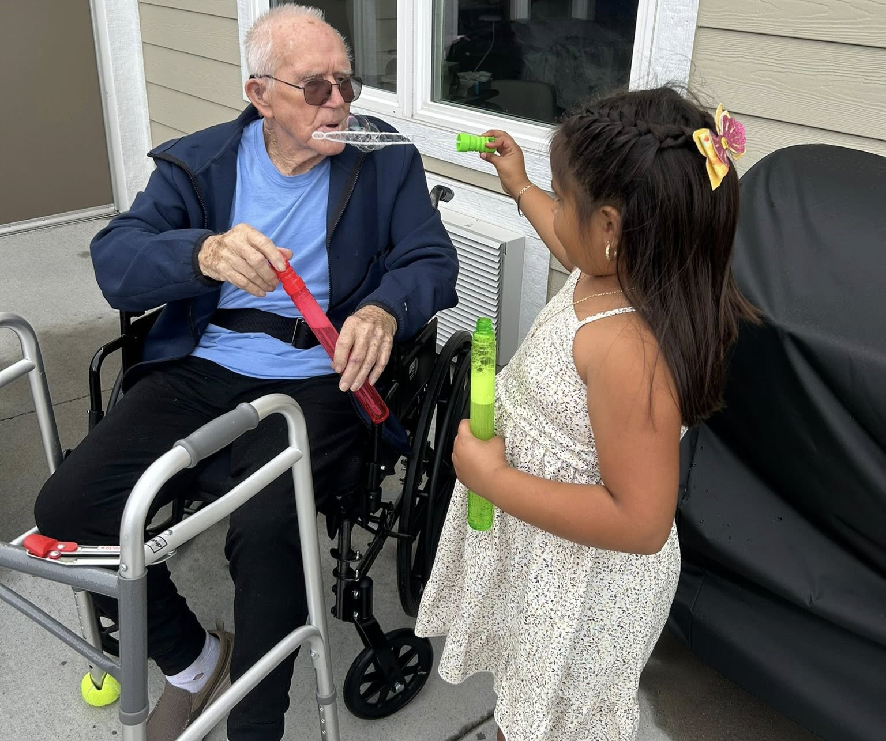
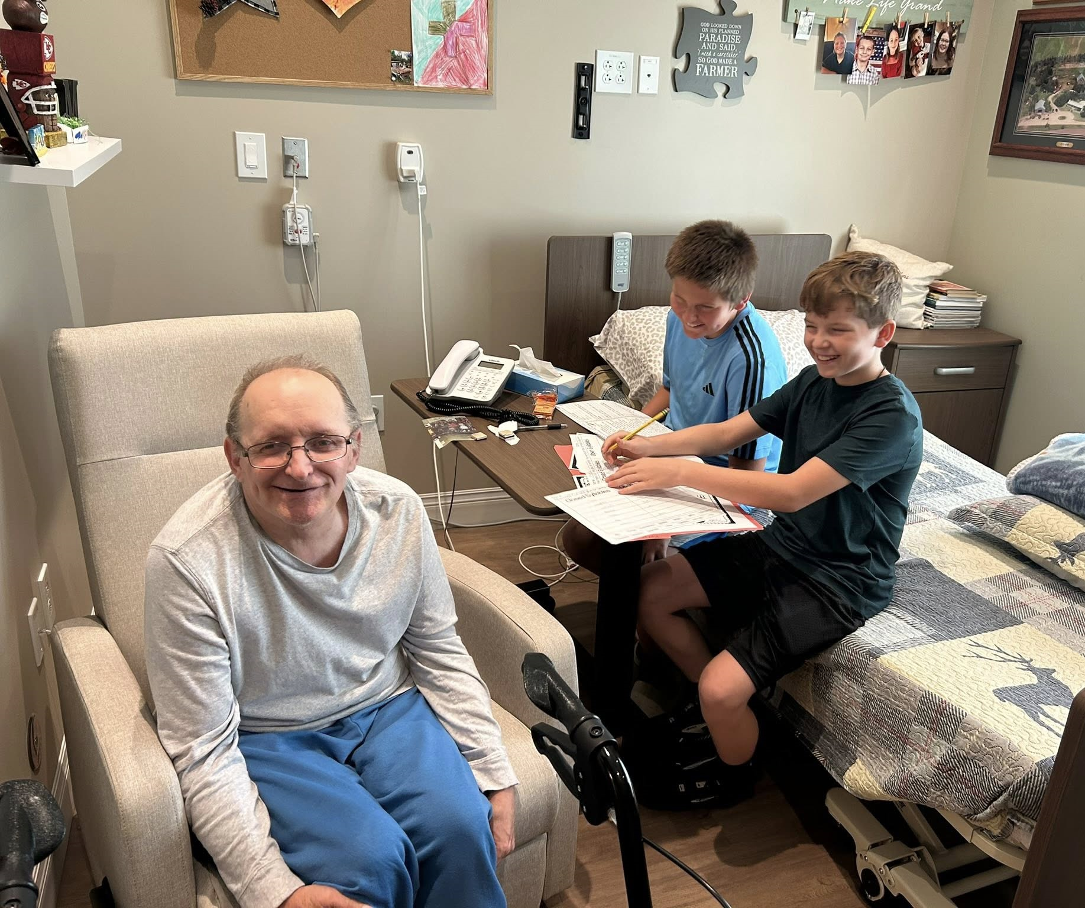
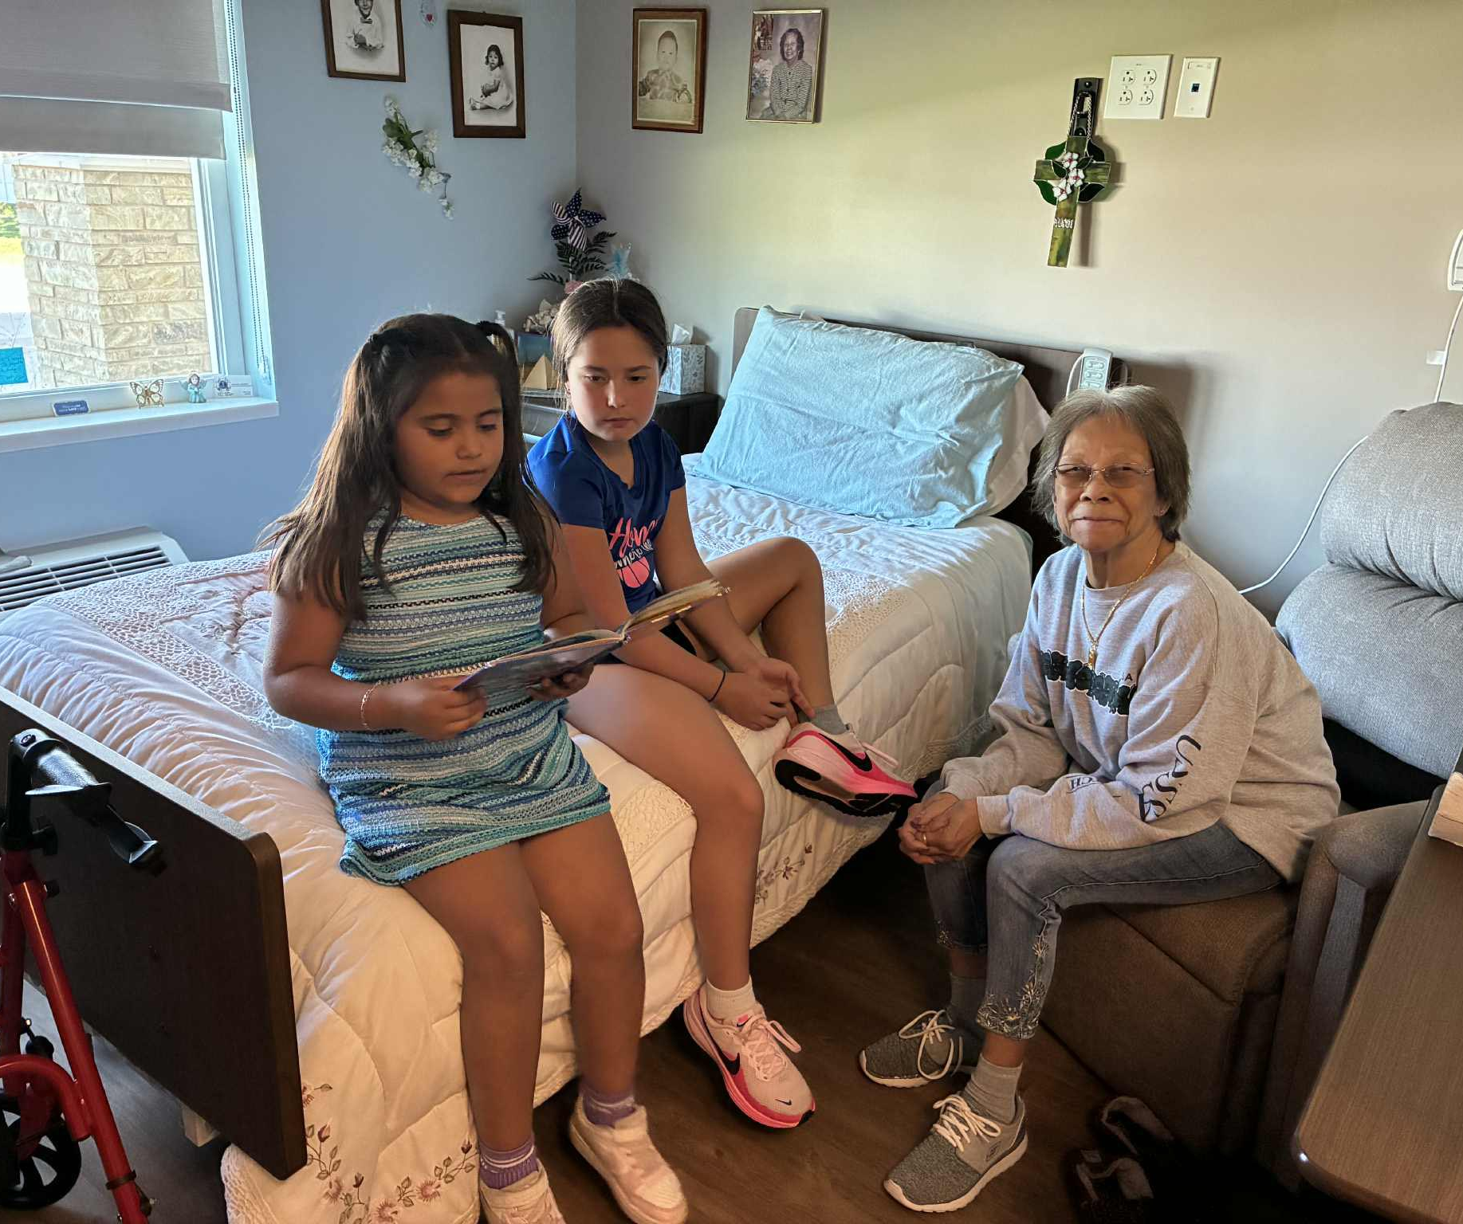
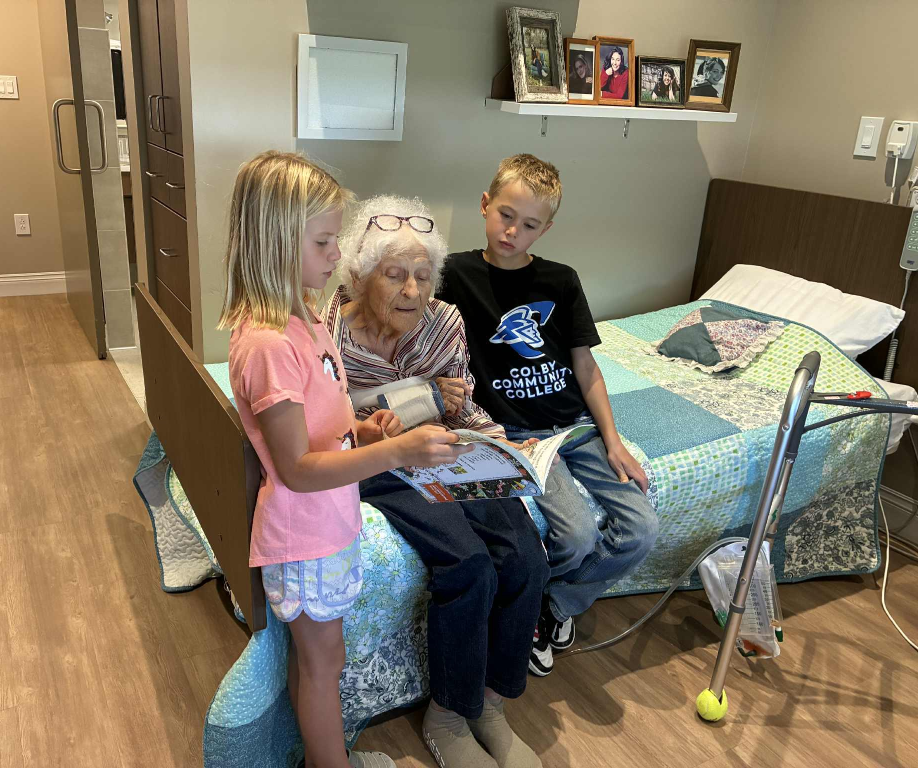
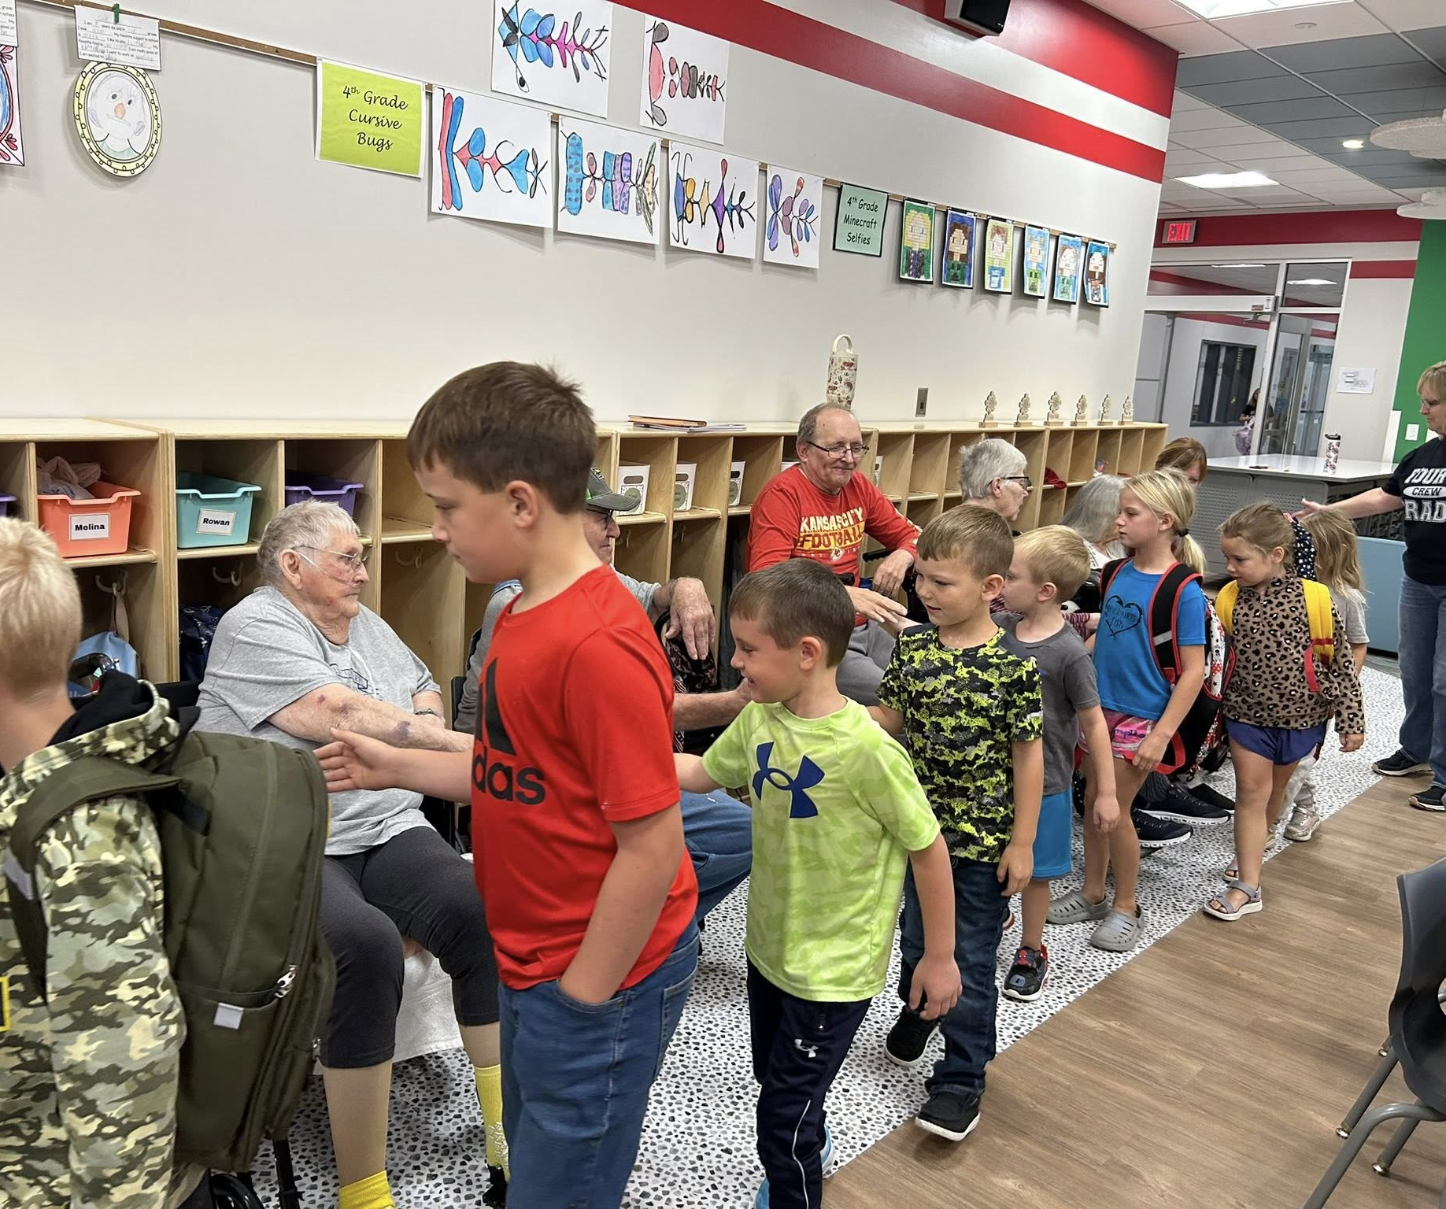
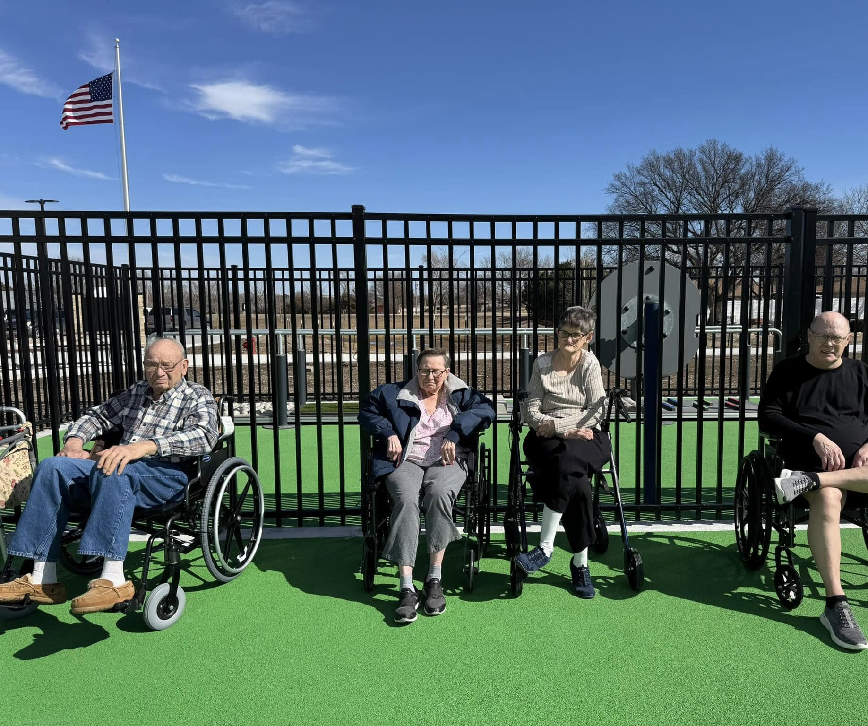

Slide 18
Logan Manor Resident Perspective
Enabling environment that promoted movement and interaction
“It’s quite a different place in that we are next to a primary school and this care service as well…And that's what makes it easier, I'm sure, for the school kids to come, because before they had to come clear downtown.”
“I would say it's a good place to be, yeah. It's just…normal.”
“I'm sure there are people that aren't happy to be here, but I don't feel that way. I was living alone for 21 years. For me, basically I'm not alone anymore.. No, like I say, I'm not alone anymore.”
“Here, we're all connected. You can go from here to the classrooms. It will be storming something fierce outside, and you're not in it.”

Slide 19
Logan Manor Resident Perspective
Choice and autonomy
“It's always nice and quiet, and if something's going on, you can go to it or you don't have to...What I like about it, they don't say, hey, you got to go do this or you got to go do that.”
“And they said ever since we moved here, they keep saying ‘this is your home’. You can do what you want and you know, go where you want, those kind of things.”

Slide 20
Logan Manor Resident Perspective
Children brought joy but also purpose and a sense of responsibility
“Well, it's sort of a bit of a pressure on you, isn’t? It makes you get up in the morning. Last night I didn't sleep real well and I had a little bit of a cough and I thought, oh, I really do not want to get up. But today's the day that we go down and spend with the kids this afternoon, so I definitely will be doing it.”
“It gives you an incentive. To get up and get moving in the morning…You got obligations. People that want to see you.”
“It makes a day go by faster.. it's not near as long day…it gives you a reason. Yeah, a reason to get up and get going. It'll help them as much as it'll help us.”
It gives your spirit a lift… [Being] stuck here in the room doing nothing is not good for you.

Slide 21
Logan Manor Resident Perspective
Opportunity to be ‘useful’, exercise skills and pursue hobbies
“I go down every Tuesday and Thursday. I go down to the grade school and I work with the kids down there…Yeah, we do math.”
“I was, and still am, big on writing letters…so I write to each of the children. Now this Summer, I'll have to get all their addresses, and that way I can stay in touch.”
“We went down one day and played games from like when we were kids…and the kids had never played cards. I said ‘I'll teach you a card game’…so I taught them.”

Slide 22

Thank you!
He who has a ‘why’ for which to live, can bear with almost any ‘how’
Friedrich Nietzsche

Slide 23
Bibliography
Irving, J. (2025). ‘I Keep Myself Busy. I Choose What I Do.’ Sense of Purpose in Long-Term Care. Journal of Aging & Social Policy, 1–21. https://doi.org/10.1080/08959420.2025.2561430 [Published only yesterday so hot off the press!]
Irving, J. (2024). “Just Get Up and Get on.” Purpose in Later Life. Activities, Adaptation & Aging, 49(1), 1–23. https://doi.org/10.1080/01924788.2024.2317013
Irving, J. (2020). The Australian response to elder abuse and neglect: An overview. In M.K. Shankardass (ed.) Combating elder abuse in Australia and India. Springer.

