Slide 1
PEAK 2.0:
Essential for the Business Future of LTC

Slide 2
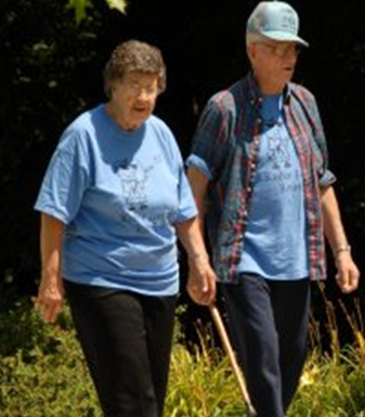
Presentation Overview
In order to continue caring for aging Kansans, nursing homes must remain viable businesses.
Innovation (person-centered care) is needed to keep nursing homes relevant in today’s market.

Slide 3
Workforce
Census & Payer Mix
Quality
Regulations
Consumer Expectations
Challenges & Opportunities

Slide 4
33%
TURNOVER COSTS 33% OF AN EMPLOYEE’S SALARY
$222,750
THE ANNUAL COST FOR A NURSING HOME WITH 45% TURNOVER.
Notes:
Calculated based on an average of 60 employees.
33% of $25,000 per year average salary.
$8,250 per turnover

Slide 5
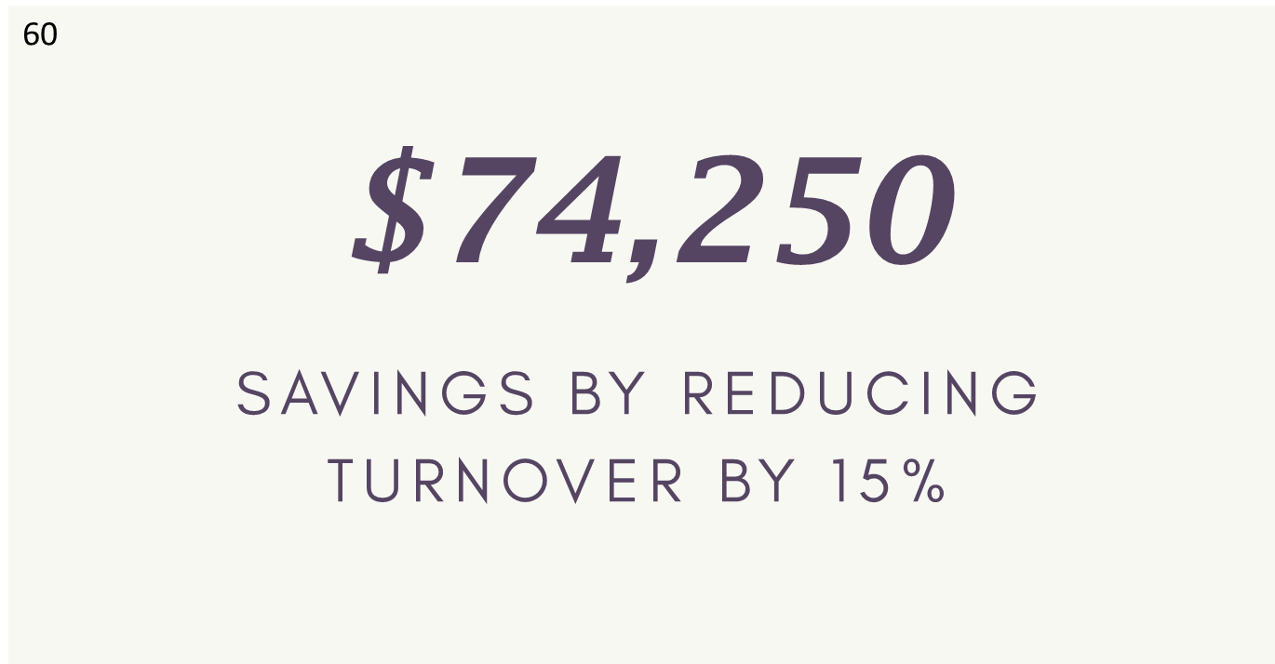
$222,750
THE ANNUAL COST FOR A NURSING HOME WITH 45% TURNOVER.
Notes:
Calculated based on an average of 60 employees.
33% of $25,000 per year average salary.
$8,250 per turnover

Slide 6
$371,250
One PEAK home’s turnover rate went from 110% to 35%. That’s a 75% reduction in turnover.
PEAK 2.0 Example
Notes:
Calculated based on an average of 60 employees.
33% of $25,000 per year average salary.
$8,250 per turnover

Slide 7
What do staff want?
RESPECT AND APPRECIATION
MEANINGFUL WORK
EDUCATION AND KNOW EXPECTATIONS
INPUT IN DECISIONS
COMMUNICATION
COMPETITIVE PAY AND PROMOTION
CARING, NUTURING LEADERSHIP
Susan Gilster, PhD, RN; PCC Dementia Compliance

Slide 8
PEAK KNOWS WORKFORCE
PEAK 2.0 HAS CRITERIA BUILT INTO THE PROGRAM THAT PROMOTES HIGH LEVELS OF ENGAGEMENT, EMPLOYEE GROWTH AND DEVELOPMENT, AND EXPECTATIONS OF INVOVLEMENT IN DECISION-MAKING THROUGHOUT THE ORGANIZATION; ALL OF WHICH WERE CITED AS THINGS STAFF WANT IN THEIR JOBS.

Slide 9
What do customers want in regards to workforce?
KNOW ME (THE CUSTOMER)
CARING AND CONCERNED STAFF
COMPETENTLY TRAINED STAFF
RESPECTFUL STAFF
Susan Gilster, PhD, RN; PCC Dementia Compliance

Slide 10
PEAK ADDRESSES CONSUMER WANTS.
PEAK 2.0 HAS CRITERIA THAT HELPS HOMES IMPLEMENT CONSISTENT STAFFING, WHICH LEADS TO STAFF BEING ABLE TO KNOW FEWER RESIDENTS REALLY WELL RATHER THAN A LITTLE ABOUT LOTS OF RESIDENTS. CAREER DEVELOPMENT CRTIERIA ALSO EMPHASIZES STAFF TRAINING AND DEVELOPMENT.

Slide 11
MAINTAINING HIGH CENSUS IS INTERGRAL TO A VIABLE BUSINESS.
22%
THAT TRANSLATES TO A 22% INCREASE IN REVENUE FOR THAT YEAR.
15%
SEVERAL PEAK HOMES INCREASED THEIR CENSUS BY 15%.

Slide 12
$574,875
One home improved average census from 45 residents to 54 residents annually. Primary drivers they believe are word of mouth advertising.
PEAK 2.0 Example
Notes:
Calculated based on $175 per day rate.

Slide 13
CENSUS IS DRIVEN BY CONSUMER DEMAND
PEAK 2.0 AIDS HOMES IN IMPLEMENTING A MODEL OF CARE THAT CONSUMERS WANT AND ULTIMATELY WILL DEMAND. HAVING ACCESS TO FREE RESOURCES, TRAINING, AND TECHNICAL SUPPORT TO IMPLEMENT CARE CONSUMERS WANT IS A WIN/WIN.

Slide 14
“ PDPM (Patient Driven Payment Model) redefines the relationship between payment and quality measures, realigning payment incentives and quality incentives.”
Joel VanEaton
Quality
Now paying for high quality and cost containment.

Slide 15
Clinical Quality & PEAK 2.0
Major depressive symptoms declined by 49% from stage 0 (non-participants) to stage 3 (comprehensive adoption of pcc).
Residents with indwelling catheters declined significantly from stage 0 to stages 2 and 3.
Low risk residents with pressure ulcers declined significantly from stage 0 to stages 2 and 3.
Composite measures of overall health show Stage 2 and 3 home residents have better overall health than Stage 0.

Slide 16
Resident Satisfaction & PEAK 2.0
Homes at Levels 3 - 5
***
Residents’ overall satisfaction with their nursing homes does not increase significantly until Stage 4 (relative to Stage 0).
% Good/ Excellent
Overall Satisfaction
Stage: F(4,102)=2.85, p=0.0278
Stage 0 = Homes not in PEAK Stage 1 = Homes in Foundation Year Stage 2 = Homes at Level 1 Stage 3 = Homes at Level 2 Stage 4 = Homes at Levels 3-5
Notes:
Let’s look at some of the specific findings.

Slide 17
Resident Satisfaction & PEAK 2.0
Homes at Levels 3-5
Homes at Levels 3-5
*
*
Homes at the Foundation Level
*
% Good/ Excellent
Overall
Quality of Life
Overall
Quality of Care
Overall
Quality of Service
Stage: F(4, 106)>1.9, p<0.15
Stage: F(4, 106)>1.9, p<0.15
Stage: F(4, 106)>1.9, p<0.15
Stage 0 = Homes not in PEAK Stage 1 = Homes in Foundation Year Stage 2 = Homes at Level 1 Stage 3 = Homes at Level 2 Stage 4 = Homes at Levels 3-5
Notes:
Overall quality of life (QoL) and quality of care (QoC) do not increase significantly until Stage 4; quality of service (QoS) is only increased significantly in Stage 1.
QoL and the other two domains improved by 5-10 percentage points between Stage 0 facilities and Stage 4 facilities.

Slide 18
Federal Regulations and PEAK 2.0
85x
The State Operations Manual (SOM) uses person-centered care 85 times throughout the document. It is now a requirement, not an option. Let’s continue to teach homes how to provide person-centered care.

Slide 19
Change over costs
Any time a new model of care is initiated (PCC) there is a learning curve, which has costs.
PEAK 2.0 offsets costs by providing training, resources, and technical assistance.
Remember, only costs that are incurred directly as a result of PCC should be allocated to the cost of the PCC program. Organizational overhead exists regardless of the care type provided and should not be included. (SCAN Foundation)

Slide 20
Because person-centered care is an expectation, homes will incur change over costs with or without PEAK.
These costs are reduced with PEAK.

Slide 21
Person-centered care is important to Kansas nursing home’s future.
Person-centered care is what our Kansas elders want and deserve.
PEAK 2.0 helps nursing homes implement the deep systems changes needed to support PCC.
Our recommendations:
Keep PEAK 2.0 an incentive to emphasize PCC’s importance.
Revision PEAK 2.0 with high engagement of key stakeholders.
Conclusions

