Slide 1
Shepherding Grief and Bereavement
For Staff and Residents

Slide 2
Shepherding Grief and Bereavement
Presenter Biography
Dr. Johan Tredoux, Ph.D., BCC
St. Croix Hospice Chaplain

Slide 3
Shepherding Grief and Bereavement
St. Croix Hospice Values
Integrity
Collaboration
Accountability
Respect
Excellence
Notes:
At St. Croix Hospice we like to start every education with our ICARE values of integrity, collaboration, accountability, respect and excellence. We like to review theses values because this is what makes us as St. Croix Hospice special and makes us stand out against the rest. We bring each of these values into every interaction that we have not only with our patients and their families but with the facility that we work with, the providers that we work with, and with each other.

Slide 4
Shepherding Grief and Bereavement
“You matter because of who you are, and you matter to the last moment of your life. We will do all we can, not only to help you die peacefully, but also to live until you die.”
Dame Cicely Saunders
Notes:
Dame cicely Saunders was an extraordinary woman who started her career as a nurse and later became a medical social worker and finally a physician. She is the founder of the contemporary hospice movement started in 1967 with the establishment of St. Christopher’s Hospice in London.
She forever revolutionized the way society cares for the ill, dying and bereaved.
Her idea about hospice and care for the dying can be summarized by this quote: (Read quote on slide)

Slide 5
Shepherding Grief and Bereavement
Objectives
Identify different types of grief and how they affect residents and staff
Define cultural humility
Describe how cultural humility applies to patients/residents/staff/family grief and bereavement
Explain how hospice can help
Notes:
We have several objects for todays education: (Read slide)

Slide 6
Shepherding Grief and Bereavement
What is Grief?
Grief is the normal and natural response to the loss of someone or something important to you.
Relationships
Identity
Roles
Job
Independence
Good health
Security
Loved ones
Notes:
So, what is grief? Well, grief is the normal and natural response to the loss of someone or something important. While it is most commonly thought to occur after a person experiences a death, it can also occur after a person loses a job, ends a relationship, loses a home, or any other situation that causes sudden and unexpected change. Unexpected changes can result in a more complicated grief journey. For example, someone who has been watching his/her aging parent pass away after a long life may experience less grief than someone who loses a parent young in life when it’s unexpected.

Slide 7
Shepherding Grief and Bereavement
Grief Emotions
Grief presents as a gamut of emotions which can be unpredictable but are neither right or wrong and need expression.
Denial
Anxiety
Sadness
Guilt
Ambivalence
Loneliness
Hopelessness
Anger
Emptiness
Abandonment
Shock
Fear
Shame
Numbness
Relief
Notes:
Grief can present as any number of different emotions including: (read some examples from the slide)

Slide 8
Shepherding Grief and Bereavement
Grief can be…
All consuming. Impacting every area of life.
Different for everyone. Factors that impact how someone manages grief.
Emotional
Intellectual
Physical
Spiritual
Social
Personality
Support system
Cultural background
Past coping mechanisms
Spirituality
Social expectations
Notes:
Grief can also be all consuming and impact all aspects of someone’s life including emotional, intellectual, physical, spiritual, and social. Everyone experiences and manages grief differently and how they do is influenced by many factors including personality, support system, cultural background, past coping mechanisms, spirituality, social expectations.

Slide 9
Shepherding Grief and Bereavement
Grief Reactions
Physical
Emotional or Behavioral
Headaches
Weakness/fatigue
Rapid heart rate
Muscle tension, aches, pains
Shortness of breath
Appetite changes
Tightness in the chest or a sensation of not being able to breath
Numbness
Anger
Anxiety
Confusion
Sadness and excessive crying
Trouble staying focused/decrease in productivity
Vivid dreams related to the loss
Visiting places that hold memories of avoiding them
Notes:
Grief can also present in different physical, emotional and behavioral ways including: (Read some examples from the slide).

Slide 10
Shepherding Grief and Bereavement
Types of Grief
Anticipatory
Chronic
Complicated
Cumulative
Delayed
Disenfranchised
Distorted
Normal
Notes:
There are many different types of grief, some of which we will review further in this education. Here are some examples of grief:
Delayed – Can happen if you’re experiencing stark feelings of sorrow and longing even if the loss occurred a long time ago. There may have been something that occurred that didn’t allow that person to grieve right after the death of their loved one. (explain Dixie going through this)
Complicated – Occurs when you’re grieving process does not move all the way through the steps of grief. It can be prolonged and much more intense. With this grief, they may feel more depressed and have increased anxiety. Complicated grief typically requires help from a mental health professional. REFER OUT
Cumulative – This type of grief happens when you experience an additional loss shortly after (or while still processing grief from another loss). Facilities experienced this in the past year with increase in deaths.
Chronic – results when extremely intense reactions to loss do not subside. These emotions will last for a long time and cause incredible distress that may continue to intensify.

Slide 11
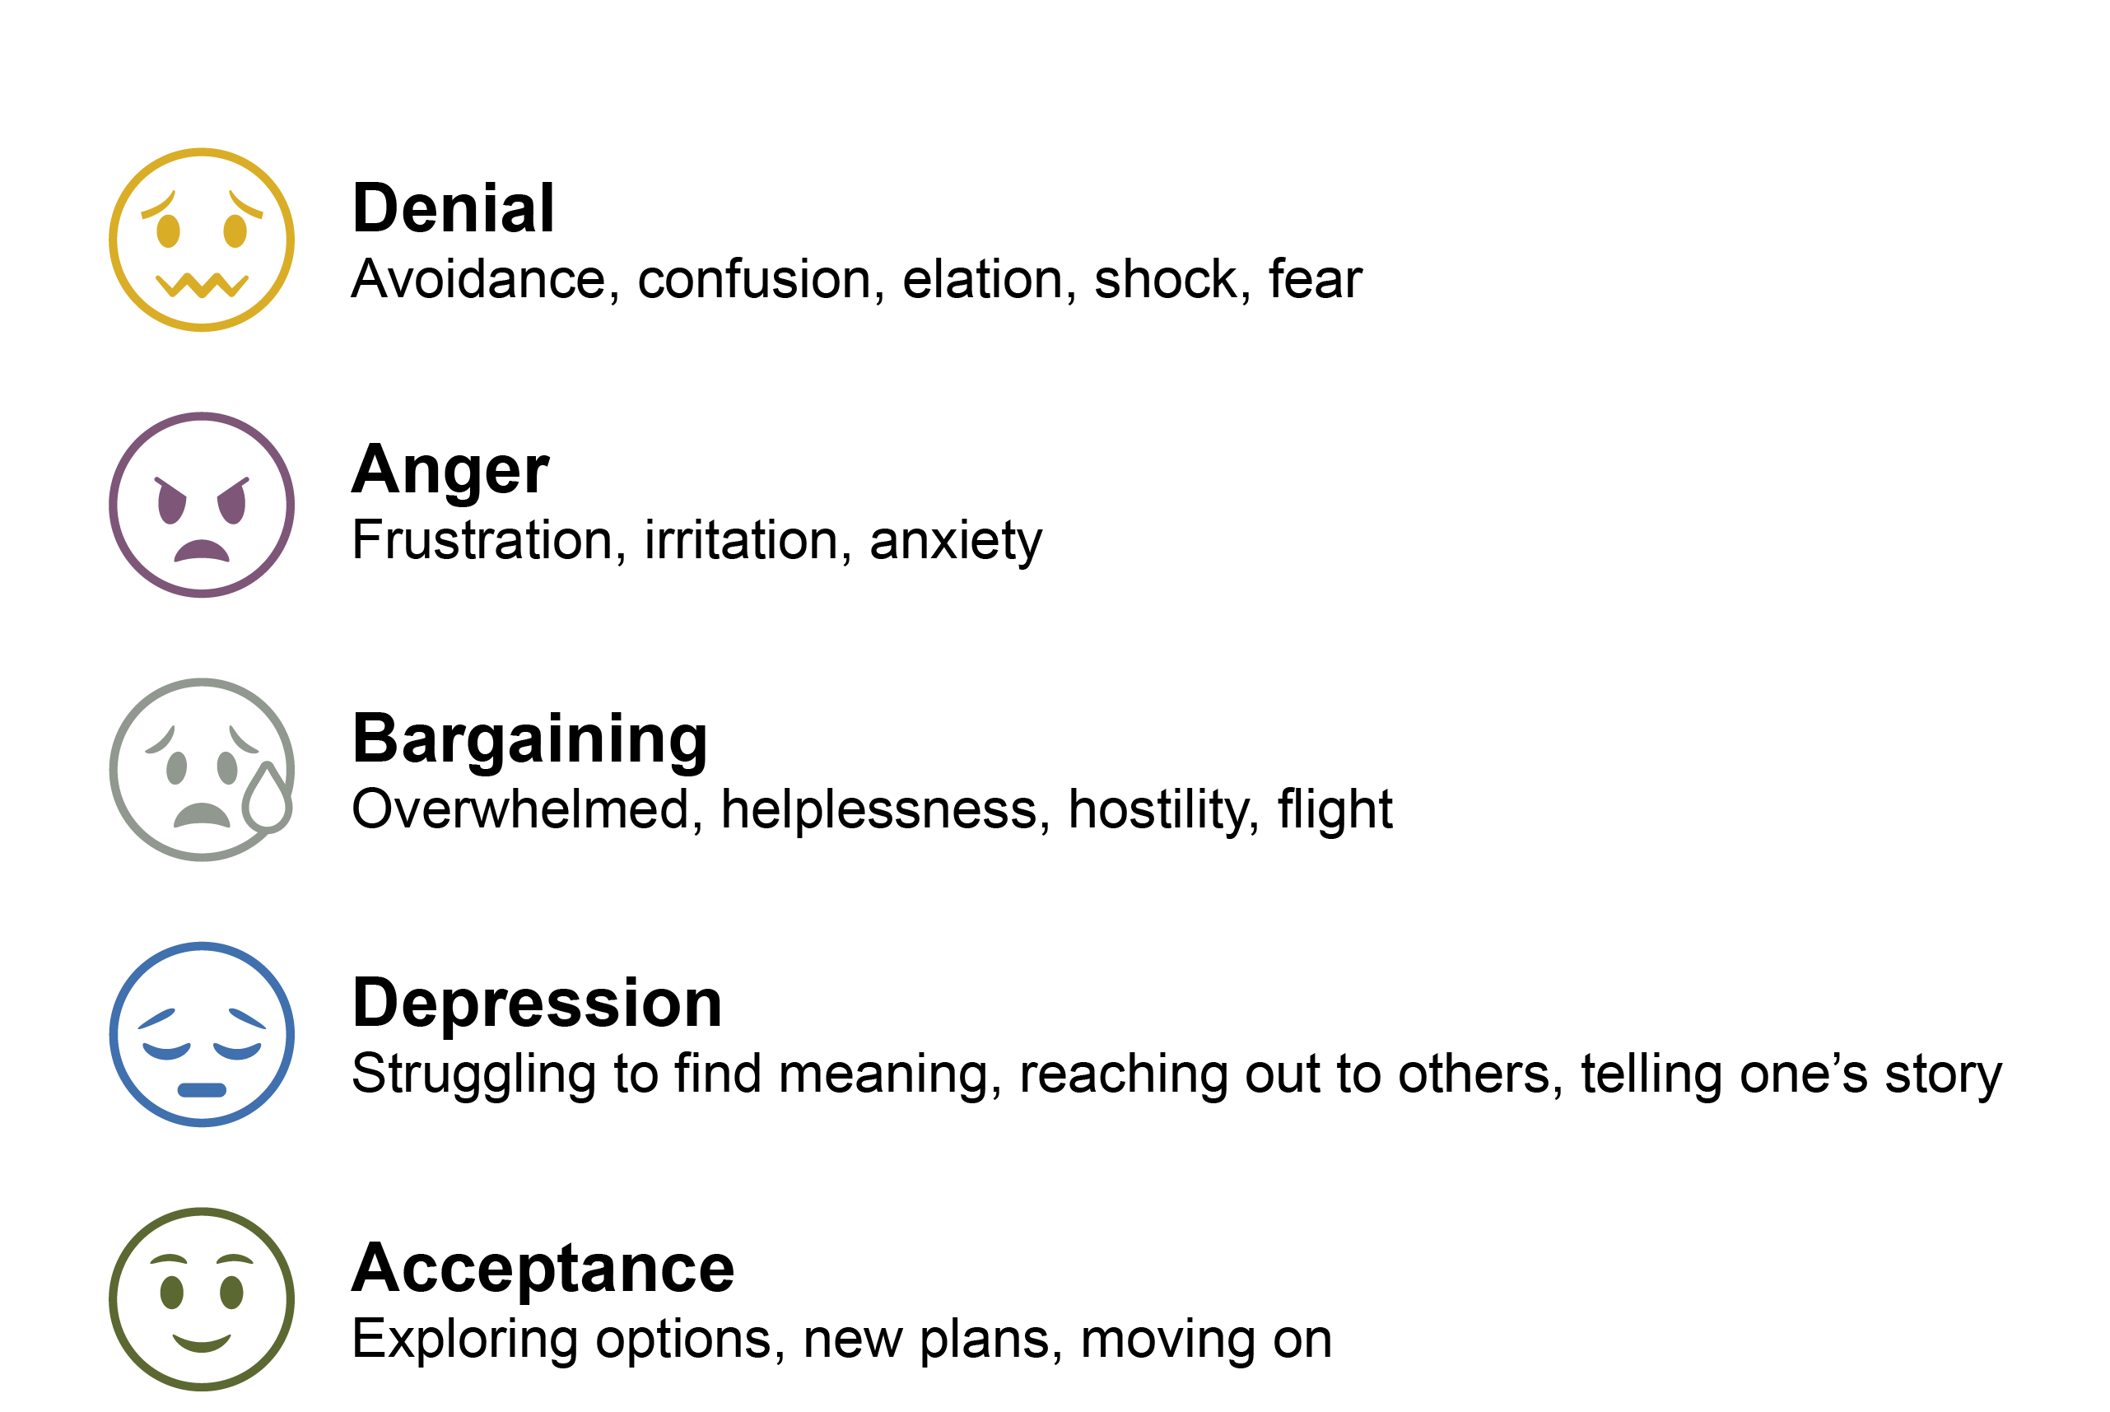
Shepherding Grief and Bereavement
Classic Grief
The 5 Stages of Grief
Notes:
First let's look at classic grief. In classic grief there are typically 5 stages known as the Kubler Ross stages of grief. Those stages include denial, anger, bargaining, depression, and acceptance. So, lets look at these stages a little deeper.
1. Denial – in this stage people most often avoid their feelings. They are confused and shocked by the loss they are experiencing, and they may experience a great amount of fear. People most often feel denial as a way of coping. They become numb so that they can continue to function, whereas if they are hysterical, they may not be able to function. They may feel out of touch with reality, and this can bother people around them who worry about them or need their support as well.
2. Anger – in this stage a person will likely feel frustration, irritation, and anxiety. People often feel and say things such as, “why do bad things always happen to me.” They might have all-or-nothing thinking that presents as feeling like their life is destroyed, terrible, or ‘over’. Anger is a natural response to grief because nobody prefers to experience loss. People often look to anger as well to blame others instead of recognizing accountability toward loss. For many people, anger is easier to feel than sadness or devastation.
3. Bargaining – in this stage people will likely have trouble with identifying purpose and meaning in their life. They will perhaps reach out to others with similar experiences to form a sense of community in their grief. They begin to talk more openly about their grief and story. This is often a time when individuals will wonder if they could have changed the outcome that resulted in their deep sense of loss. For example, a person might wonder “what if I had never gotten in that car, then the accident might not have happened.”
4. Depression – in this stage a person will feel overwhelmed, hopeless, hostile, and even engage in isolation from loved ones. People feel empty and struggle to function. For example, they might struggle to get out of bed because the world is too overwhelming to them. People might engage in self-harming behaviors or suicidal planning. This is a period where they will benefit greatly from counseling and support.
5. Acceptance – individuals in this stage may feel at peace and begin to explore options after their loss. They begin to feel as though they have “moved on.” This does not mean that they do not miss life the way that it was before the loss, but they begin to believe that they will be okay after the loss. Emotions generally stabilize and people can cope effectively. They begin to function again and find some sense of normalcy.

Slide 12
Shepherding Grief and Bereavement
Anticipatory Grief
Refers to a feeling of grief occurring before an impending loss. Typically, the impending loss is the death of someone close due to illness.
Can be experienced by the person dying and those close to them.
Doesn’t mean one won’t grieve later.
Notes:
Anticipatory grief is a common form of grief experienced by those in an end-of-life experience including individuals with a terminal illness, a caregiver, or a loved one. Anticipatory grief occurs when a loss is impending and does not mean that the individual will not grieve later, after the loss.

Slide 13
Shepherding Grief and Bereavement
Secondary Losses
Secondary losses are additional changes and loss experienced when someone is terminally ill.
Loss of who that person was
Change/strain on your relationship with the person
Loss of role
Loss of identity
Change of personality
Loss of routine
Loss/change of family support
Loss of dreams for the future
Notes:
Anticipatory grief can also be associated with secondary losses. When someone is experiencing a terminal illness, their life may be surrounded by additional changes like: loss of personhood, change in relationships, loss of family role, loss of identity, change in personality, loss of routine, change in support, and loss of future dreams.

Slide 14
Shepherding Grief and Bereavement
Disenfranchised Grief
Also known as hidden grief, refers to any grief that goes unacknowledged or unvalidated by social norms.
How the loved one passed away
Estranged relationship
Ex-spouse or partner
A distant friend
A previous co-worker or classmate
Can also happen if a person
Has had to cope with a lot of losses in a short time
Was taught to set aside their emotions
Feels it’s not professional to show emotion
Is affected by death related to a critical incident or traumatic event
Notes:
Another common form of grief is disenfranchised grief, which refers to the grief that goes unacknowledged or unvalidated by social norms. Examples of when disenfranchised grief may occur include; social unacceptable death (for example my brother was shot while he was robbing a bank). Estranged relationships, the passing of an ex-partner or spouse, the loss of a distant friend, coworker or former classmate.
Disenfranchised grief can also be triggered by an individual having to cope with a lot of losses in a short period of time. Or maybe the person was taught to set their own emotions aside and “suck it up”. Maybe the individual feels that expressing the grief is unprofessional. Critical incidents or traumatic events can also trigger disenfranchised grief.

Slide 15
Shepherding Grief and Bereavement
Supporting Others Through Grief
There is no right way to grieve and mourn. Be very careful not to impose your ideas, beliefs or expectations on others.
Be present, listen and acknowledge their feelings
Understand and accept other cultural and religious perspectives about illness and death
Check in with children and teens who process grief differently, consider creating special activities to meet their needs
Be specific in your willingness to help
Check in frequently and be will to stay engaged for as long as needed
Notes:
It is important to remember that there is not right or wrong way to grieve or mourn. We can help others through their grief by:
Being present, an active listener and acknowledge their feelings.
Not imposing our ideas and beliefs on others and understanding that other cultures and religious have alternate perspectives on illness, death and dying.
Be mindful of the everyone checking in with children and teens who process grief differently, consider creating special activities to meet their needs
Be specific in your willingness to help instead of saying “is there anything I can do to help” say “I’m going to make you a lasagna what day should I bring it over this week”
Check in frequently, and be will to stay engaged for as long as needed

Slide 16
Shepherding Grief and Bereavement
Supporting Others Through Grief
What to say
What not to say
Acknowledge the situation: “I heard that your sister died”
Express concern honestly. “I am so sorry” or “I don’t know what to say”
Offer help: “Is there anything I can do for you?”
“I know how you feel”
“They are in a better place”
“It’s god’s will”
“You’re so strong”
“You’ll get over it”
“Don’t cry”
Notes:
When supporting others there are several examples of things that are helpful to say and somethings that may be seen as challenging or unhelpful.
Helpful comments may include:
Acknowledging the situation: “I heard that your sister died”
Expressing concern honestly. “I am so sorry” or “I don’t know what to say”.
Or offering help: “Is there anything I can do for you?”
Some unhelpful things include:
“I know how you feel”
“They are in a better place”
“It’s God’s will”
“You’re so strong”
You’ll get over it”
“Don’t cry”

Slide 17
Shepherding Grief and Bereavement
Supporting Colleagues Who are Grieving
It can feel difficult or awkward to talk about death and grief with colleagues. Many people avoid the subject. However, you do not need special knowledge about bereavement to help a colleague. A simple and compassionate approach often helps.
Acknowledge the death and its impact – such as a simple expression of sympathy in person, by the phone or as a written message
Listen to them when they need it
Offer support in a sensitive way – find out what resources and support are available in your workplace
Ask how you can help
Check in with them again – sometimes people may need space or privacy at first
Notes:
It can feel difficult or even awkward to talk about death and grief with colleagues. Many people avoid the subject. However, you do not need specialist knowledge about bereavement to help a colleague. A simple and compassionate approach often helps.
Acknowledge the death and its impact – such as a simple expression of sympathy in person, by the phone or as a written message.
Listen to them when they need it
Offer support in a sensitive way – find out what resources and support are available in your workplace
Ask how you can help
Check in with them again – sometimes people may need space or privacy at first.

Slide 18
Shepherding Grief and Bereavement
Supporting Healthcare Workers Through Grief
The expectation that we can be immersed in suffering and loss daily and not be touched by it is as unrealistic as expecting to be able to walk through water without getting wet.
-Kemen
Notes:
Being a healthcare worker comes with many unique struggles including loss. (Read slide)

Slide 19
Shepherding Grief and Bereavement
Misconceptions of Grief in Healthcare
I cannot do my job if I’m busy dealing with grief.
This is my job, it’s not a personal loss.
Grieving for a patient is unprofessional.
I am not affected by death.
I need to move on, there are other patients to care for.
Notes:
Misconceptions that we often tell our selves as healthcare works include: (Read Slide)

Slide 20
Shepherding Grief and Bereavement
Dealing with Death and Dying at Work
Sometimes you may set aside your emotions to be able to help others or work under pressure. However, it is important to look after yourself as well as others when you are affected by death. It is OK to grieve.
Acknowledge the death
Allow yourself to feel sadness and other emotions
Acknowledge the help and support you gave the person who died and their family
Talk about the death and how you feel with someone you trust
Identify healthy ways to cope and look after your mental health
Exercise
Listening to music
Journaling
Hobbies
Ask for support if you need it
Notes:
And sometimes you may set aside your emotions to be able to help others or work under pressure. However, it is important to look after yourself as well as others when you are affected by death. It is OK to grieve. You can do so by:
Acknowledging the death
Allowing yourself to feel sadness and other emotions
Acknowledging the help and support you gave the person who died and their family
Talk about the death and how you feel with someone you trust
Identify healthy ways to cope and look after your mental health
Exercising
Listening to Music
Journaling
Participating in hobbies
And asking for support if you need it

Slide 21
Shepherding Grief and Bereavement
Honoring the Dying
Cherish each moment with the person
Travel
Creating legacy keepsakes
Videos
Voice recordings
Handwritten cards or letters to family members to open at a later date
Thumb prints and hand molds
Leave nothing left unsaid
Notes:
A way to support all individuals through the grief process is honoring those individuals who are terminally ill. You can help to honor these individuals by encouraging the making of memories through cherished moments, travel and new experiences, creating legacy keepsakes like video and voice recordings or handwritten letters that can be give to family and friends at a later date. You can create remembrance tokens like thumb prints, photos, or hand mold and most importantly encourage the sharing or moments leaving noting left unsaid.

Slide 22
Shepherding Grief and Bereavement
Honoring the Deceased
Remember significant dates (anniversary of death, birthday, holidays)
Write a letter or poem
Create a collage of photographs
Donation in their honor
Create a memorial garden
Visit cemetery or location
Create a new tradition to mark special dates
Take a moment to reflect
One thing I will never forget about them is…
One way to memorialize them is….
If I could see them again, I would tell them…
Notes:
We can also honor those who have passed by: (Read slide)

Slide 23
Shepherding Grief and Bereavement
Cultural Competency vs Cultural Humility
Cultural Competency
Learning about other cultures
Understanding and controlling your own biases
Adapting your behavior and communication style based on those around you
Uses your knowledge about different groups to determine how you interact with others
Can lead to generalizations
Cultural Humility
Being aware of power imbalances and biases
Showing respect for others’ values and beliefs
Ongoing personal reflection and growth of knowledge
Being honest about your knowledge gaps
Recognizing no culture is better than another
Keep in mind that not all people in a specific culture will necessarily share the same values and beliefs.

Slide 24
Shepherding Grief and Bereavement
Cultural Humility and Grief
Grief is influenced by our:
Attitudes
Beliefs
Death practices
Mourning practices
Personal identification with
Culture
Race
Ethnicity
Assimilation
Gender roles
Community support
Religious beliefs
Practice cultural humility by asking questions about the person’s views on dying, death and grief

Slide 25
Shepherding Grief and Bereavement
Cultural Humility and Religion/Spirituality
Religion vs. Spirituality
Practices
Communion
Sacrament
Prayer
Meditation
Yoga
Different perceptions
Illness
Suffering
Pain
Treatment
Family involvement

Slide 26
Shepherding Grief and Bereavement
Cultural Humility and Religion/Spirituality
Spiritual Screening – FICA
Faith
Do you practice any type of spirituality or religion?
If they reply “no” you can continue by asking: What in your life gives you the most meaning?
Importance
What role does your faith/spirituality play in your life?
What are your needs currently?
Has your faith/spirituality affected how you manage your health/illness?
Community
Are you part of a spiritual or religious community?
How does this group support you?
Address
How would you like the team to help you with any spiritual or religious concerns?

Slide 27
Shepherding Grief and Bereavement
Cultural Humility and Death/Dying
Who can care/touch the dying/deceased
Symbols
Rosaries, shawls, stones, images, talismans
Rituals
Singing, chanting, sacrament, candles, smudging, incense, anointing, positioning, moments of silence, ceremonial washing, readings, prayer
Burial traditions/customs
Earth, sky, tomb, cremation, tree, scattering

Slide 28
Shepherding Grief and Bereavement
How to Practice Cultural Humility
When in doubt ask questions
Practice active listening
Be present, even in moments of silence
Show respect and nonjudgment
Refrain from projecting your own beliefs/practices on others

Slide 29
Shepherding Grief and Bereavement
How Can Hospice Help?
Hospice care (from the Latin term hospes, a word which referred both to guests and hosts) focuses on improving the quality of life for patients and families facing a life limiting illness
Primary goals of hospice care include providing comfort, pain management, emotional and spiritual support, and promoting dignity of the terminally ill person
Hospice care neither prolongs nor hastens the dying process
Care is palliative (not curative) to control pain and symptoms associated with the terminal illness
Hospice includes bereavement support for 13 months after the loved one’s death includes:
Check-in phone calls or visits
Ongoing grief and loss information and communication
Referrals to community and online resources, including grief support groups and counselors
Notes:
(Read Slide)

Slide 30
Shepherding Grief and Bereavement
Hospice Eligibility
Notes:
The best thing you can do to support yourself, a patient, and/or loved one through a terminal process is to get hospice involved as soon as possible to avoid the chances of a crisis occurring.
Subtle signs that may indicate that you or your loved one may be ready for hospice include frequent hospitalization over the past year, progressive weight loss, significant changes in the assistance required to complete activities of daily living, worsening shortness of breath, frequent falls over the past three months, non healing wounds, and/or frequent infections.

Slide 31
Shepherding Grief and Bereavement
The Interdisciplinary Team
Notes:
St. Croix Hospice expert care teams coordinate with each primary care doctor to ensure comfort and quality of life. There are MANY different people on the hospice team working toward the same goal of providing comfort and dignity at the end of life.

Slide 32
There when you need us the most.
855-278-2764 stcroixhospice.com

