Slide 1
Befriending Conflict: Crafting Your Conflict Resolution Story
Person-Centered Care Conference
October 9th, 2024
Brett M. Mallon, Ph.D.
Conflict Resolution Program

Slide 2
Today’s Approach
What is conflict?
Learning your story of conflict:
Step 1: Discover the Conflict
Step 2: Explore Perspectives
Step 3: Craft the Best Story
Step 4: Living Your Story

Slide 3
Exploring your existing views of conflict
What word(s) come to mind when you hear “conflict”?

Slide 4
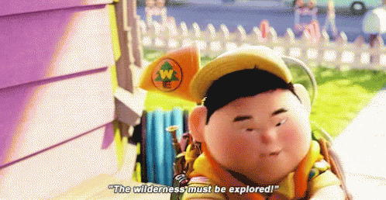
Step 1: Discover the Conflict

Slide 5
Step 1: Discover the Conflict
Relationship conflicts
Strong negative emotions, personality clash, misperceptions or stereotypes
Data conflicts
Lack of information, misinformation, disagreement about what is relevant
Interest conflicts
Competition over perceived incompatible needs
Structural conflicts
Caused by external forces (e.g., organizational structure, time constraints)
Value Conflicts
What is good or bad, what is right or wrong

Slide 6
Step 1: Discover the Conflict
What is the conflict about?
Embrace your intense emotions.
What is YOUR story?
What does this conflict mean to you?

Slide 7
Step 2: Explore Perspectives
Identity
Emotions
Power

Slide 8
Step 2: Explore Perspectives
How are you and the other person currently portrayed in this conflict?
What are you feeling in the current conflict?
What is the scope of the conflict?
What power dynamics are at play?

Slide 9
Step 3: Craft the Best Story
Shifting from a focus on what is, to what could be.
Envision the ideal future.

Slide 10
Step 3: Craft the Best Story
What is your vision of the best outcome?
What skills do you need to make that happen?
Inquire, Imagine, Innovate.
Craft the conflict story that brings you to an ideal future.
Get creative!

Slide 11
Step 4: Living Your Story
Effective conflict resolution requires teamwork and coordination between conflict partners.
Separate the people from the problem.
Focus on interests, not positions.

Slide 12
Step 4: Living Your Story
1) Reduce the noise
Be clear and concise. Don’t overstate things at risk of the other party feeling “buried” in the same message stated redundantly in different ways.
2) Consider the listener’s perspective
Reduce the potential for misunderstanding by considering what your message might mean to the listener.
3) Work to understand the intended message
Seek clarification when needed.
4) Be an active listener
Ask questions, clarify messages, and make an effort to get on the same page about what is being communicated back and forth.

Slide 13
Final Thoughts
Inevitable Conflict = A Lifetime of Stories
There is no blueprint! Every conflict is unique, requiring us to engage creatively and wipe our slate clean before each conflict journey.
We must embrace everyday peacebuilding.

Slide 14
Feel free to reach out to me with any questions in the future!
Brett M. Mallon, Ph.D.
bmallon@k-state.edu
Program Chair and Director
Conflict Resolution Program
Kansas State University

