Slide 1
Nursing & Risk
Villa St Francis

Slide 2
Under Catholic Community Health however we respect and welcome all residents as our value is to help those sick and underserved no matter their social determinations.
170 bed community
2 memory neighborhoods
1 rehab to home neighborhood
1 hospice suites
4 LTC dual certified bed neighborhoods.

Slide 3
What is a risky decision?
Decision made by the resident that might go against best medical practice or have safety risks. Such as allowing a diabetic to eat multiple cup cakes

Slide 4
When developing your community policy on risky decisions think about these core questions:
What do you expect of your staff?
How do you want the team to respond when a resident makes a risky decision?
What kinds of situations do you want the nurse to be directly involved with?
What kind of situations do you just want the team to tell the nurse about later?

Slide 5
For example:
I might be comfortable with a direct caregiver giving an resident with Diabetes a piece of pie and then inform the nurse, so blood sugar can be monitored.
I might be comfortable with a direct caregiver supporting a resident in the request to skip breakfast because they are not hungry. I would want that communicated to the team so food could be offered again later.
However, I might not be comfortable with a direct caregiver giving a requested steak to a person with a diet order for Pureed foods.
** As a team think about possible situations and decided how you want your team members to respond. The goal focus is to accommodate resident decisions while mitigating risks.

Slide 6
Policy and Procedures Development
Avoid Blanket policy- Dementia resident might not be able to sit outside alone but that does not mean a policy should be in place for no resident to be outside
Direct Care staff are empowered and supported by facility to respect resident decisions in the moment
Some examples-
Allowing resident to sleep and wake up at time of choice
Respect choice of having undisturbed sleep
Respect choice to bath
Staff can in the moment respect resident wishes to wear clothing of choice
Food of choice at time and place of choice
Access to funds and shopping during and after business office hours
resident wishes on hair style
respect wishes on activity of choice
MOST Important- answer can’t be “NO” use resources such as cell phones, resident summery, Kardex, house supervisor, management, nurse, PCC, family to help support and respect resident decisions.

Slide 7
Don’t forget like most everything else with PEAK respecting risky decision can starts on Admission
Prior to admission we have getting to know you forms we utilize to get to know resident's daily routines/likes/dislikes/community involvement/ family history.
We have found that knowing what someone did while at home prior to admission helps us respect risky decisions while they are here in our community.
For example, if a resident reports they always sleep in recliner at home even though they have multiple wounds we will provide education and options for pressure reliving bedding however if they choose to want to bring their recliner to sleep in, we respect those decisions on admission.

Slide 8
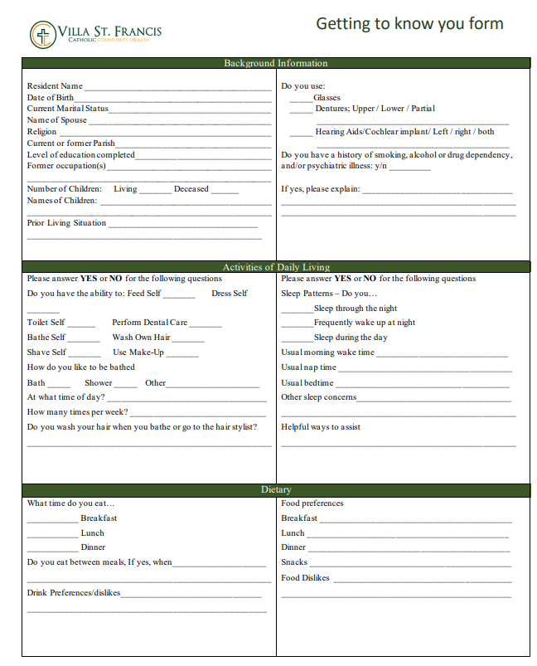
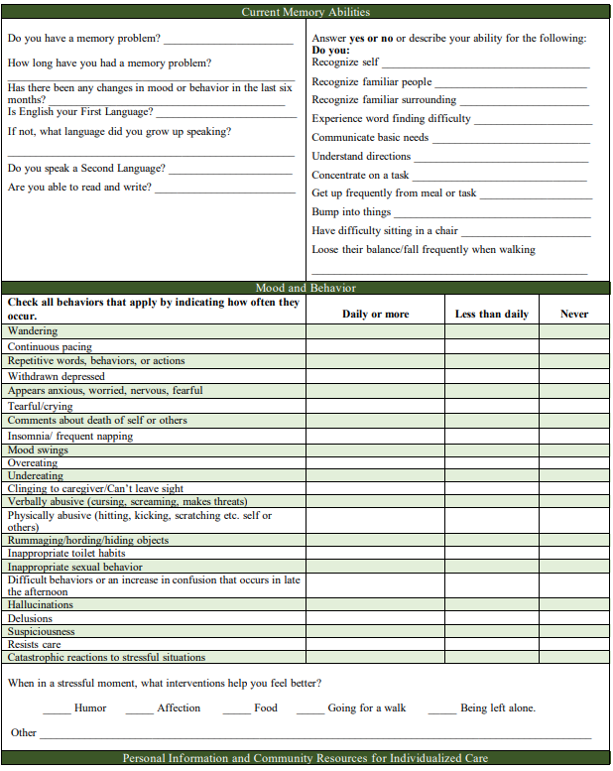
Getting to know you form

Slide 9
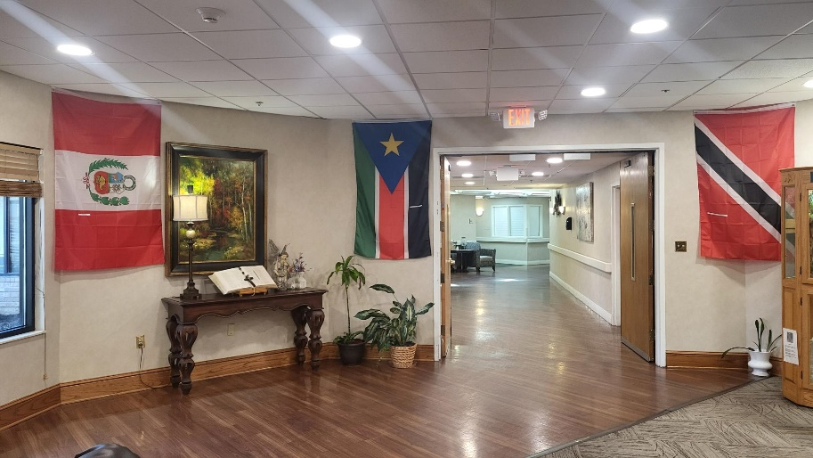
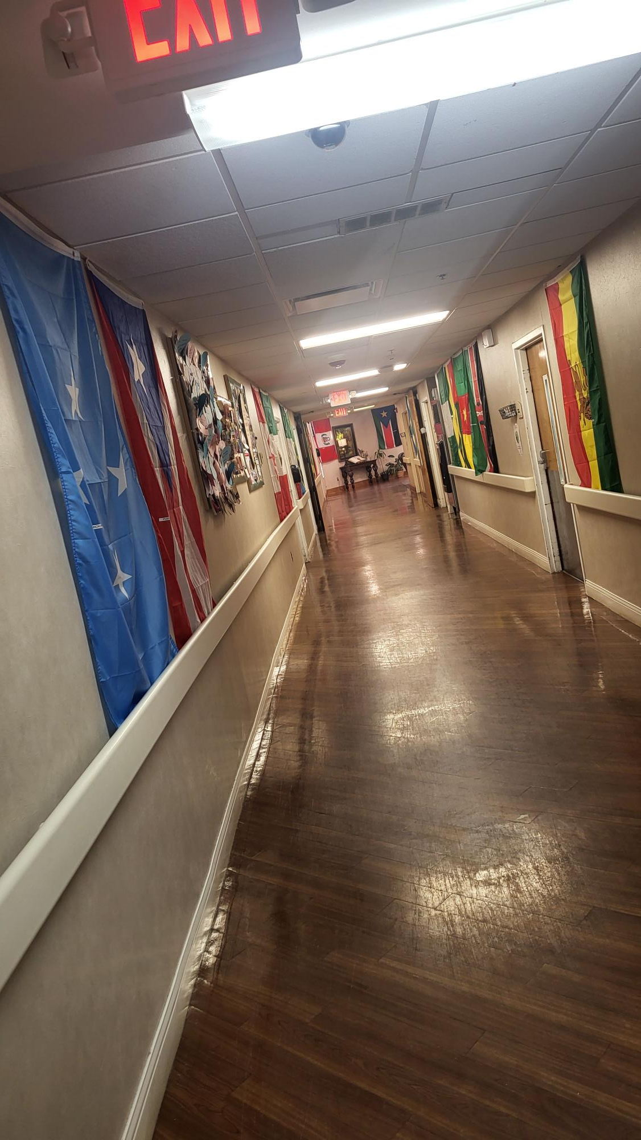
21 Countries of Origin

Slide 10
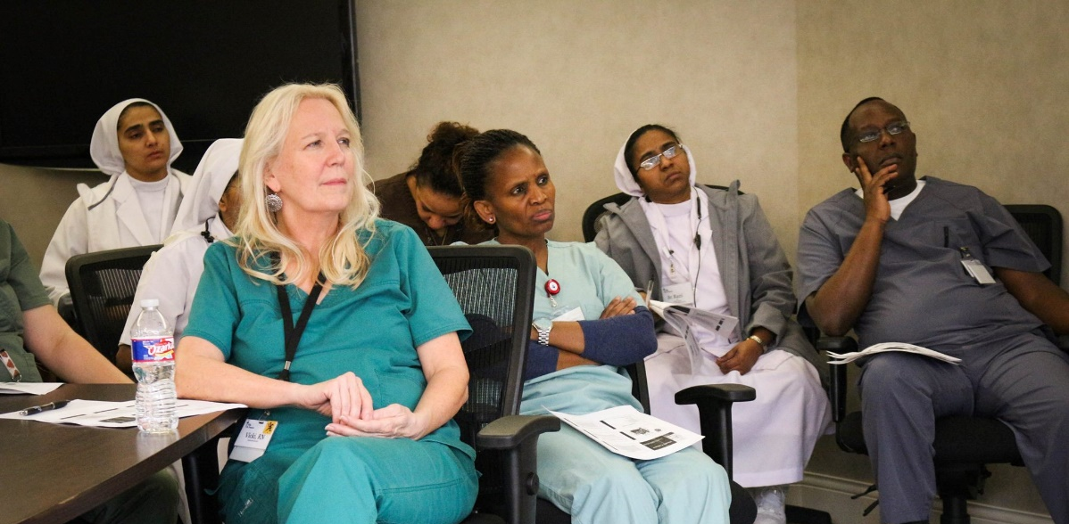
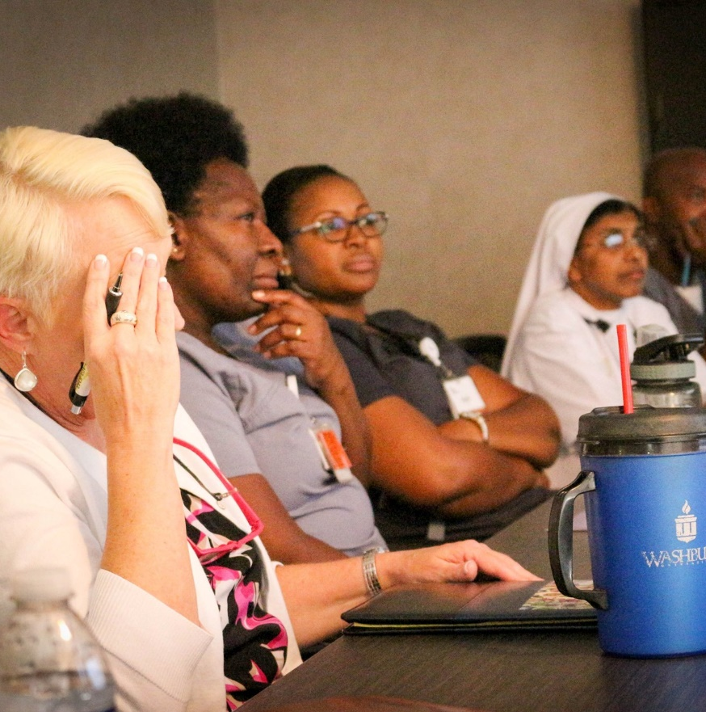
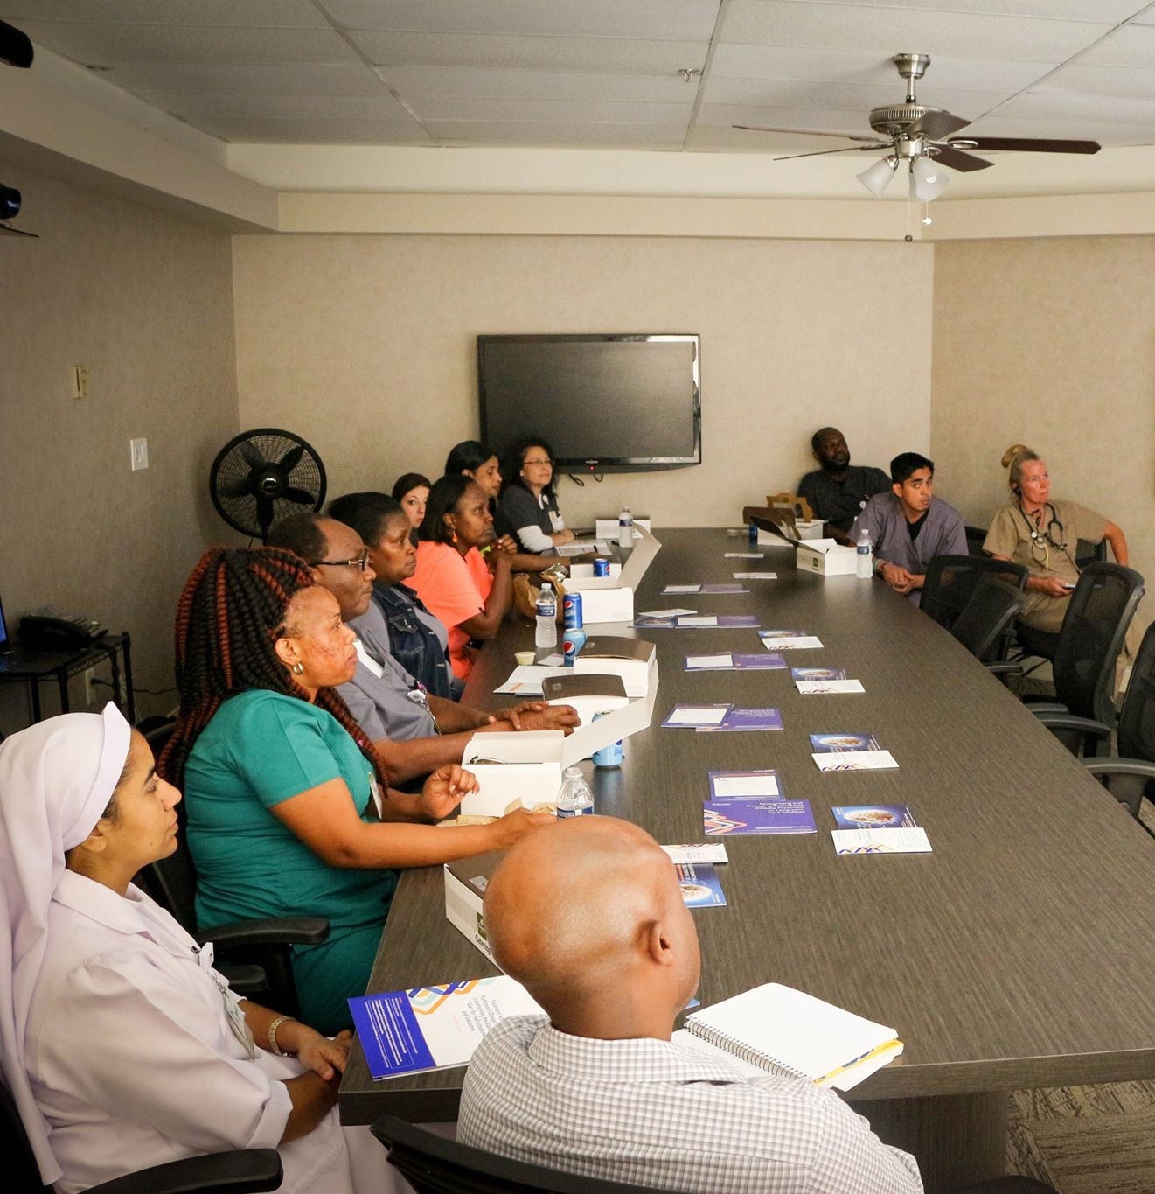
Thinking about training
Determine how to get the training to be received by our staff
Multiple countries
Multiple religions
Multiple back grounds

Slide 11
When training give examples and resources
When training give examples
Do 1 to 1 training to help with retention
Interpreters if needed for training
Small amount of information for training at a time
Review training that was completed and do ongoing education
We do on hire, during hire process with group orientation, every spring and fall. Also, on going as needed if any trends. We have PEAK built into our Monthly QAPI program.

Slide 12
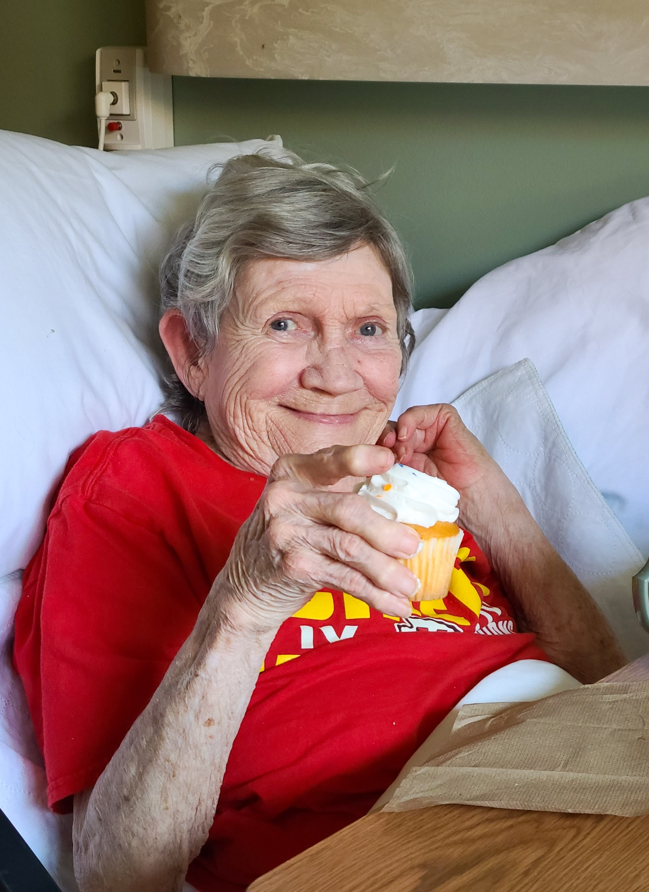
Respect choice of having undisturbed sleep even if resident is incontinent and/or not able to self-position- (only if resident choice, not for staff convenience, staff cannot neglect resident by keeping them in bed for staff convivence)
Staff can offer extra absorbent brief that is stocked in brief closet and accessible to staff.
Staff can offer extra pillows before going to sleep for undisturbed sleep to help off load while sleeping
If resident declines both staff can respect wishes in the moment without needing approval from nurse or management. Staff are to report to nurse after choice is respected.
talk with resident about risk of skin break down with not moving in bed at night
talk with resident about infection risk with incontinence and wet skin
talk about skin break down with having incontinence and wet skin

Slide 13
Respect choice to bath or not bath
Talk to resident about infection risk with not bathing or keeping self-clean
Talk with resident about risk for skin break down when skin not kept clean.
3. Staff can give alternative options such as:
Spa tubes
bed bath,
towelettes,
shower cap wash,
Sink wash up
4. If resident decline alternatives, then staff can respect their wishes in the moment without needing approval from nurse or management. Staff are to report to nurse after choice is respected.

Slide 14
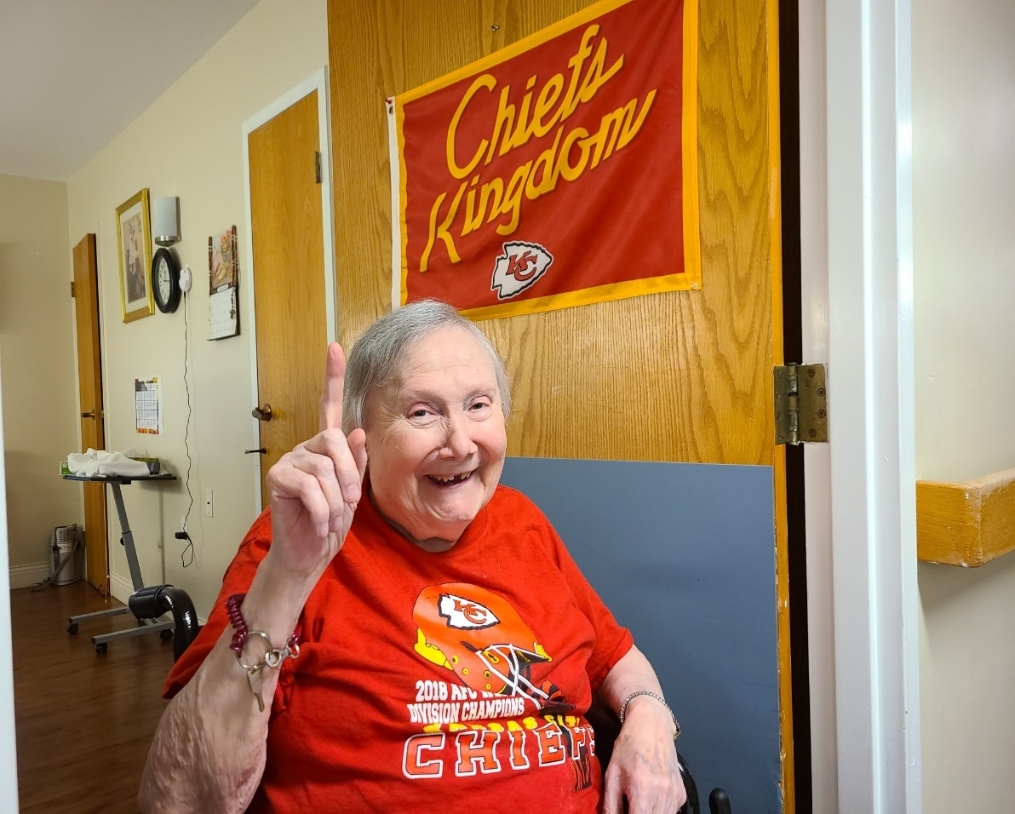
Staff can in the moment respect resident wishes to wear clothing of choice. Such as night gown during the day, pajamas during the day, jeans to bed, etc.
1. Staff to speak with resident about attire and offer choices and respect those choices even with resident with dementia
2. Staff to talk with resident on risk of dignity with clothing choices
3. Staff are Not supported by VSF to allow resident to wear no clothing out of room or clothing that does not cover private areas on body. In these cases Direct care staff are to refer to their nurse

Slide 15
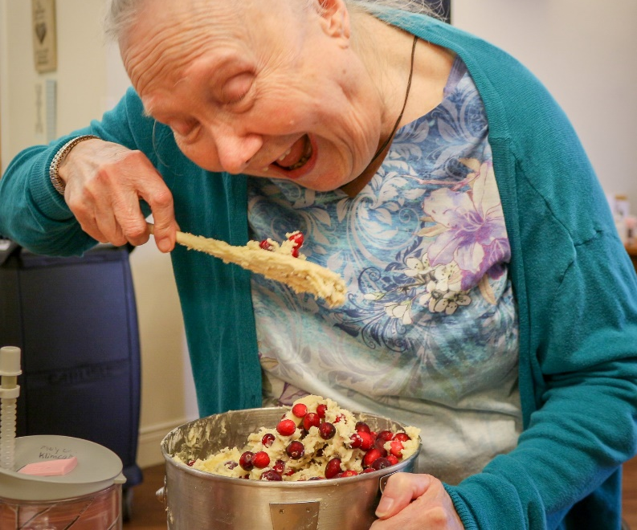
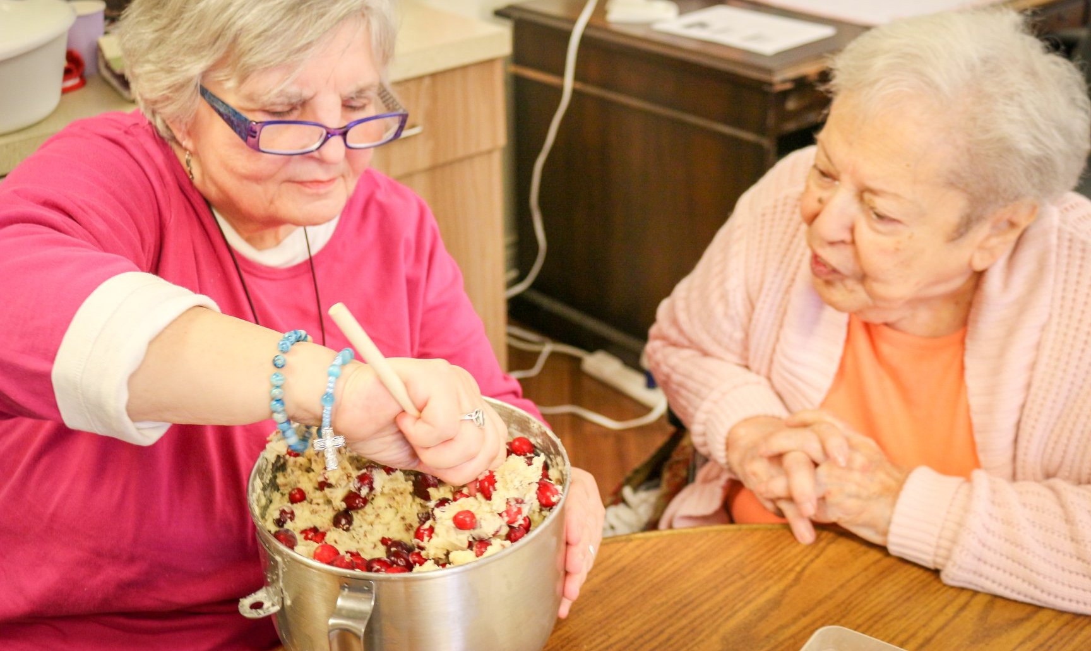
Staff have access to always available menu for resident and can order or make resident food
Staff can respect resident wishes in the moment and order or serve any food or fluids even if resident has dx such as CHF, DMII. – Staff to notify nurse of resident choice after serving so nurse can know if monitoring is needed.
Staff can respect resident wishes and order food/drinks for resident even if resident already had several meals that day. (see 24 hours kitchen training)
Direct care staff are NOT supported by facility to provide diet that is not ordered by physician. Example staff are NOT able to provide a full piece of steak to a resident who is on a puree diet. Staff are to notify charge nurse for these situations.
***When unable to say yes in moment with risk staff should still not use verbiage such as “ I’ll go ask the nurse” I need to ask the nurse” this indicates to resident that nurse has final say over their life not them having choices. Instead try to use verbiage of “Ok, let me see what I can do about this”

Slide 16
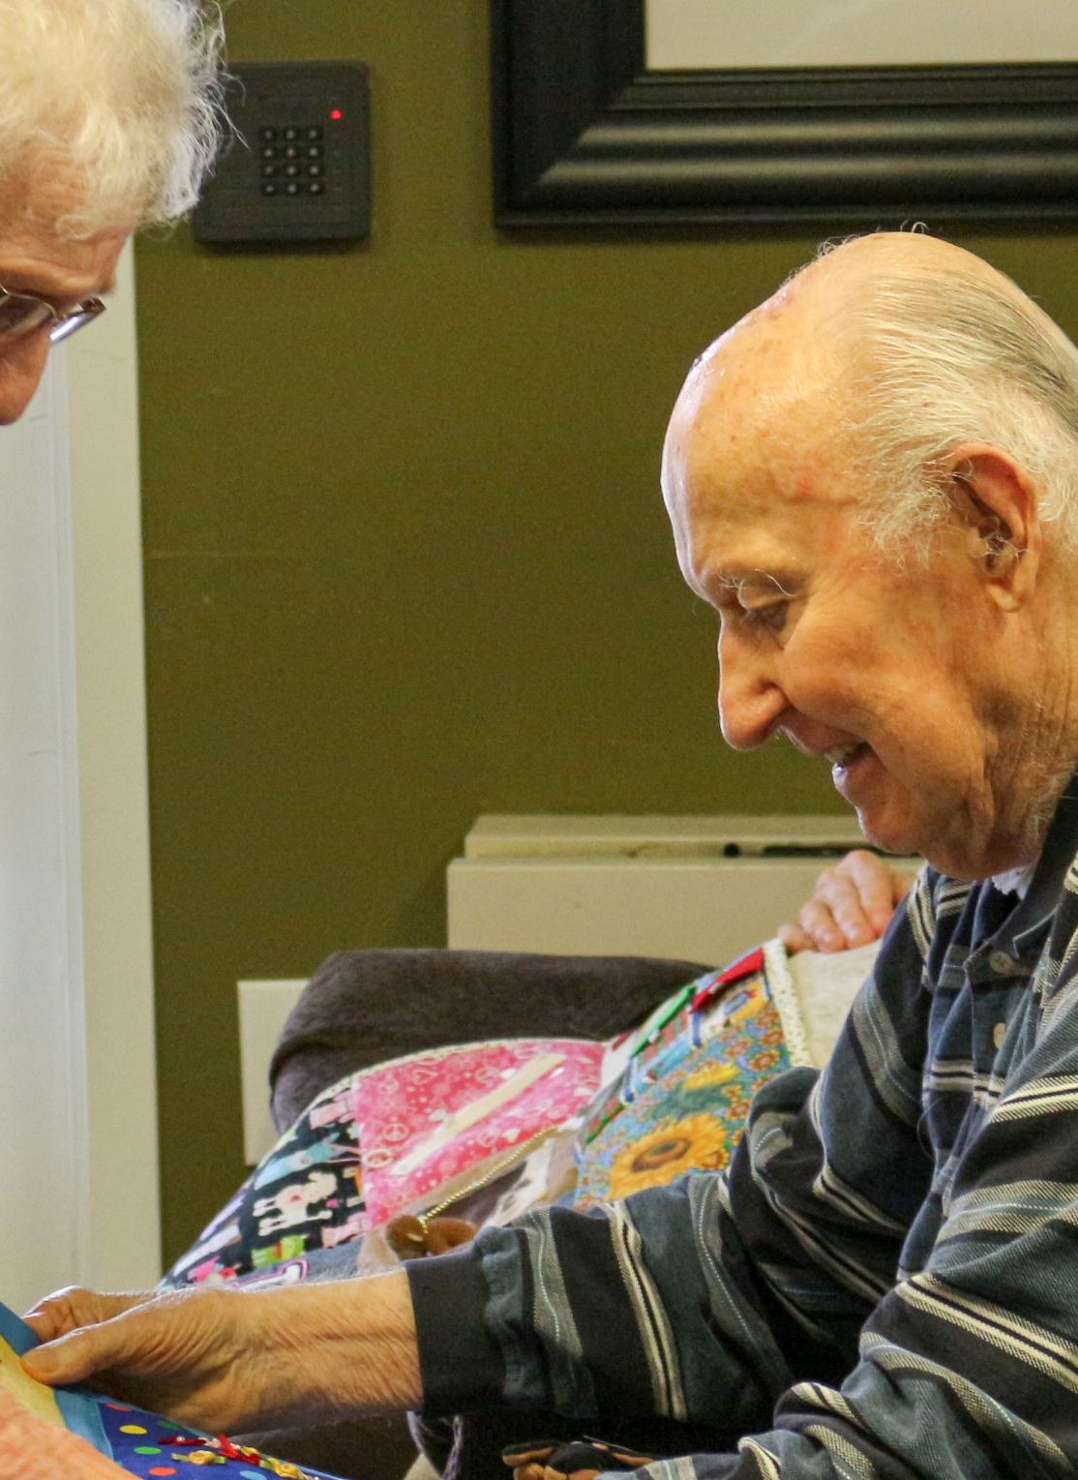
Staff can in the moment respect resident choice to not have room cleaned or laundry put away
Staff can talk with resident on infection risk with room not being cleaned
Staff can talk with resident about safety risk such as trips with room not being cleaned.
Staff can offer small cleaning and or later time of day to clean.
Staff are NOT supported to leave spills on floor in room. If resident request not cleaned, then staff are to report to nurse immediately.

Slide 17
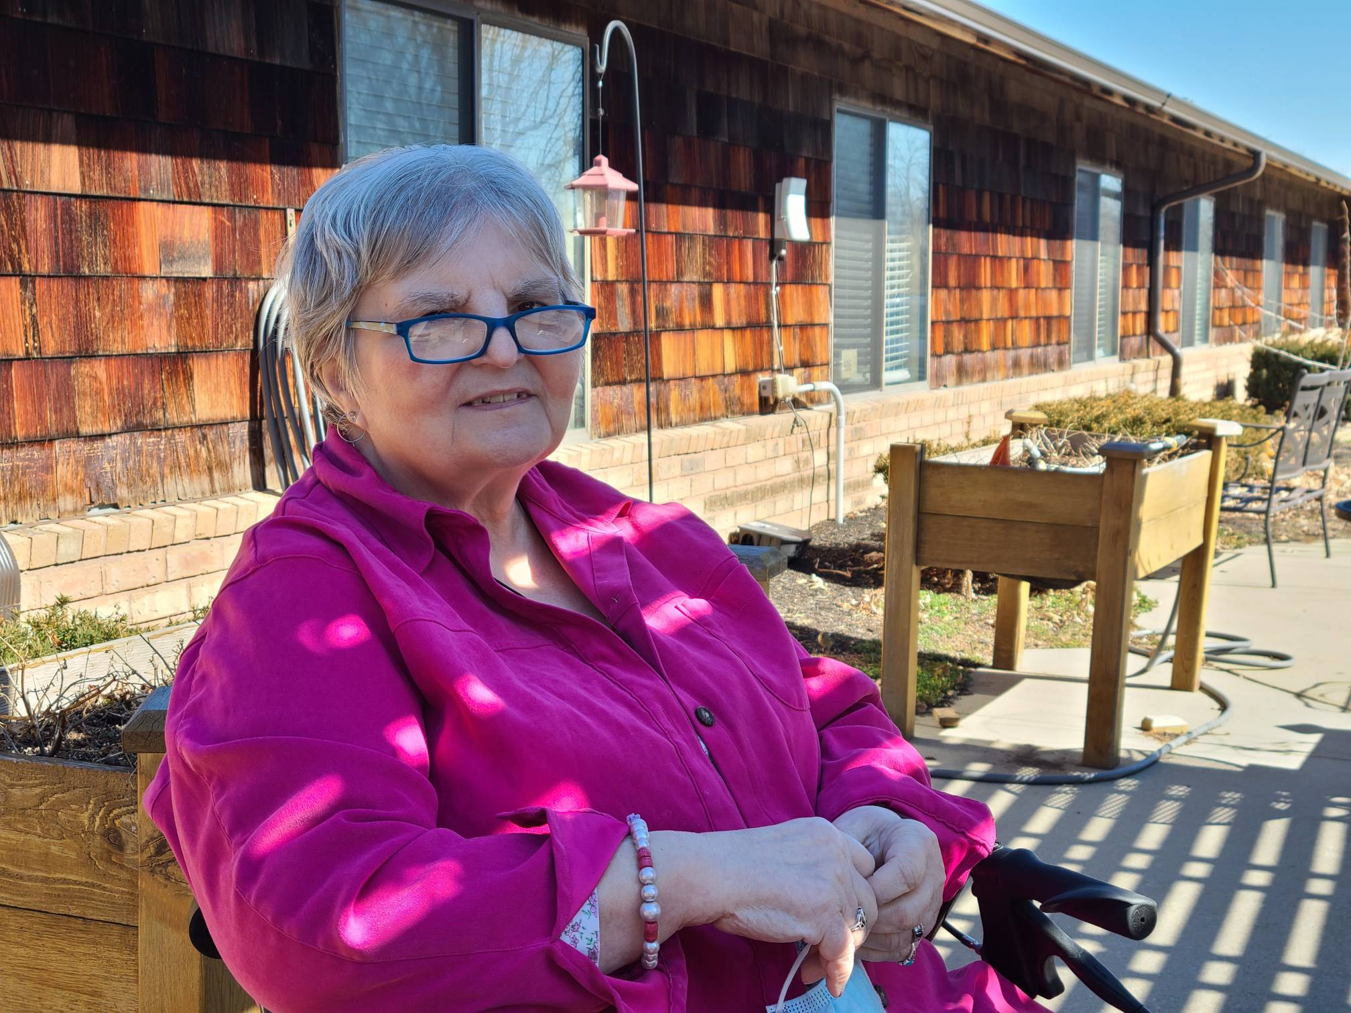
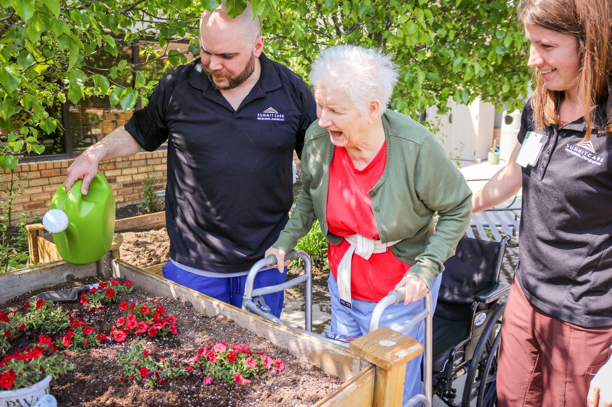
Staff can respect wishes on activity of choice
Staff can assist resident to any activity they would like to attend.
Staff can also respect wishes if resident does not want to attend activity even if family told staff to take them.
Staff can respect wishes to go outside even if hot. Staff to go tell nurse after respecting wishes

Slide 18
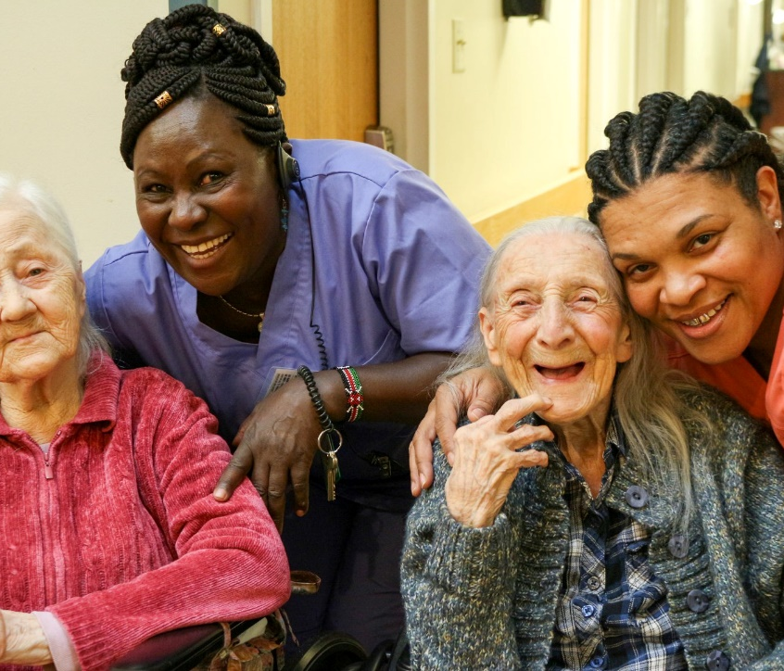
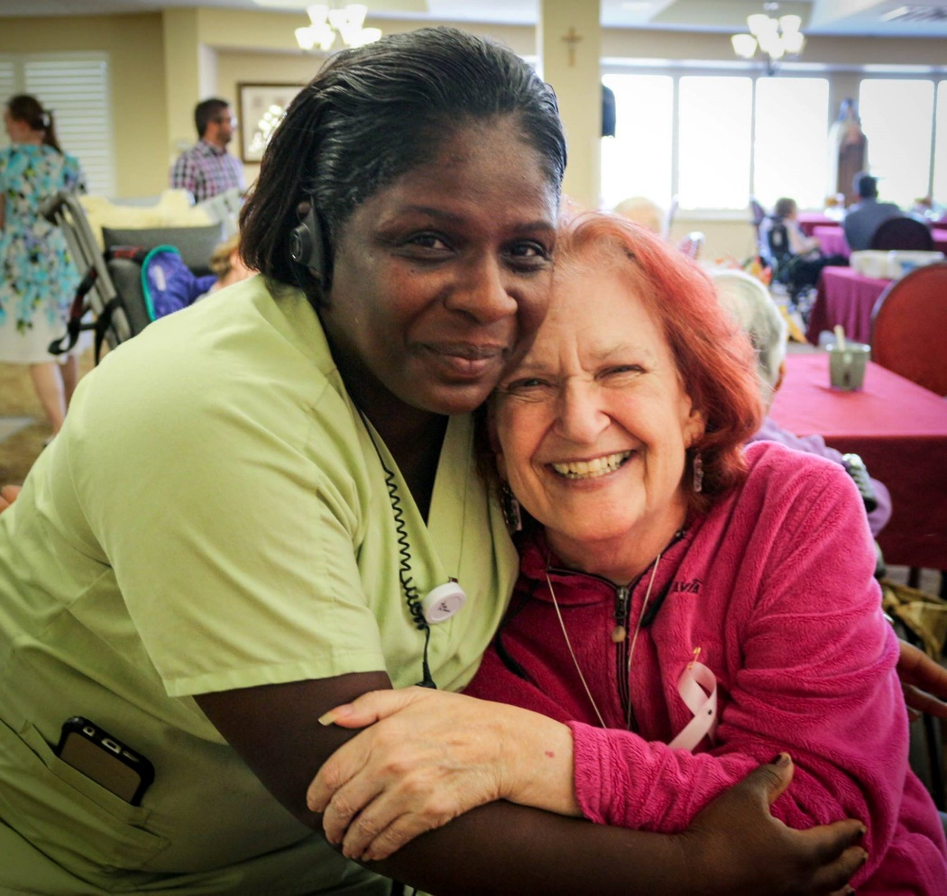
Family and resident choices/rights
Staff can in the moment talk with family about resident choices. Staff also can utilize phones and call for other support if needed such as nurse, Social Services, management to talk with family about resident choices and risks.
Example:
If resident family wants resident to get hair cut/ permed and resident states, they do not want to get hair done. Staff are to respect resident wishes in the moment and educate family of their choices.
If family states they want mom/dad up and out for activity. But resident tells you he/she does not want to go to activity; Staff should respect resident wish in that moment and education family on resident choices. This is the resident right to do activity of their choice.

Slide 19
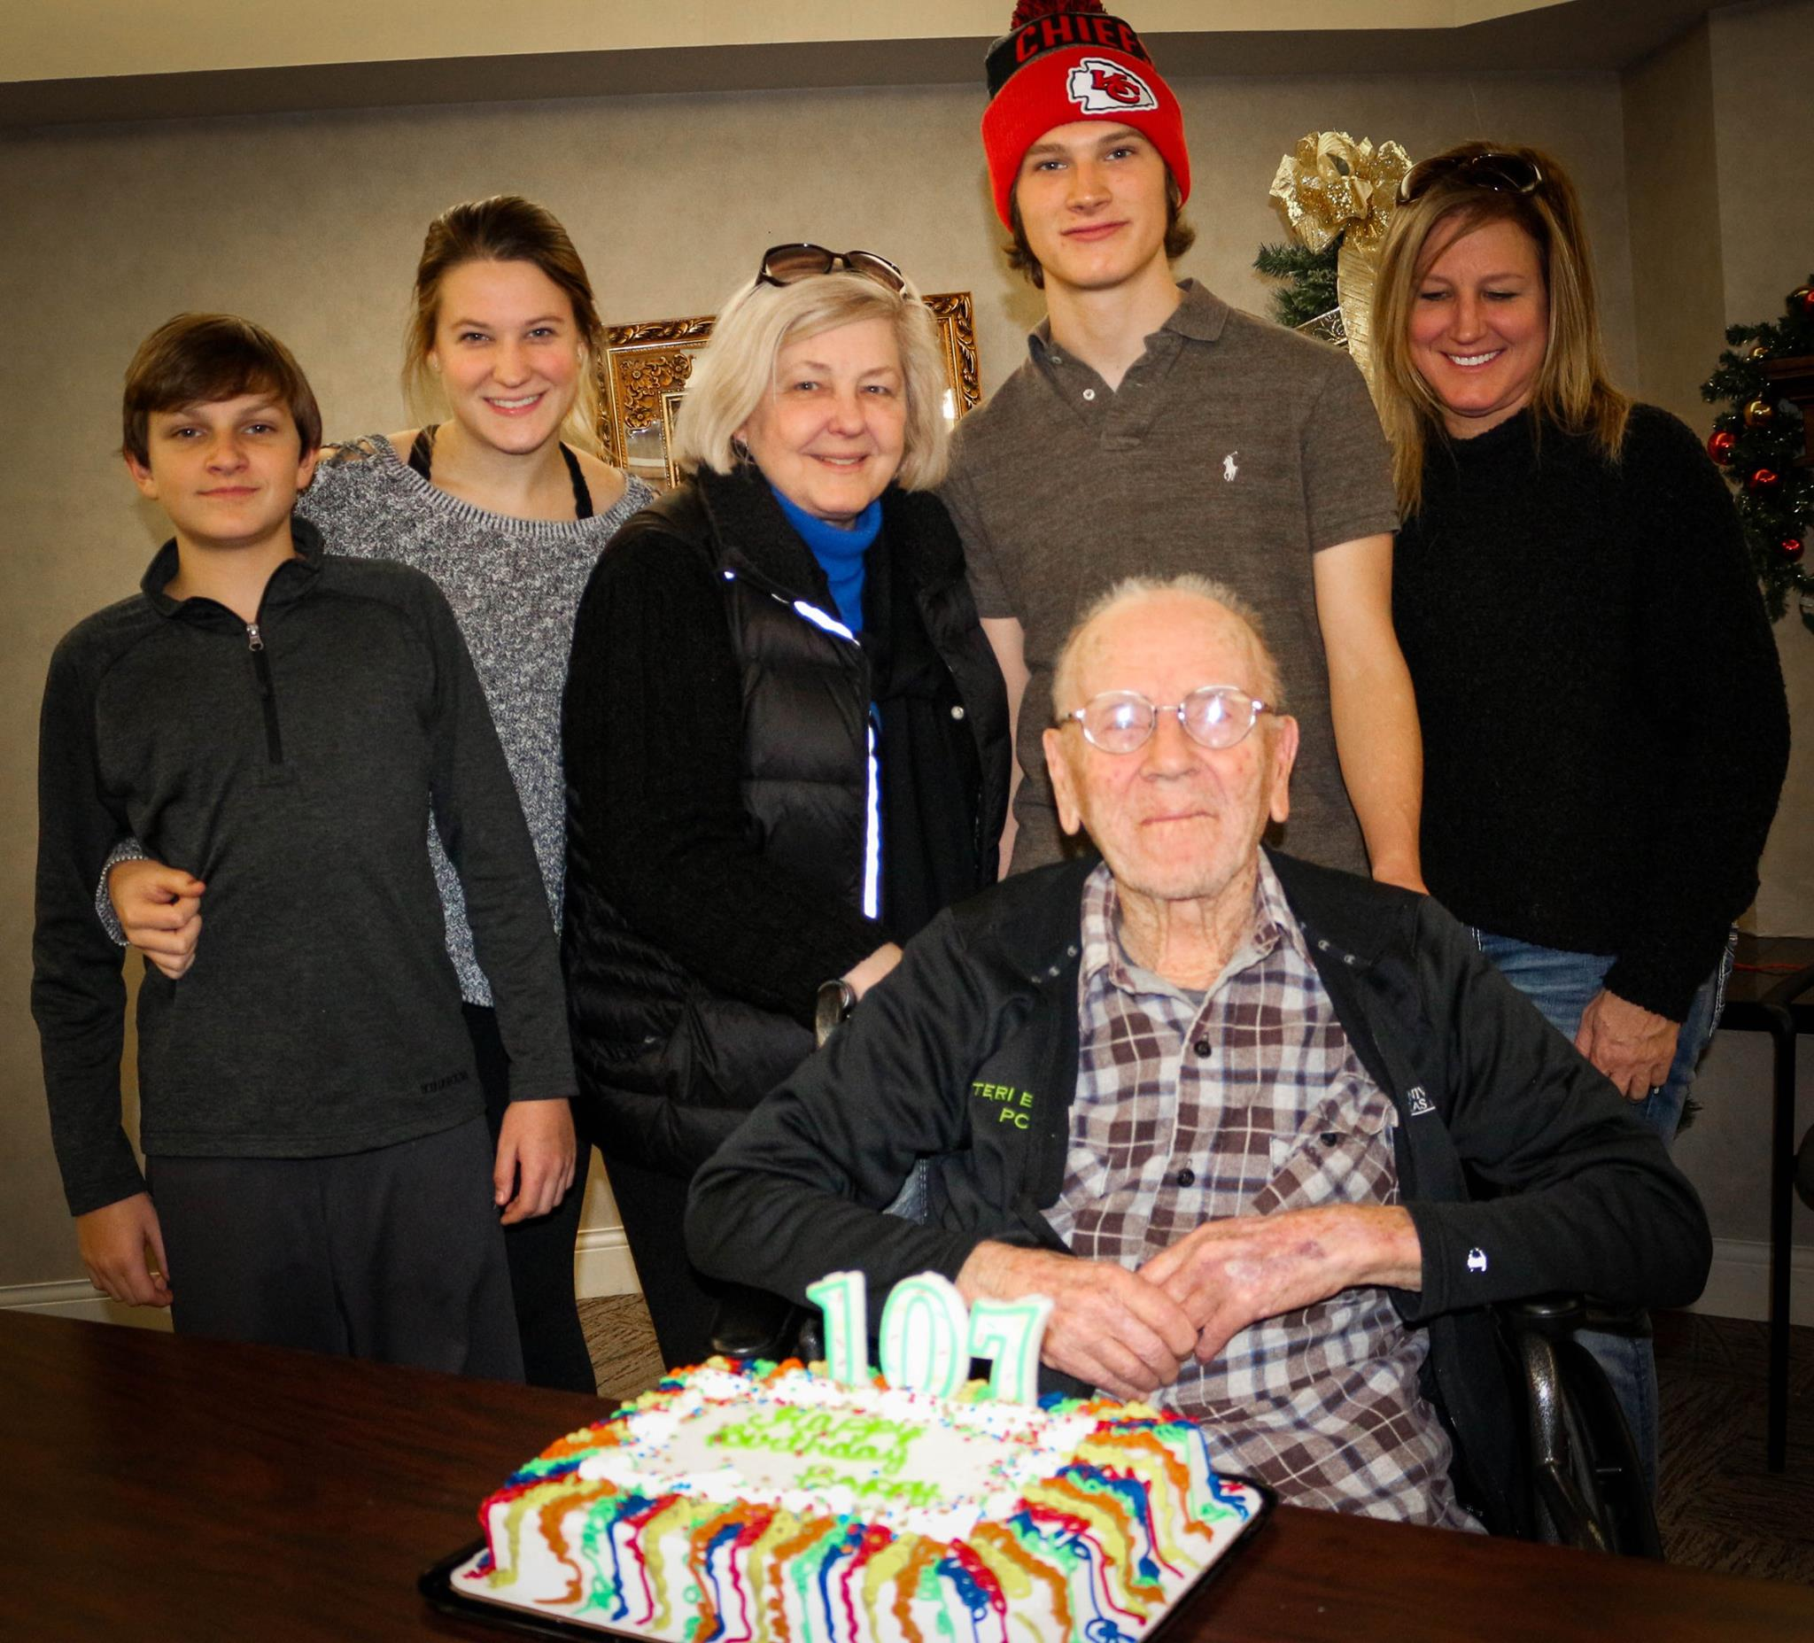
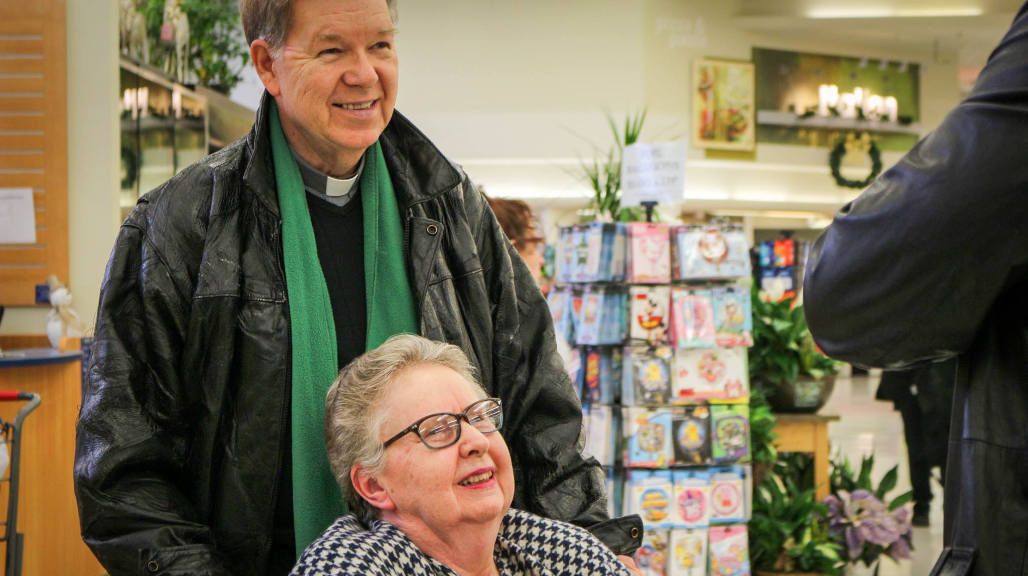
Transportation- resident have rights to go on outings as they should choose. This is for the residents. Staff not to use this to get out of work for a few hours. Do Not except money or them to buy you items or food on outings.
Staff can educate resident on risk factors such as safety when wanting to uber
Staff are to assist resident when they want to go on outings.
Staff can assist resident on getting out their resident funds from cubex
3. Uber/transportation list

Slide 20
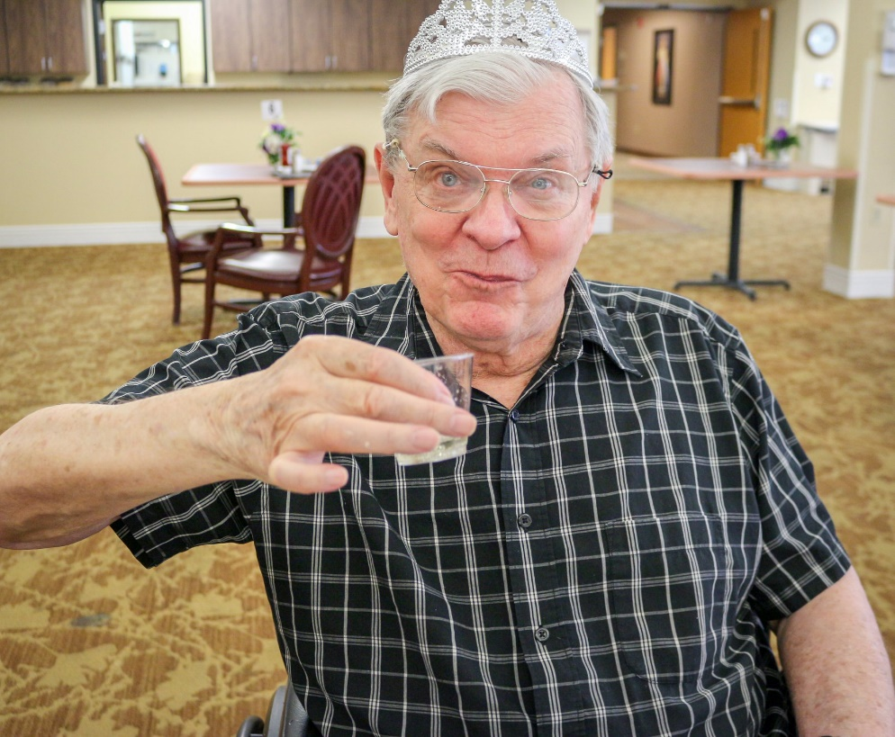
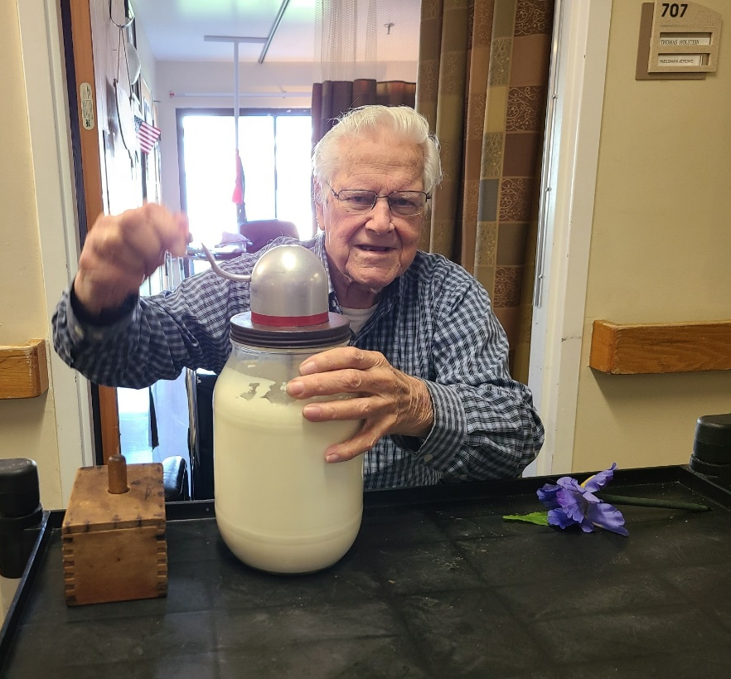
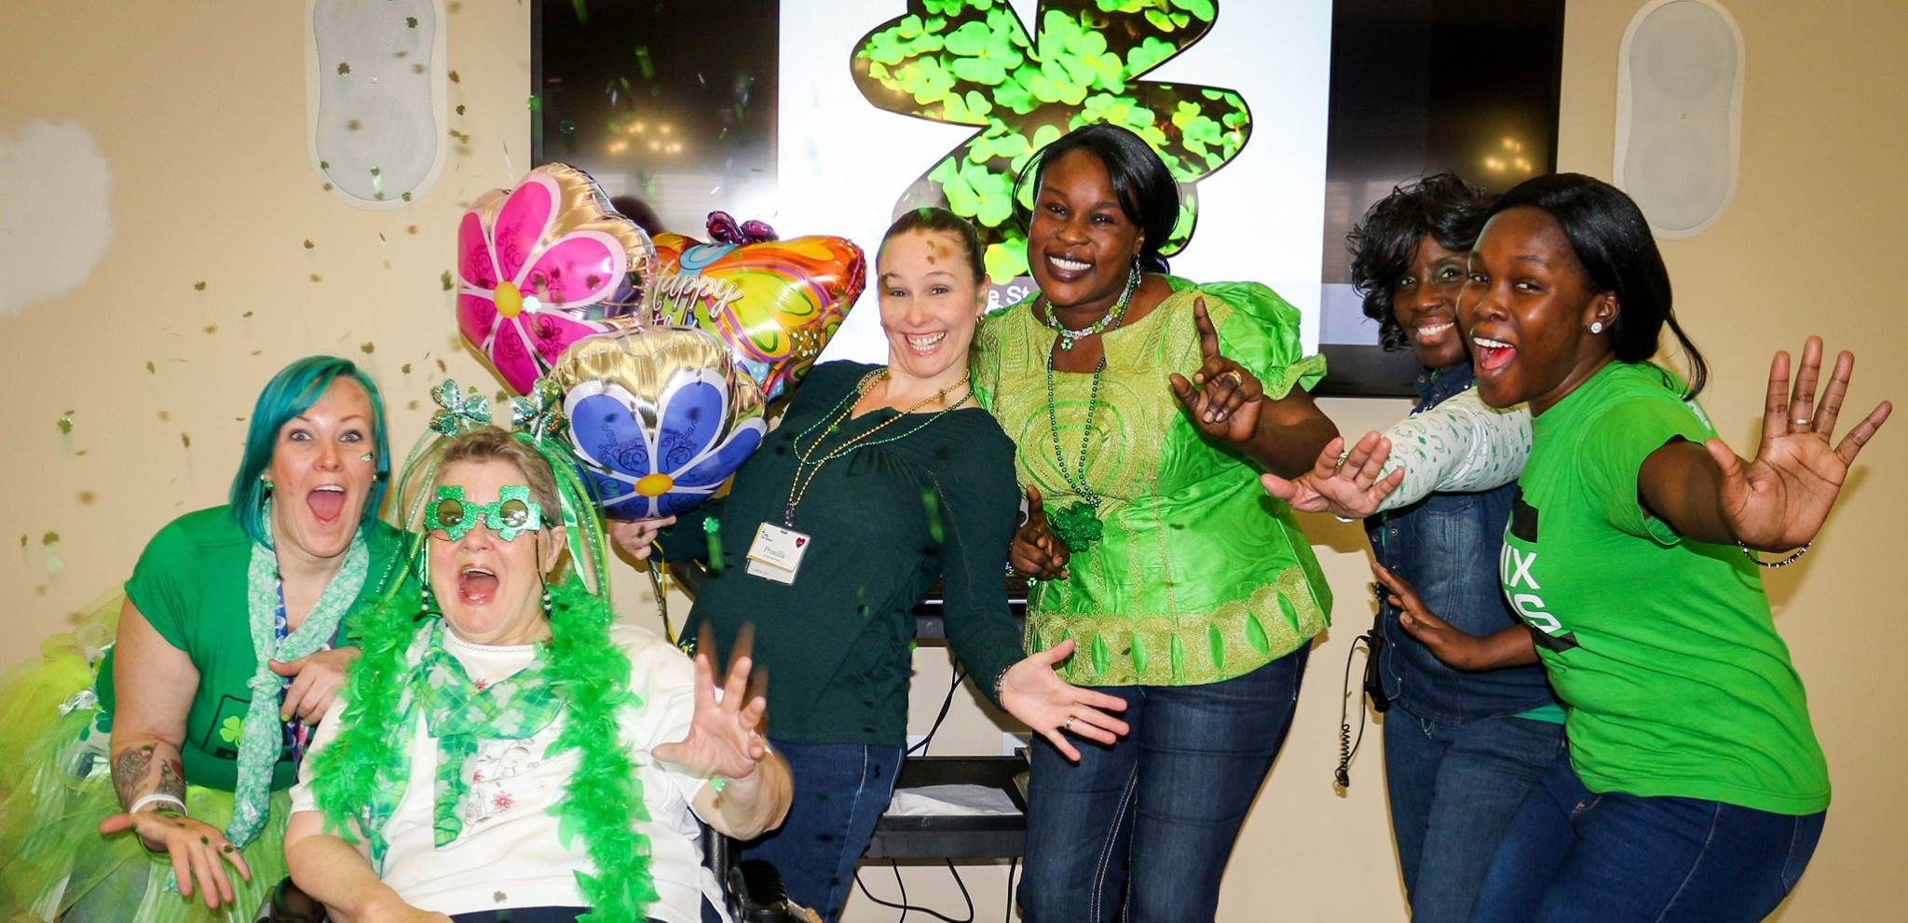
Remember Key things
This is their home, and they have the choices to live the way they want.
We are required to educate elders about the consequences of their decisions. All team members should understand that while they are expected to support resident decisions, they are also responsible to educate residents of any potential consequences or health risks that might result from their decision
Talk about alternatives your direct care staff can offer and different staff approaches that might be used
If resident choices are on a routine basis such as always wanting to eat just desert, please update resident summery/ Care plan
Encourage team members to make decisions on an individual basis. Avoid “blanket policies”.
Utilize resources such as Kardex/resident summery/care plan that have resident preferences on them and respect wishes

Slide 21
QUIZ

Slide 22
1. Bob daughter was here this morning and saw on activity calendar that BINGO is today. She asked you to take Bob to BINGO at 2pm. Bob has Dementia, and you know his daughter is his DPOA. When it comes time to take bob to BINGO Bob tells you he is tired and wants to lay down. You should:
Tell Bob his daughter wants him to go to Bingo
b. You tell him he always has a good time and should go to be with his friends.
c. Assist Bob to lay down
d. Tell Bob that Bingo is only today and if he misses it he won’t be able to play till next week.

Slide 23
It is 1130 and Jane is coming back from an activity. Jane asks you to lay her down because she is not hungry and does not want to eat lunch. You know she is a diabetic and it’s almost noon. You should:
Tell Jane that its almost noon and she needs to have her blood sugar checked and eat
Tell Jane that she can eat lunch and then lay down
Tell her you are about to go to help in the dining room and will not be available to help her get back up if she changes her mind.
Assist Jane to lay down per her wishes, then notify nurse

Slide 24
You get to your neighborhood at the beginning of your shift. You notice that John is still in bed. John normally is up and greets you when you arrive. You should:
Make sure you go to his room first and wake him up
Get report from night shift about John
Tell the nurse. Then you and the nurse go and wake him up to make sure he is okay
Turn on the light in his room and see if he wakes up

Slide 25
It is 2am and Mary who has Dementia wakes up. She thinks it is morning time and gets dressed for the day. She asks you if she can have pancakes and sausages. You should:
Tell her no because she is a Diabetic and can’t eat that food
Tell her it is the middle of the night, and she needs to go back to bed and can have breakfast later in the morning when it's time.
Tell her if she eats now, she will be hungry before lunchtime and she will gain weight if she eats too many meals in one day.
Get her the food she requested. Then notify the nurse.

Slide 26
Jake has Dementia and has an incontinence episode. Daughter tells you that Jake needs to be taken to shower and cleaned. Jake tells you “NO” I don’t want a shower. You should:
Take him to the shower because his daughter told you to, and she is standing there and will be mad if you do not
Tell the daughter she must make him take the shower
Offer other cleaning options such as towelettes, sink bath.
Tell Jake you are taking him to the living room to get him to go with you then trick him into the shower room.

Slide 27
Debbie's daughter tells you that her hair is getting long and to please take her to beauty shop tomorrow to have it washed, cut, curled. When it is Debbie scheduled time for her hair appointment Debbie tells you that she does not want her hair cut or curled. She wants it to grow out. You should:
Call the daughter so she can tell Debbie she needs her hair to be cut
Turn on the TV to distract Debbie while the beautician cuts her hair.
Tell the beautician what Debbie said so she can respect her wishes to only wash her hair.
Tell Debbie you will make a deal with her. If she cuts her hair, then she does not have to curl it.

Slide 28
YOU HAVE THE POWER TO SUPPORT RESIDENT CHOICE !!

Slide 29
References /Contact
PEAK Website-
https://www.hhs.k-state.edu/aging/research/peak20/pcc-resources/
Catholic Community Health Website-
https://catholiccommunityhealth.org/
Kacie Lynn
Number- 913-747-0281
Email - klynn@catholiccommunityhealth.org

