Slide 1


Educator Instructions
REMOVE THIS SLIDE
BEFORE PRESENTING
Customize this presentation to fit your needs. Please add or remove content.

Slide 2


Climate change is a global challenge that is not in debate among climate scientists.
SCIENCE CONSENSUS REGARDING CLIMATE CHANGE
ATHENAS is a multi-national Initiative funded by the U.S. Department of Agriculture
Notes:
Educators have the responsibility to focus on facts and evidence with students.
The purpose of this module is to explain the agreement, or consensus, scientists have reached on climate change.

Slide 3
SCIENTIFIC CONSENSUS REGARDING CLIMATE CHANGE IS DEFINITE
There is a strong scientific consensus that the global climate is changing and that human activity contributes significantly.
Human-induced climate change is caused by greenhouse gas emissions from industry, transport, agriculture and other vital economic sectors.
Notes:
Some of the things that underpin this scientific consensus.

Slide 4
SCIENCE CONSENSUS REGARDING
CLIMATE CHANGE
The Intergovernmental Panel on Climate Change (IPCC), which was formed by the World Meteorological Organization (WMO) and United Nations Environment Programme (UNEP) is one of the major bodies of scientists who are studying the scientific findings and reporting conclusions to the scientific community and public. See the full report by the WMO published in March of 2013.
According to the California’s Office of Planning and Research, approximately 200 scientific organizations support the consensus position - human actions are responsible for climate change.

Slide 5
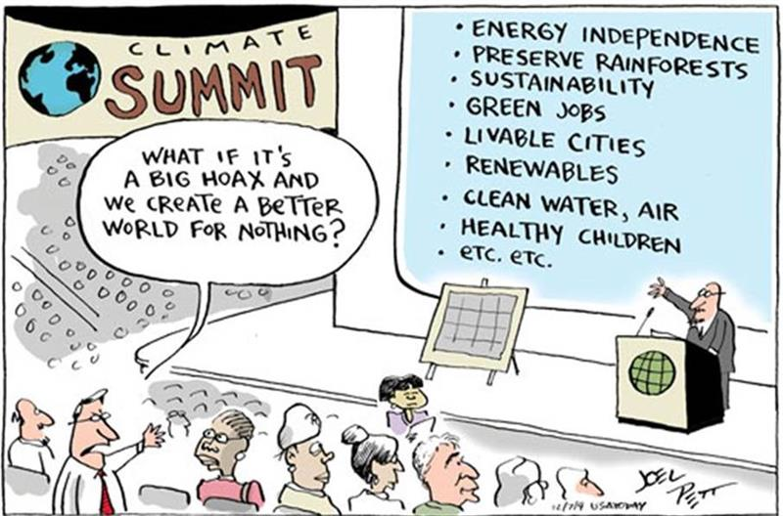
SCIENCE CONSENSUS AND THE CLIMATE CHANGE DEBATE
Source: Joel Pett, Lexington Herald-Leader Cartoonist, USA Today, December 7, 2009

Slide 6

CLIMATE CHANGE REQUIRES URGENT ACTION
Humanity is the major influence on the global climate change observed over the past 50 years. Rapid societal responses can significantly lessen negative outcomes.
Source: The American Geophysical Union (Adopted 2003, revised and reaffirmed 2007, 2012, 2013) Human‐Induced Climate Change Requires Urgent Action (2013)

Slide 7
ENTITIES THAT HAVE IDENTIFIED THEIR CONSENSUS THAT CLIMATE CHANGE IS HAPPENING
U. S. National Academy of Sciences
The American Meteorological Society
The American Geophysical Union
American Association for the Advancement of Science
American Chemical Society
American Medical Association
American Physical Society
The Geological Society of America
U. S. Global Change Research Program
Source: http://climate.nasa.gov/scientific-consensus/
Notes:
This is a selected list of scientific organizations that have published statements articulating consensus on climate change.

Slide 8
CLIMATE CHANGE IS REAL
Comprehensive scientific assessments of our current and potential future climates clearly indicate that climate change is real, largely attributable to emissions from human activities, and potentially a very serious problem.
Source: American Chemical Society (2004) ACS Public Policy Statement: Climate Change (2010-2013)

Slide 9
OVER 200 WORLDWIDE SCIENTIFIC ORGANIZATIONS AGREE THAT CLIMATE CHANGE IS HAPPENING
For a list of scientific organizations that have come to this consensus,
visit this website:
http://opr.ca.gov/s_listoforganizations.php

Slide 10

Pacific Institute for Climate Solutions provides Climate Science Basics learning modules at this website http://pics.uvic.ca/education/climate-insights-101
Teachers TV Climate Changes: The Causes (13:41 minutes) https://www.youtube.com/watch?v=RHrFBOUl6-8
It's Okay To Be Smart presents Why People Don't Believe in Climate Science (7:33 minutes) https://www.youtube.com/watch?v=y2euBvdP28c
It's Okay To Be Smart presents Climate Science: What You Need To Know (6:19 minutes) https://www.youtube.com/watch?v=ffjIyms1BX4
MORE INFORMATION
AND RESOURCES

Slide 11



