Slide 1


Educator Instructions
REMOVE THIS SLIDE BEFORE PRESENTING
Customize this presentation to fit your needs. Please add or remove content.

Slide 2
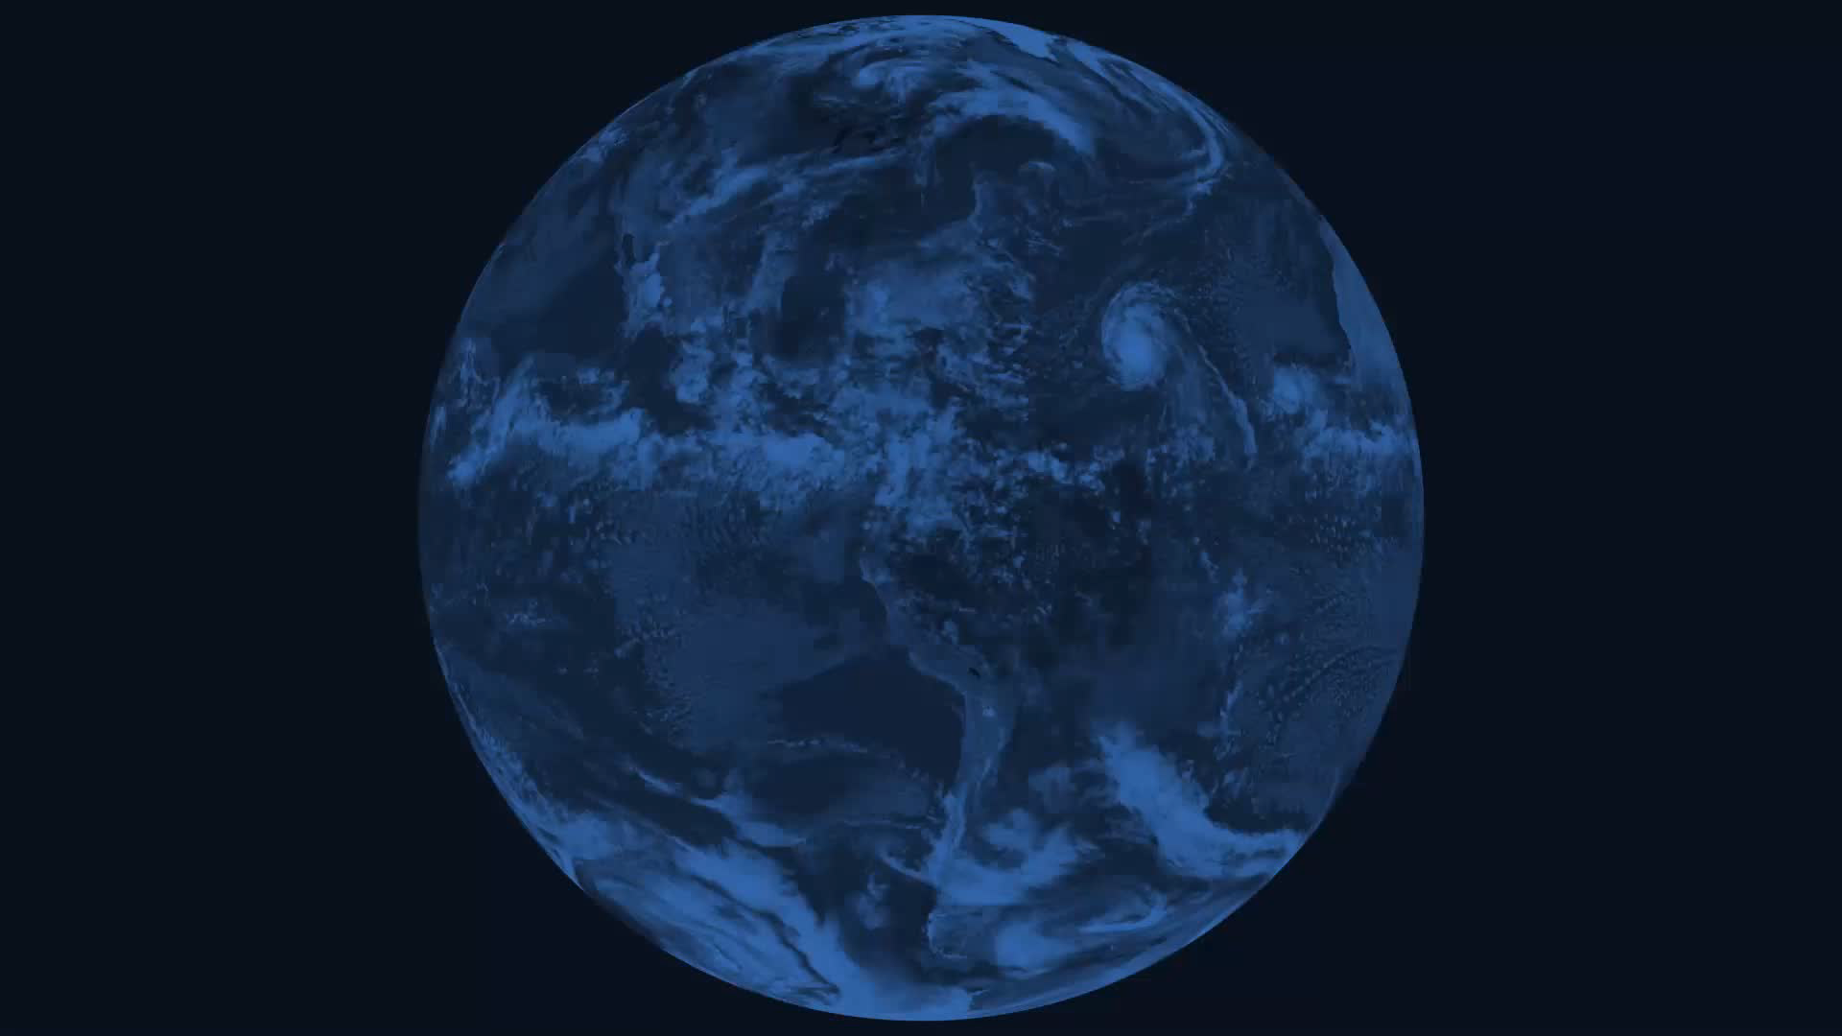

The purpose of this section is to explain the climate system. An understanding of how the climate system works to maintain the Earth’s energy balance is necessary to understand how the changes we see in our environment are forcing warming and other related changes that are collectively known as climate change.
CLIMATE SYSTEM
ATHENAS is a multi-national Initiative funded by the U.S. Department of Agriculture

Slide 3
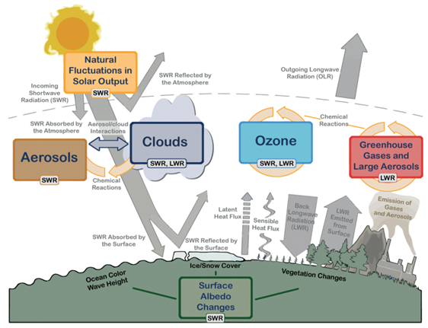
WHAT CONTROLS EARTH’S CLIMATE?
Source: Cubasch, U., D. Wuebbles, D. Chen, M.C. Facchini, D. Frame, N. Mahowald and J.-G. Winther, 2013: Introduction. In: Climate Change 2013: The Physical Science Basis. Contribution of Working Group I to the Fifth Assessment Report of the Intergovernmental Panel on Climate Change [Stocker, T.F., D. Qin, G.-K. Plattner, M. Tignor, S.K. Allen, J. Boschung, A. Nauels, Y. Xia, V. Bex and P.M. Midgley (eds.)]. Cambridge University Press, Cambridge, United Kingdom and New York, NY, USA, pp. 119–158, doi:10.1017/CBO9781107415324.007.
Notes:
An illustration of the interdependent aspects of the Earth's climate system relative to the Earth's energy balance.

Slide 4

HOW DOES THE CLIMATE SYSTEM WORK?
Notes:
https://youtu.be/lrPS2HiYVp8

Slide 5
THE CLIMATE OF THE EARTH IS CONTROLLED BY THE EARTH’S ENERGY BALANCE
Energy flows into the Earth from the Sun and flows out when it is radiated into space.
The Earth’s energy balance is determined by the amount of sunlight that shines on the Earth (insolation) and the characteristics of the Earth’s surface and atmosphere that act to reflect, circulate and re-radiate this energy.
This video describes how NASA monitors the Earth's energy flows: http://pmm.nasa.gov/education/videos/real-world-monitoring-earths-energy-budget-ceres

Slide 6
INSOLATION
The measure of the amount of solar radiation (energy) falling on a surface and it is a very important factor in determining the climate of the Earth.

Slide 7
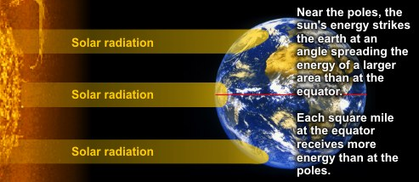
THE EFFECTS OF VARYING INSOLATION ON OUR CLIMATE
Source: http://www.srh.noaa.gov/jetstream/tropics/tropics_intro.htm
Notes:
Sunlight falls most directly on the equator, and only obliquely (at an angle) at the poles. This means that sunlight is more concentrated at the equator. The same amount of energy covers twice as much area when it strikes at an angle of 30 degrees compared to when it strikes a surface directly. The energy striking the Earth indirectly has less ability to warm the Earth because there is less energy per unit of surface area than when the sunlight strikes the surface of the Earth more directly.
This difference explains why the equator has a hot climate and the poles have a cold climate. Differences in insolation also explain the existence of seasons.
For many years now, satellites have been monitoring these energy flows using spectrometers that measure the intensity of energy at different wavelengths flowing to the Earth and from the Earth.

Slide 8
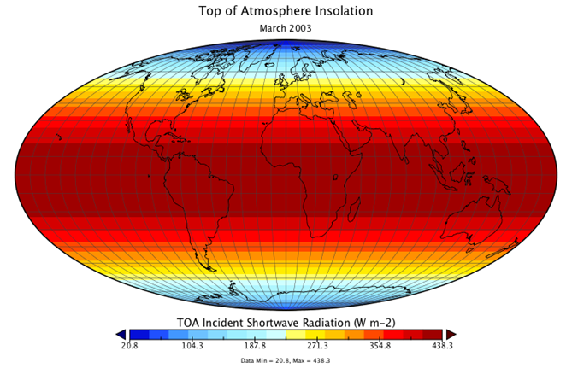
APPROXIMATELY 49% OF THE INSOLATION IS ABSORBED BY THE EARTH’S SURFACE
Source: https://www.e-education.psu.edu/earth103/node/1007
Notes:
The insolation at the top of the atmosphere averaged for the month of March.

Slide 9
DIFFERENT ORBITAL VARIATIONS AND HOW THEY EFFECT CONDITIONS ON EARTH
The Earth’s orbit around the sun is not perfectly circular
The closer the Earth is to the Sun the more concentrated the solar radiation (insolation)
Earth’s orbit is also not fixed
Called Milankovitch Cycles
Changes the total insolation and the timing of the insolation
Notes:
The Earth’s orbit around the sun is not perfectly circular so sometimes the earth is closer or further from the Sun. This also changes the amount of insolation, as the closer the Earth is to the Sun the more concentrated the solar radiation.
Earth’s orbit is also not fixed, it changes over time. These changes are referred to as Milankovitch Cycles (changing the total insolation and the timing of the insolation).
These orbital variations have made a big difference in conditions on the Earth during the period in which humans have inhabited it.

Slide 10
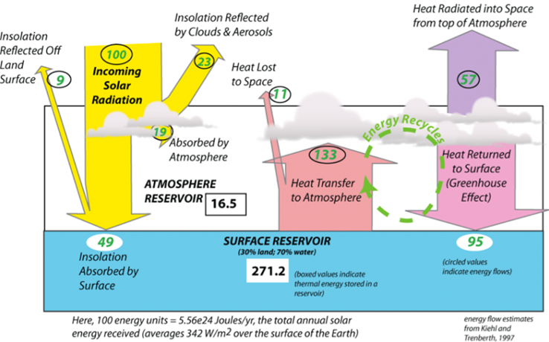
ENERGY FLOWS IN THE CLIMATE SYSTEM
Source: https://www.e-education.psu.edu/earth103/node/1007
Notes:
The view of the climate system depicted is one of stability —energy flows in and out, in perfect balance, so the temperature of the earth should stay the same.
But if we can learn anything from studying Earth’s history, we learn that change is the rule and stability the exception. When change occurs, it almost always brings feedback mechanisms into play — they can accentuate and dampen change and they are incredibly important to our climate system.

Slide 11
ALBEDO
A measure of how reflective a surface is (higher the albedo = the more reflective).

Slide 12
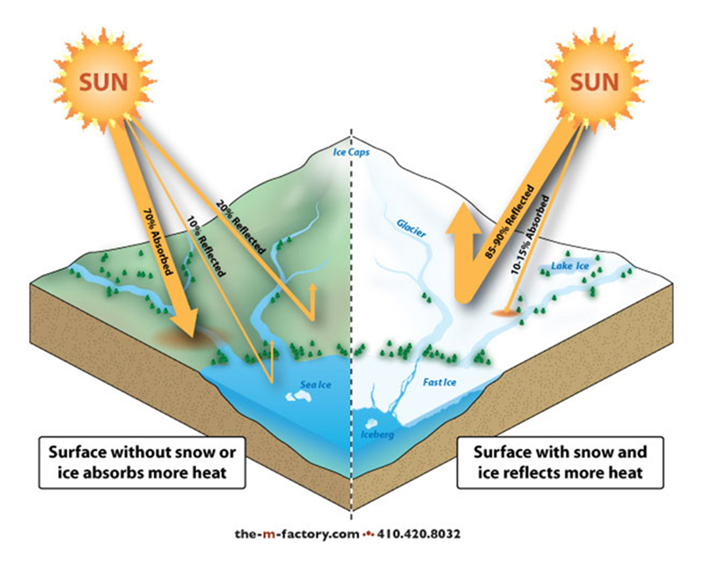
ENERGY ABSORBED VERSUS REFLECTED
Source: http://oceanbites.org/sea-ice-and-albedo-should-we-be-worried/
Notes:
One way to change how quickly energy exits the Earth system is to change the reflectivity of the surface.
Compare the difference in darker surfaces to the brightness of snow‐covered ice.
The dark surface is going to absorb the sun’s rays (and heat the Earth’s surface) while the snow is reflecting the sunlight back into space.

Slide 13
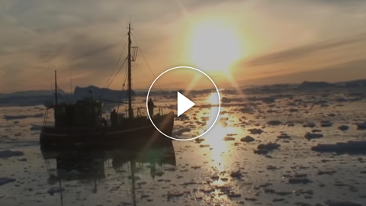
120 SECONDS OF SCIENCE: WHAT IS THE ICE ALBEDO FEEDBACK?
Notes:
https://youtu.be/5rqREjFaRho

Slide 14
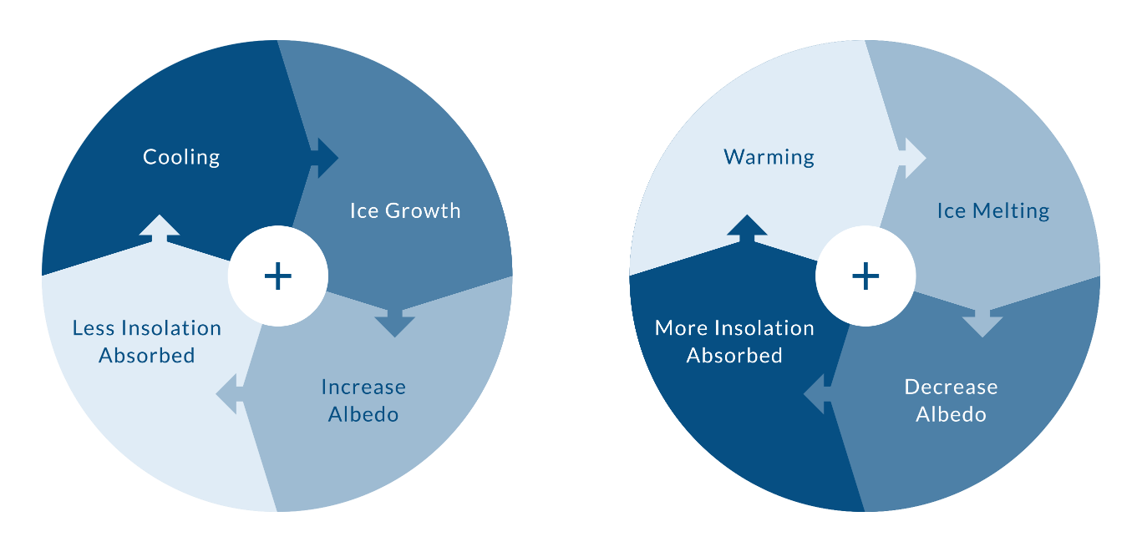
POSITIVE FEEDBACK MECHANISM
Changes in albedo can create a positive feedback that reinforces a change in the climate. A positive feedback is a process which amplifies the effect of an initial change.

Slide 15
POSITIVE FEEDBACK MECHANISMS TEND TO LEAD TO RUNAWAY CHANGE
Climate cools (initial change)
Snow (which has a higher albedo than bare ground) covers more of the surface
Initial cooling increases the amount of sunlight that is reflected back into space, cooling the Earth further
Notes:
If such a loop continued for long enough, this process could result in the entire Earth being covered in ice.
Since this chain of events furthers the initial change that triggered the whole thing, it is called a positive feedback (but note that the change may not be good from our perspective). Positive feedback mechanisms tend to lead to runaway change — some small initial change is thus accentuated into a major change.

Slide 16
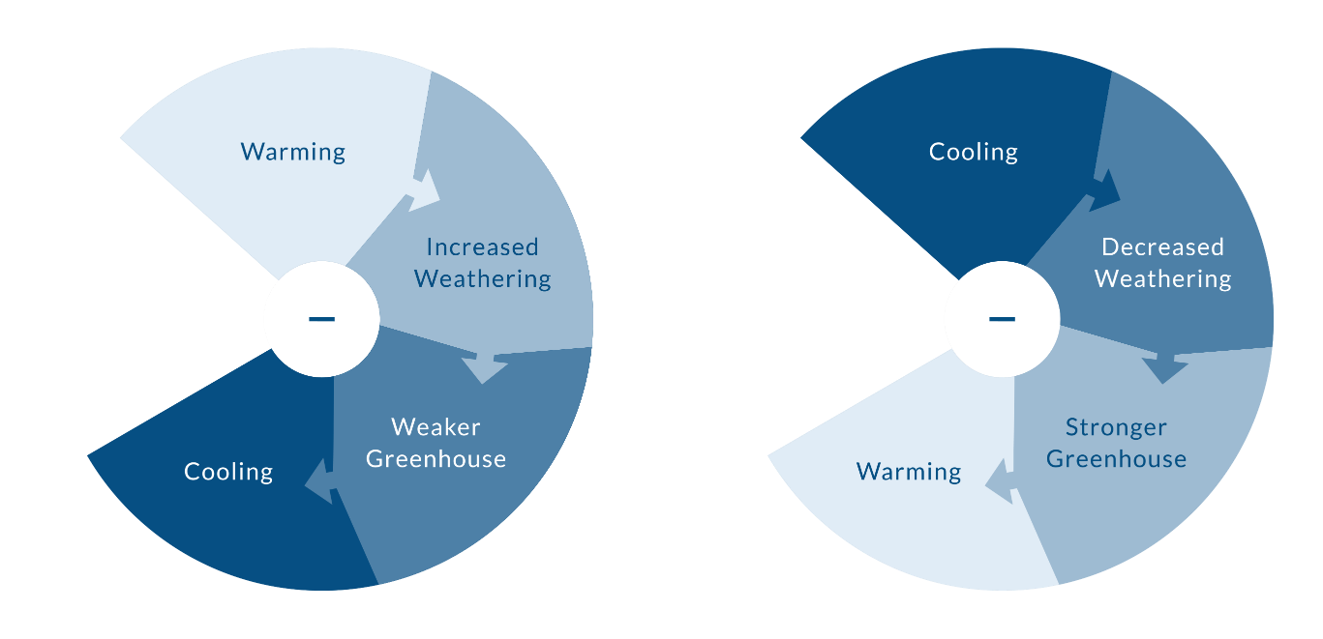
NEGATIVE FEEDBACK MECHANISM
In the Earth system, positive and negative feedbacks are essential components that play an important role in maintaining a more or less stable state. A negative feedback mechanism stabilizes a system, preventing an extreme state.

Slide 17
WEATHERING
Rocks exposed at earth’s surface interact with water and the atmosphere undergoing a set of chemical and physical changes called weathering.

Slide 18
WEATHERING FEEDBACK
Weathering process involves a chemical reaction
Carbonic acid is formed when carbon dioxide dissolves in water
Acid rain contains carbonic acid
Another chemical reaction is initiated when acid rain falls on rocks, dissolving minerals and breaking down their structure
Weathering process is a sink for atmospheric carbon dioxide (an important greenhouse gas)
Removing carbon dioxide from the atmosphere weakens the greenhouse effect, cooling the Earth
Chemical weathering occurs more rapidly in hotter climates, which are associated with higher levels of carbon dioxide
Notes:
The weathering process involves a chemical reaction. When carbon dioxide dissolves in water, carbonic acid is formed. Acid rain contains carbonic acid and when it falls on rocks sensitive to carbonic acid, another chemical reaction is initiated, dissolving minerals and breaking down the structure of the rocks. In this way, the atmospheric carbon is transported by rivers into oceans where it is trapped for thousands of years before it is returned to the atmosphere or stored in marine sediments or corals.
This process of weathering is thus a sink for atmospheric carbon dioxide, which is an important greenhouse gas. If you remove carbon dioxide from the atmosphere, you weaken the greenhouse effect and this leads to cooling of the Earth.
Like many chemical reactions, this chemical weathering occurs more rapidly in hotter climates, which are associated with higher levels of carbon dioxide.
So consider a scenario in which some warming occurs; this will encourage faster weathering, which will consume carbon dioxide, which will lead to cooling. In this case, the initial change triggered a set of processes that countered the initial change — this is called a negative feedback (even though it may have beneficial results) because it works in opposition to the change that triggered it.

Slide 19
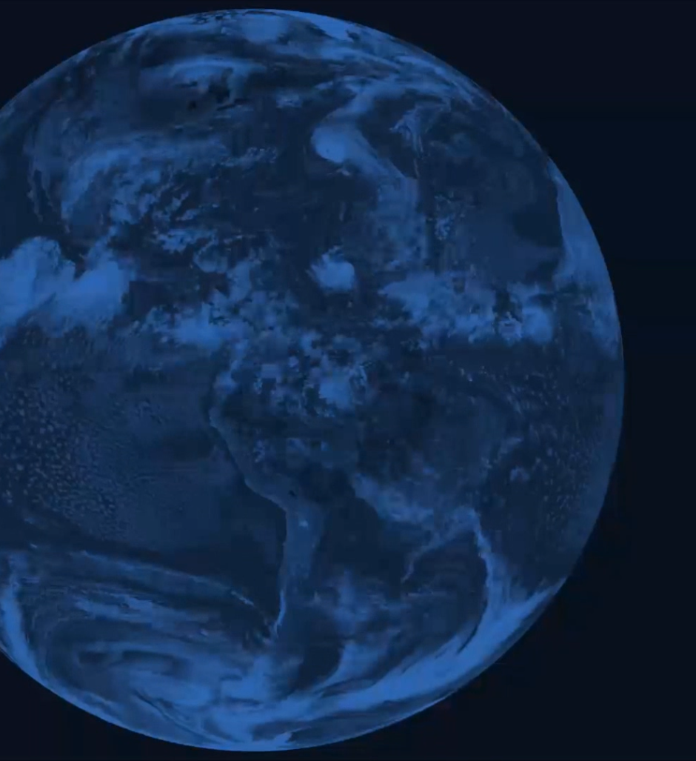

IN-CLASS ACTIVITY
The Department of Geosciences at Georgia State University has published a set of labs that may be helpful. Of particular interest is Lab 5 Global Surface Temperature http://sites.gsu.edu/geog1112/global-surface-temperature/

Slide 20
Video released by Yale Climate Connections This Is Not Cool http://www.yaleclimateconnections.org/2013/11/new-ipcc-report-featured-in-this-months-this-is-not-cool-video/
IPCC Fifth Assessment Report http://www.ipcc.ch/
This IPCC Report provides information about observed changes in the climate system http://www.climatechange2013.org/images/report/WG1AR5_SPM_FINAL.pdf
A University of British Columbia online course http://www.youtube.com/user/climateliteracy
Module 2 Introduction to the Climate System https://www.youtube.com/playlist?list=PLAHtWWrZTgn-i_U-ft6cjsTj2faylPSJO
Module 3 Earth's Energy Balance https://www.youtube.com/playlist?list=PLAHtWWrZTgn8boLKB4-a1PV5y_u_b0MJU
100 Views of Climate Change, Colorado State University http://changingclimates.colostate.edu/
MORE INFORMATION AND RESOURCES

Slide 21


