Slide 1


Educator Instructions
REMOVE THIS SLIDE
BEFORE PRESENTING
Customize this presentation to fit your needs. Please add or remove content.

Slide 2


The purpose of this section is to provide an understanding of the carbon cycle and how changes in carbon stores impact climate change.
CARBON CYCLE
ATHENAS is a multi-national Initiative funded by the U.S. Department of Agriculture

Slide 3
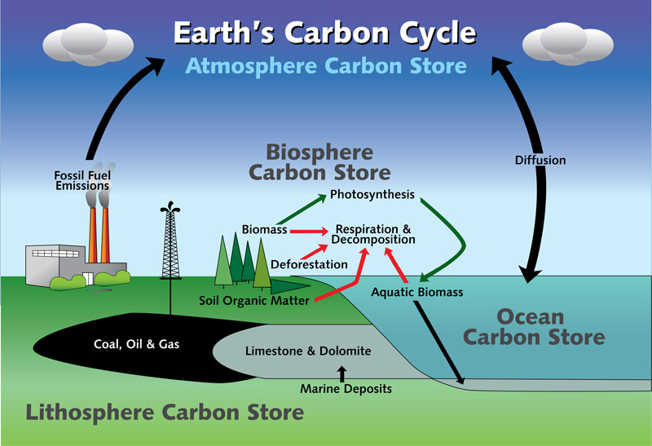
CARBON CYCLE
Source: http://www.dec.ny.gov/energy/76572.html

Slide 4
THE EARTH HAS FIVE SPHERES THAT ARE PART OF THE CARBON CYCLE:
1
ATMOSPHERE
Envelope of gases surrounding earth
4
LITHOSPHERE
Rigid outer part of earth’s surface
2
HYDROSPHERE
All bodies of water
5
BIOSPHERE
Regions of earth’s surface occupied by
living organisms
3
CRYOSPHERE
Frozen part of earth’s surface
Notes:
Carbon is exchanged among Earth's oceans, atmosphere, ecosystem, and geosphere. This movement of carbon, in its many forms is the carbon cycle.

Slide 5
CARBON IS THE FUNDAMENTAL
BUILDING BLOCK OF LIFE
All living organisms are built of carbon compounds. It is the fundamental building block of life and an important component of many chemical processes.
In the atmosphere, carbon is present primarily as carbon dioxide (CO₂), but also as other less abundant but climatically significant gases, such as
methane (CH4).

Slide 6
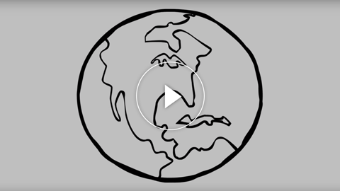
WHAT'S THE DEAL WITH CARBON?
This animation describes the carbon cycle and how it is affected by human activity.
It was featured in the Sustainable Shelters exhibit at the Bell Museum of Natural History at the University of Minnesota.
Notes:
https://youtu.be/2Jp1D1dzxj8

Slide 7
KEY POINTS TO KNOW ABOUT
THE CARBON CYCLE
Life is fueled by carbon compounds
CO₂ is released by the burning of fossil fuels
The atmosphere and oceans are continuously exchanging CO₂
The carbon cycle consists of reservoirs that store carbon (the atmosphere, the oceans, vegetation, rocks, and soil) and processes by which carbon moves between these reservoirs
Carbon sink: more carbon enters a pool than leaves it
Carbon source: more carbon leaves a pool than enters
Carbon dioxide is a major player in the Earth’s energy balance
Notes:
Life is fueled by carbon compounds. Animals and plants give off (release) carbon dioxide during respiration. Plants use carbon dioxide during photosynthesis and build new carbon compounds
See 5.1 Climate System for more about the Earth's energy balance.

Slide 8
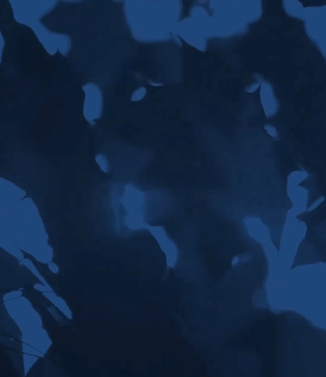

IN-CLASS ACTIVITY
POGIL Activity: The Carbon Cycle (Download PDF)
About POGIL Activities:
You can learn more about POGIL at: https://pogil.org/about
What is POGIL? from The POGIL Project on Vimeo.

Slide 9
MORE INFORMATION
AND RESOURCES
The Department of Geosciences at Georgia State University has published a set of labs that may be helpful. Of particular interest are the following:
Lab 4 The Carbon Cycle (Part 1) http://sites.gsu.edu/geog1112/lab-4-2/
Lab 4 The Carbon Cycle (Part 2) http://sites.gsu.edu/geog1112/lab-4-the-carbon-cycle-part-2/
TED Talk The Carbon Cycle (3:54 minutes) http://ed.ted.com/lessons/the-carbon-cycle-nathaniel-manning by Nathaniel Manning and Jill Johnston

Slide 10


