Slide 1


Educator Instructions
REMOVE THIS SLIDE BEFORE PRESENTING
Customize this presentation to fit your needs. Please add or remove content.

Slide 2
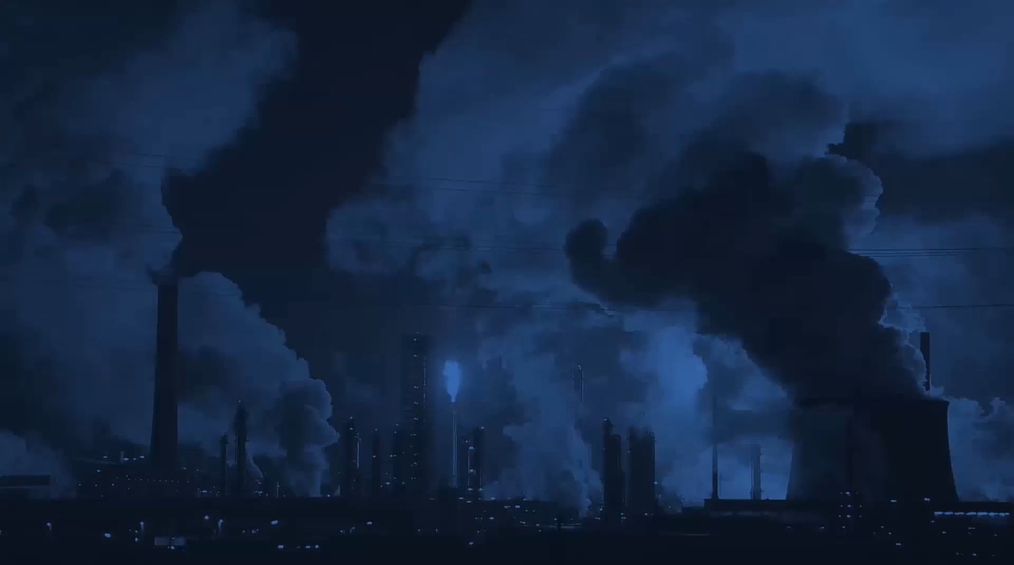

This section describes some of the most common anthropogenic (human) sources of greenhouse gases.
ANTHROPOGENIC CONTRIBUTORS TO CLIMATE CHANGE
ATHENAS is a multi-national Initiative funded by the U.S. Department of Agriculture

Slide 3
THERE IS AN IMBALANCE IN CARBON DIOXIDE LEVELS IN THE EARTH'S SPHERES
Since the start of the Industrial Revolution, humans have engaged in a range of behaviors (e.g., burning fossil fuels as an energy source and deforestation) that have increased the release of carbon dioxide into the atmosphere.
Scientific consensus is that these behaviors are interrupting the carbon cycle and contributing to long-term increases in the amount of greenhouse gases in the atmosphere.
Notes:
We are releasing carbon from ancient carbon stores so quickly that the natural processes in place to capture and store it cannot keep up with the release. The imbalance of CO₂ levels is mostly in the atmosphere and hydrosphere.
Additionally, as we cut down large sections of forest we are removing one of the major processes in the carbon cycle designed to remove CO₂ from the atmosphere (through the photosynthesis of the trees).

Slide 4
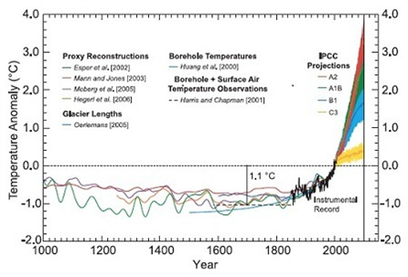
GLOBAL TEMPERATURE CHANGE OVER THE PAST 1000 YEARS
The graphic below is popularly known as the “hockey stick” and shows the drastic nature of recent climate change and the rapid change in mean global temperatures since the mid-1800s.
Source: sedgemore.com/2010/10/consolidating-the-climate-change-record/

Slide 5
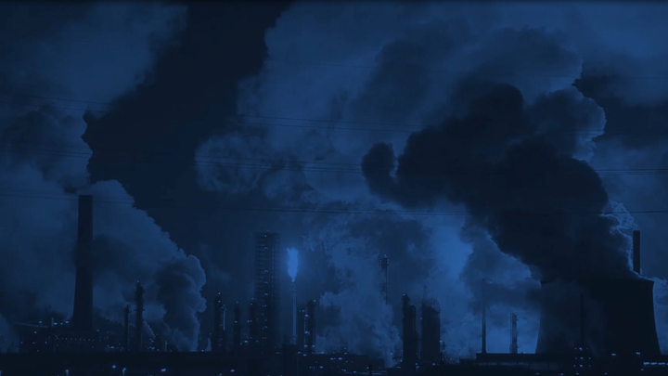
Scientific consensus is clear that by altering the composition of the atmosphere
HUMANS ARE INCREASING THE AVERAGE TEMPERATURE OF THE EARTH’S SURFACE
Source: IPCC, 2014: Climate Change 2014: Synthesis Report. Contribution of Working Groups I, II and III to the Fifth Assessment Report of the Intergovernmental Panel on Climate Change [Core Writing Team, R.K. Pachauri and L.A. Meyer (eds.)]. IPCC, Geneva, Switzerland, p 2
Notes:
There are many different factors – some natural and some not – contributing towards global climate change. However, the scientific community widely agrees that, "Human influence on the climate system is clear, and recent anthropogenic emissions of greenhouse gases are the highest in history. Recent climate changes have had widespread impacts on human and natural systems."

Slide 6
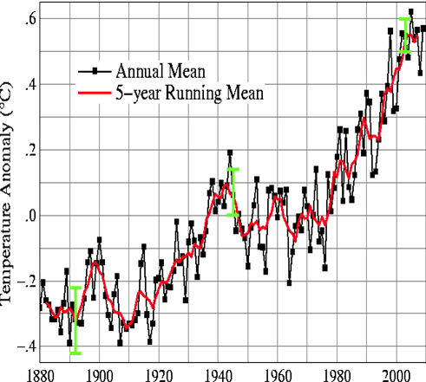
GLOBAL LAND-OCEAN TEMPERATURE INDEX
Source: http://data.giss.nasa.gov/gistemp/graphs_v3/
Notes:
This graphic shows the annual mean global temperatures since 1880.

Slide 7
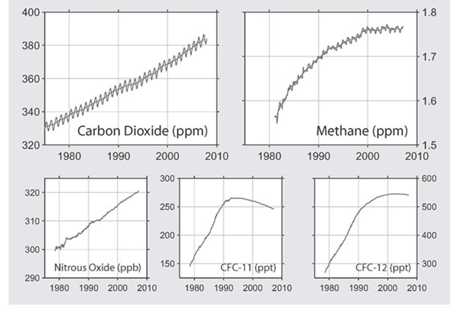
RECENT GLOBAL TRENDS IN GREENHOUSE GASES
Source: http://www.globalwarmingart.com/wiki/File:Major_greenhouse_gas_trends_png
Notes:
The rise of GHGs are believed to be responsible for most of the increase in global average temperatures during the last 50 years.
At present, approximately 99 percent of the 100-year global warming potential for all new emissions can be ascribed to just these three gases: carbon dioxide, methane, and nitrous oxide.

Slide 8
ACCORDING TO THE IPCC FOURTH ASSESSMENT REPORT: CLIMATE CHANGE 2007
“Warming of the climate system is unequivocal, as is now evident from observations of increases in global average air and ocean temperatures, widespread melting of snow and ice, and rising global average sea level.” https://www.ipcc.ch/publications_and_data/ar4/syr/en/spms1.html
“Most of the observed increase in global average temperatures since the mid-20th century is very likely* due to the observed increase in anthropogenic greenhouse gas concentrations.” https://www.ipcc.ch/publications_and_data/ar4/wg1/en/spmsspm-understanding-and.html#footnote12
*IPCC defines ‘very likely’ as greater than 90 percent probability of occurrence.

Slide 9
97 PERCENT
of climate scientists agree that climate-warming trends over the past century are very likely due to human activities.
Notes:
Most of the leading scientific organizations worldwide have issued public statements endorsing this position.

Slide 10
SO WHAT ARE HUMANS DOING TO INDUCE CLIMATE CHANGE?
Exploding population, economic growth and 150 years of industry based on fossil fuels has brought about our rapidly warming climate
We are burning carbon (in the form of coal, oil, and natural gas) for transportation, power generation, and industrial process
When burned for energy, coal, oil, and natural gas release the sequestered carbon and throw Earth’s carbon cycle out of balance
Notes:
Millions of years ago decaying organic matter was buried by sediments and in the heat and pressure underground became coal, oil, and natural gas.

Slide 11
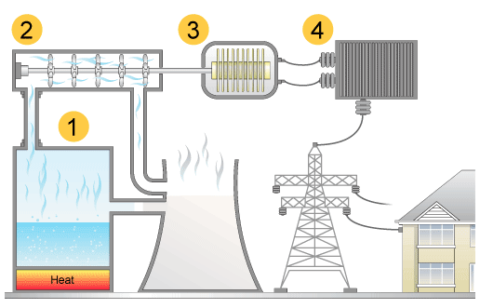
ELECTRICITY GENERATION
Source: http://www.bbc.co.uk/schools/gcsebitesize/science/21c/sustainable_energy/generating_electricityrev4.shtml
Notes:
Many students are unaware of the relationship between electricity generation and carbon dioxide production. This section provides an overview.
Electrical generation and distribution of electricity to consumers most commonly includes the components in this diagram.
Steam Generation (water boiled using coal or other sources of energy)
Turbine (steam causes the turbine to spin which translates into mechanical, or kinetic, energy transferred to the generator)
Electromechanical Generator (transforms kinetic energy into electricity)
Transformer (reduces electricity wattage for use by consumers)

Slide 12
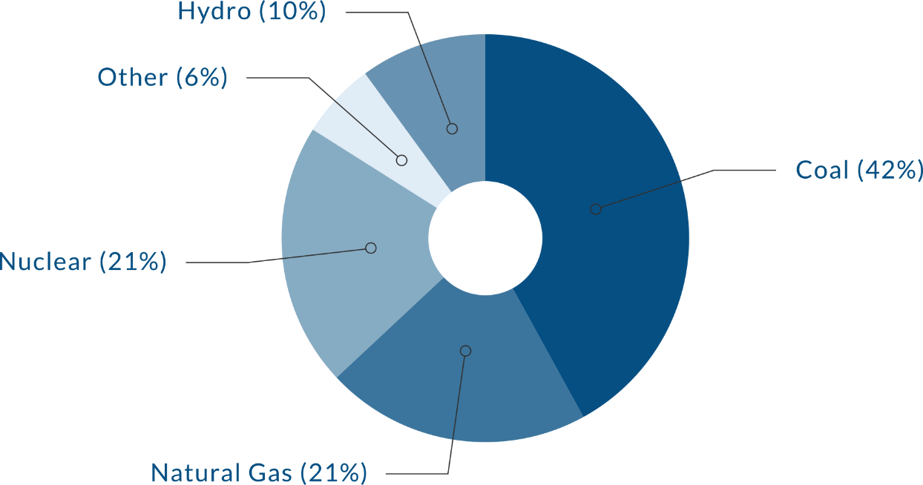
SOURCES OF ENERGY USED IN THE U.S. TO PRODUCE ELECTRICITY
Source: http://www.globalwarmingart.com/wiki/File:Greenhouse_Gas_by_Sector_png​
Notes:
There are many different ways to heat water to create steam to produce electricity. The chart shows the sources of energy used in the United States to produce electricity. Coal is the most common energy source used to generate electricity in the United States.
Globally, more than 40% of all carbon dioxide emissions come from burning coal.

Slide 13
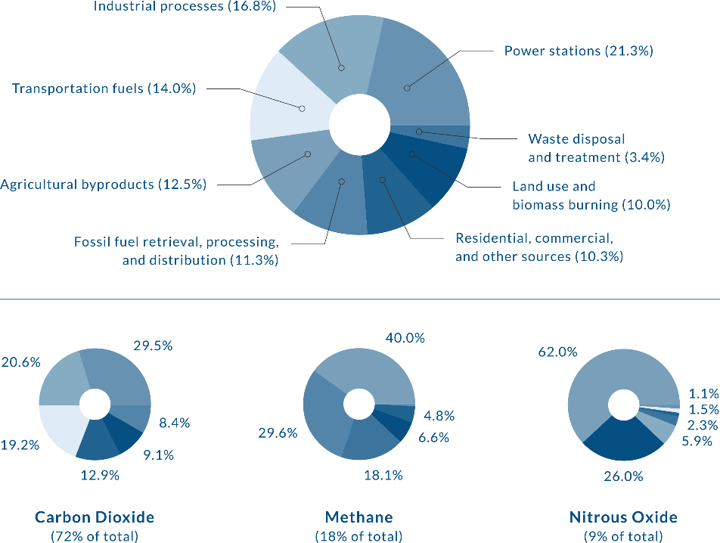
GREENHOUSE GAS EMISSIONS BY SECTOR
Source: http://www.globalwarmingart.com/wiki/File:Greenhouse_Gas_by_Sector_png​

Slide 14
10 PERCENT
The apparel and textile industry accounts for nearly 10% of total global greenhouse gas emissions
Source: Zaffalon, V. (2010). Climate change, carbon mitigation, and textiles.

Slide 15

This link is to a report by the International Energy Agency on Energy and Climate Change https://www.iea.org/publications/freepublications/publication/WEO2015SpecialReportonEnergyandClimateChange.pdf
Pacific Institute for Climate Solutions Human Influence (4:08 minutes) http://www.youtube.com/watch?v=-GDY3dCqWQU&feature=youtu.be
Pacific Institute for Climate Solutions What YOU Can Do About Climate Change (8:59 minutes) http://www.youtube.com/watch?v=VTfgNFz1DBM
100 Views of Climate Change, Colorado State University http://changingclimates.colostate.edu/
MORE INFORMATION AND RESOURCES

Slide 16
MORE INFORMATION AND RESOURCES (continued)
Science Clarified Chapter 1 The Development of Energy http://www.scienceclarified.com/scitech/Energy-Alternatives/The-Development-of-Energy.html
An overview of energy storage and transfer with information about energy sources http://www.bbc.co.uk/bitesize/ks3/science/energy_electricity_forces/energy_transfer_storage/revision/8/
A slide show on energy generation from multiple sources http://www.slideshare.net/TejKiran2/energy-resources-types-35381452

Slide 17


