Slide 1
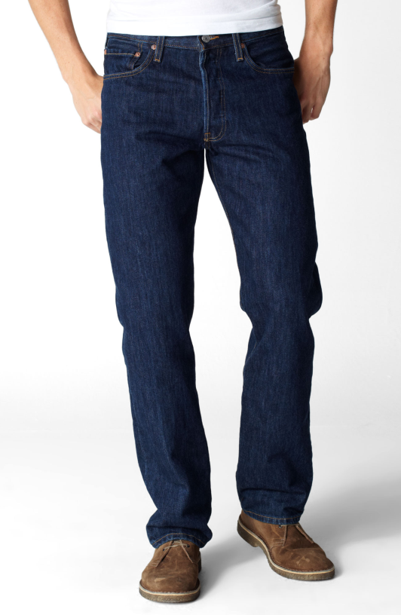
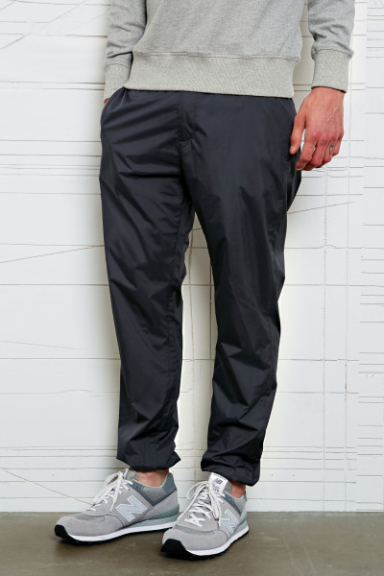

The Carbon Footprint of Apparel
100% Cotton Jeans
100% Nylon Pants
Notes:
Complete Carbon Footprint Activity

Slide 2
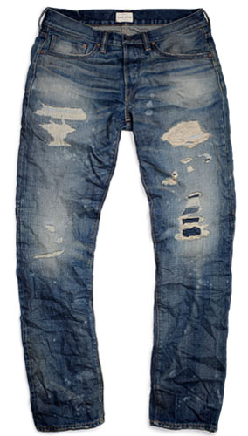
The Carbon Footprint of Apparel
100% Cotton Distressed Jeans

